Slide 2
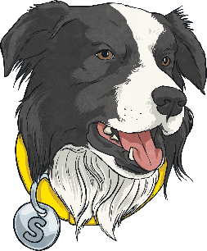
What Does Summarising Sheba Do?
Summarising Sheba helps you to:
Summarise main ideas from more than one paragraph.
This means that she is there to help you to sum up what you’ve read.
She helps you to do this by reading the text, picking out the key points that are really important and giving a quick run down of the text’s main ideas. Imagine that you’ve read a book and have to text your friend about the plot – which key messages would you tell them and which would you leave out?

Slide 3
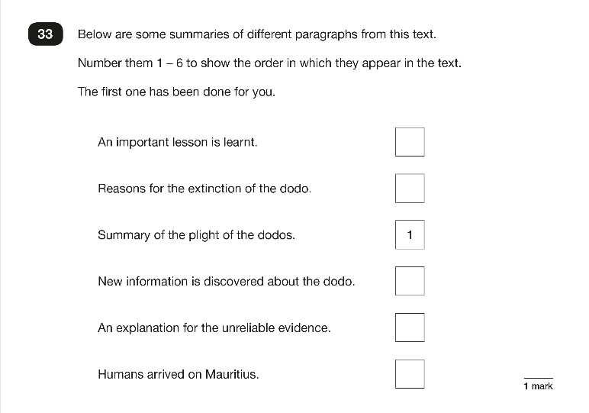
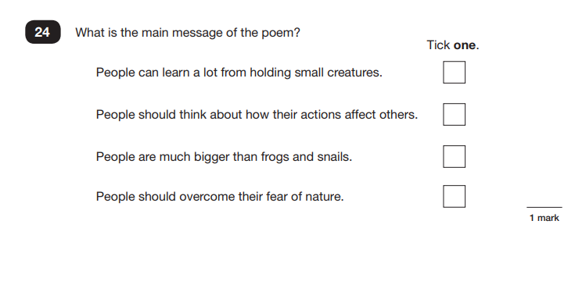
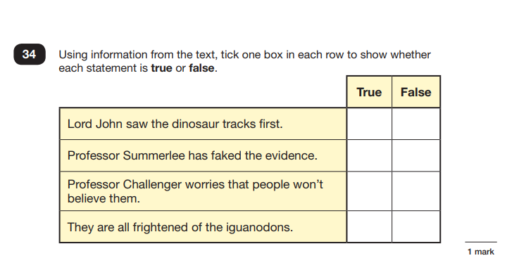
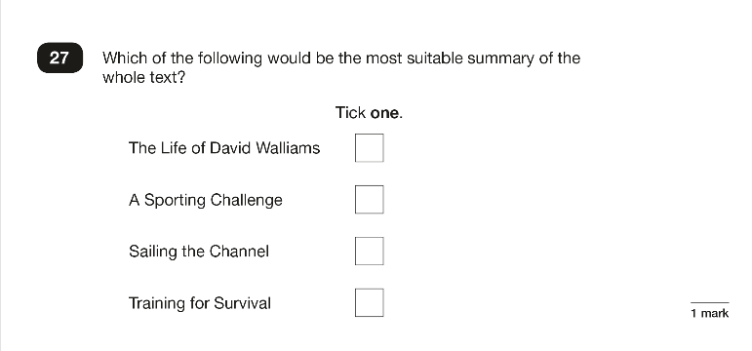
When Have We Seen
Summarising Sheba?
You will normally see one or two Summarising Sheba questions when someone is trying to check your understanding of a text. Here are some examples:

Slide 4

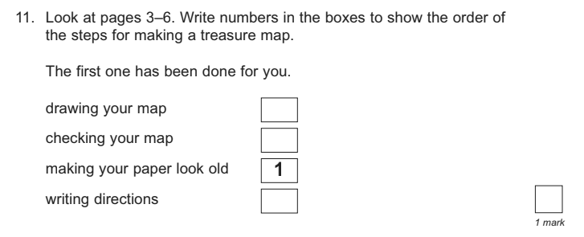
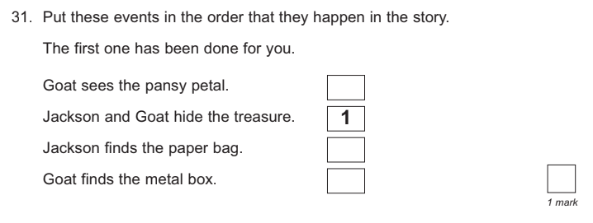
The ‘Number It’ Questions
Back
This type of question will give you different sentences from or about the text.
You have to number them to show the order they appear or happen in.

Slide 5

The ‘New Title’ Questions
Back
This type of question will give you phrases which could be new titles for the text you have read. You must choose the most suitable new title.
Sometimes, you may be asked to write your own suitable new title for the text.

Slide 6
The ‘Sum up the Message’ Questions
Back
This type of question will give you phrases which could sum up the key message of the text. You must choose the most
reasonable summary.
Sometimes, you may be asked to write your own summary of the text’s main message.

Slide 7
The ‘True or False’ Questions
Back
This type of question will give you four different sentences which summarise what you have read. It will ask you to tick whether they are true or false.
Be careful: the false sentences are purposely close to real things which happen within the text.

Slide 8
What Might Summarising Sheba Ask?
Back
Summarising Sheba might ask questions like these:
What is the main theme, argument or message of this paragraph?
Can you describe what happened in this chapter?
Write a new blurb for this story using 20 words or less.
Can you describe what happened in three short sentences?
How would you sum up…?
What is the most important message in this book?

Slide 9
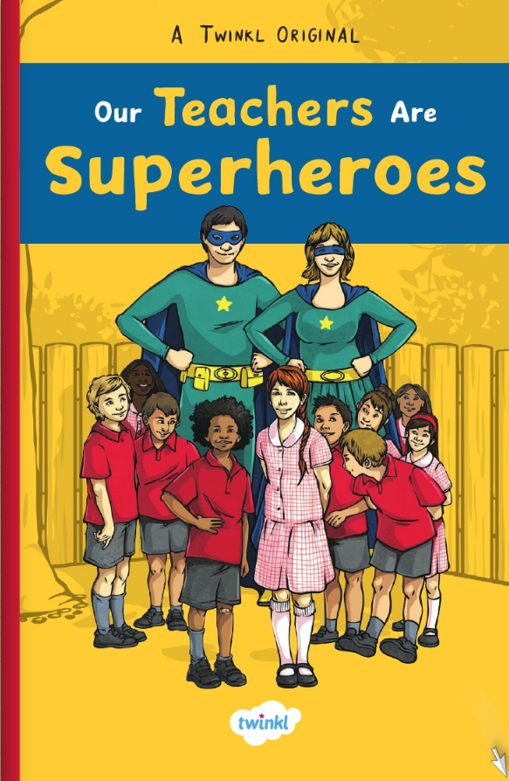
Let’s Explore Summarising Sheba Questions Together
Read the extract from Our Teachers Are Superheroes and answer the questions as a class.
Click on the image to read the text.
Read the rest of Our Teachers Are Superheroes here.

Slide 10
Let’s Explore Summarising Sheba Questions Together
Read the extract from Our Teachers Are Superheroes and answer the questions as a class.
What is the main message in the first two paragraphs? Tick one.
That children like superheroes.
That Mr Jay had great enthusiasm.
That the teachers were dressed up as superheroes.
That the children were gathered at school.
This chapter is called Superpowers.
Based on what you have read so far, write a new title for the chapter.
Sum up Benji’s preferred superpower in fewer than ten words.

Slide 11

Let’s Explore Summarising Sheba Questions Together
Read the extract from Our Teachers Are Superheroes and answer the questions as a class.
Number the following events 1-5 to show the order in which they appear in the text. The first one has been done for you.
My Jay said that they had some interesting ideas.
Benji tapped Freya on the shoulder.
Someone said that they would like to be able to fly. |  | 1
Freya and Benji live on the same street.
Freya called Benji annoying.

Slide 12
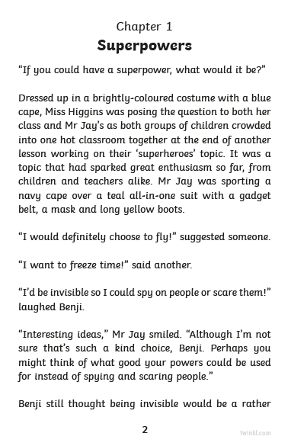
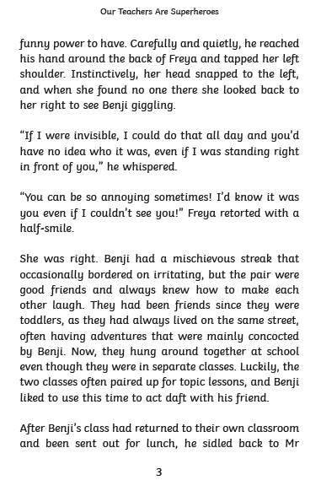
Back

Slide 13

Summing Up Summarising Sheba
Prove your understanding of what Summarising Sheba does by answering the following questions:
What does Summarising Sheba help you to do?
What sort of question might Summarising Sheba ask?
What do you think Summarising Sheba would
give as her top tip?

