Slide 2
What Does Rex Retriever Do?
Rex Retriever helps you to:
Retrieve and record information/identify key details
from fiction and non-fiction.
This means that he is there to help you to find key pieces of information within the text you are reading.
He helps you to do this by looking through the text for a specific answer. With Rex Retriever questions, the answer you are looking for is always in the text somewhere… you just have to find and retrieve it!

Slide 3
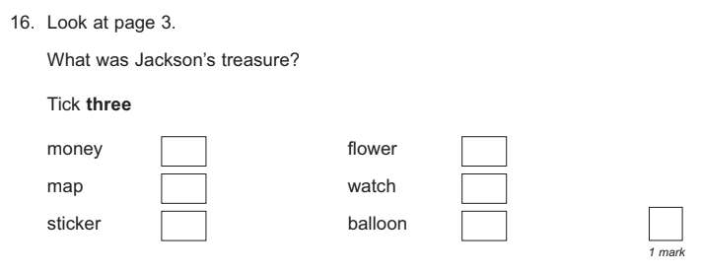
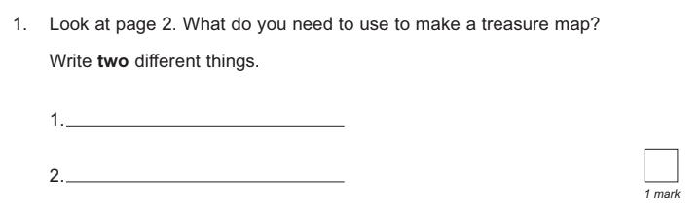
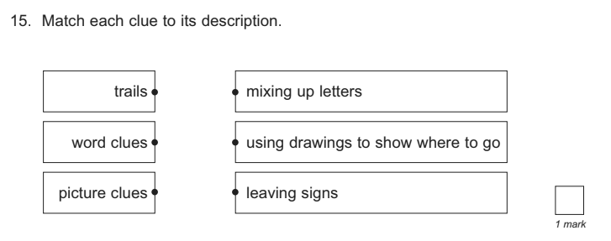
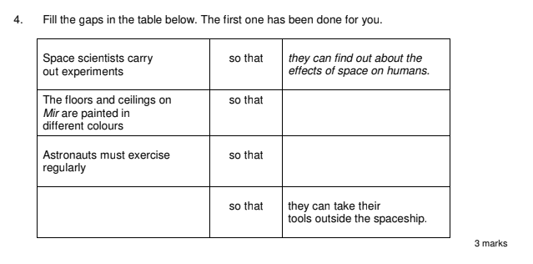
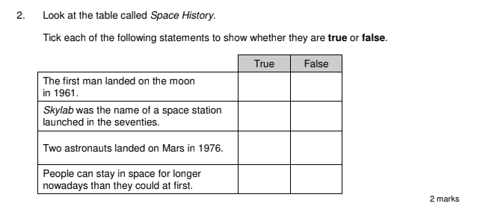
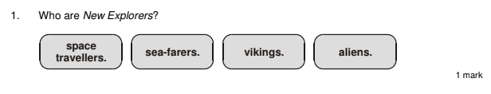
When Have We Seen
Rex Retriever?
Rex Retriever questions appear quite a lot when someone is trying to check your understanding of a text. Here are some examples:
Click on the image of each question to find out more.

Slide 4

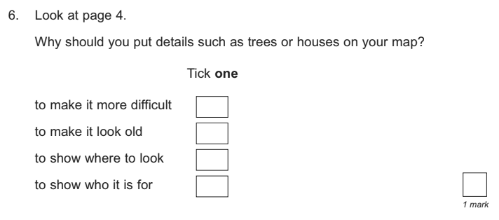
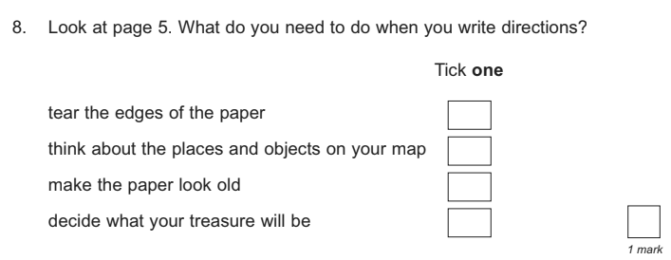
The ‘Tick It’ Question
Back
This type of question will give you different options to choose between but be careful: always check how many answers the question is
asking for.

Slide 5
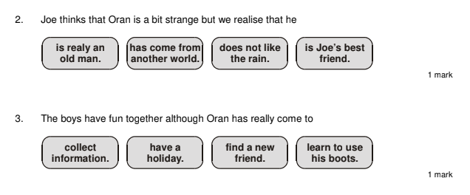
The ‘Circle It’ Questions
Back
This type of question will give you different options to choose between and you must circle the correct answer.
Often, the answer you are being asked to circle is to correctly
complete a sentence.

Slide 6
The ‘Match It’ Question
Back
This type of question asks you to draw lines to match answers together.
Sometimes you will be matching a word to what it means, sometimes you will be completing sentences and sometimes you may match a date to the event that happened on it.

Slide 7
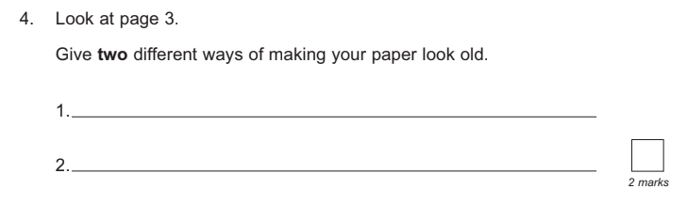
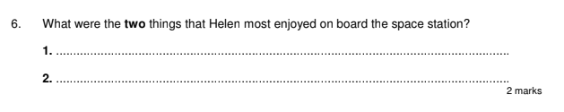
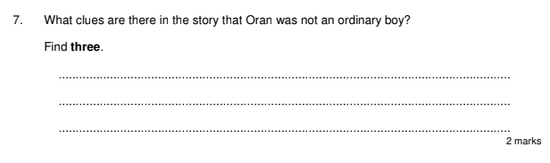
The ‘Multiple Answer’ Question
Back
This type of question will ask for two or more different answers that you have found in the text.
Make sure the answers you give are different.

Slide 8
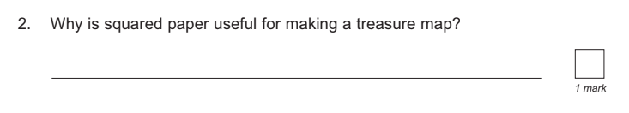
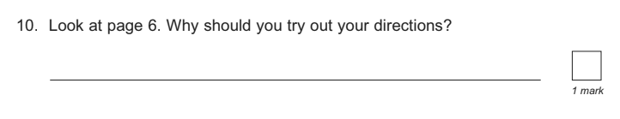
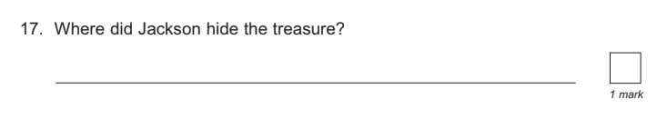
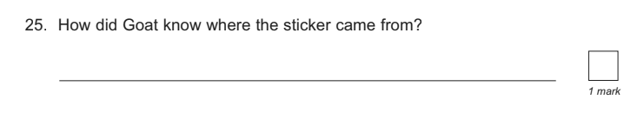
The ‘5W and 1H’ Question
Back
Many of the Rex Retriever questions you will see will begin with one of these question words:
Who…?
What…?
Where…?
When…?
Why…?
How…?
The answer is always in the text somewhere.

Slide 9
The ‘True or False?’ Question
Back
This type of question will give you four different sentences.
It will ask you to tick whether they are true or false.
Be careful: the false sentences can be very close to real
sentences in the text.

Slide 10
The ‘Complete the Table’ Question
Back
This type of question will ask you to use the information in the text to fill in the missing information in a table.
Make sure that you only add information to the table that you have read in the text. You do not need to make up new answers.

Slide 11
What Might Rex Retriever Ask?
Back
Rex Retriever might ask questions like these:
What is the name of the main character?
Which part of the text tells you…?
Where/when is this story set? How do you know?
How does the main character behave/speak/look?
What do you think is happening in this part of the story?
Who is telling this story? How do you know?

Slide 12

Let’s Explore Rex Retriever Questions Together
Read the extract from Our Teachers Are Superheroes and answer the questions as a class.
Click on the image to read the text.
Read the rest of the Our Teachers Are Superheroes story here.

Slide 13
Let’s Explore Rex Retriever Questions Together
Read the extract from Our Teachers Are Superheroes and
answer the questions as a class.
List the names of the two class teachers mentioned in this extract.
What reason did Benji give for wanting to be invisible?
Decide whether the following statements are true or false:
Benji tapped Mr Jay on the shoulder.
Freya found Benji annoying.
Miss Higgins wore a gadget belt.
Benji and Freya were brother and sister.
What colour are the boots mentioned on the first page? Tick one.
navy blue orange
yellow teal

Slide 14
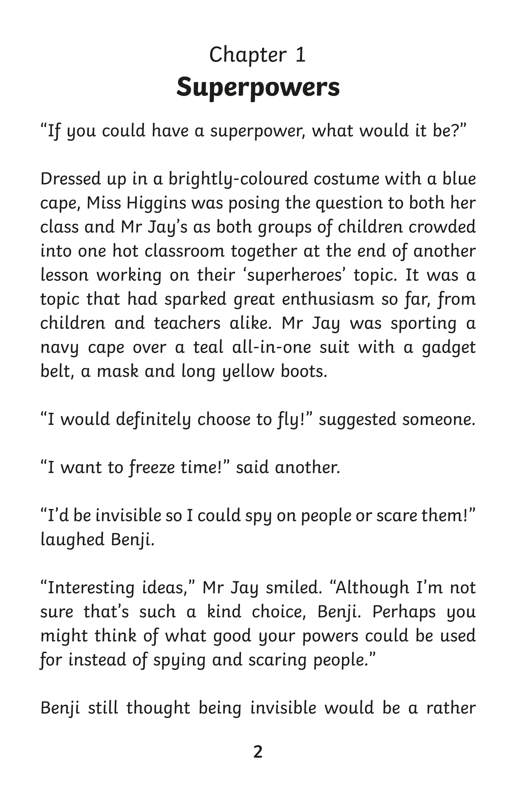
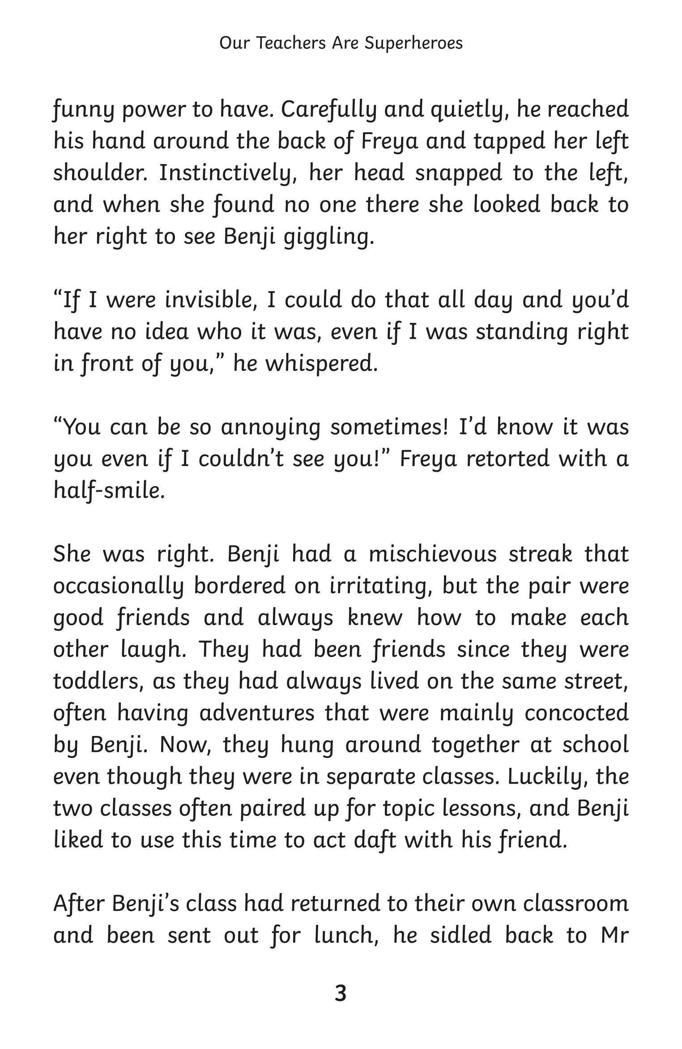
Back

Slide 15
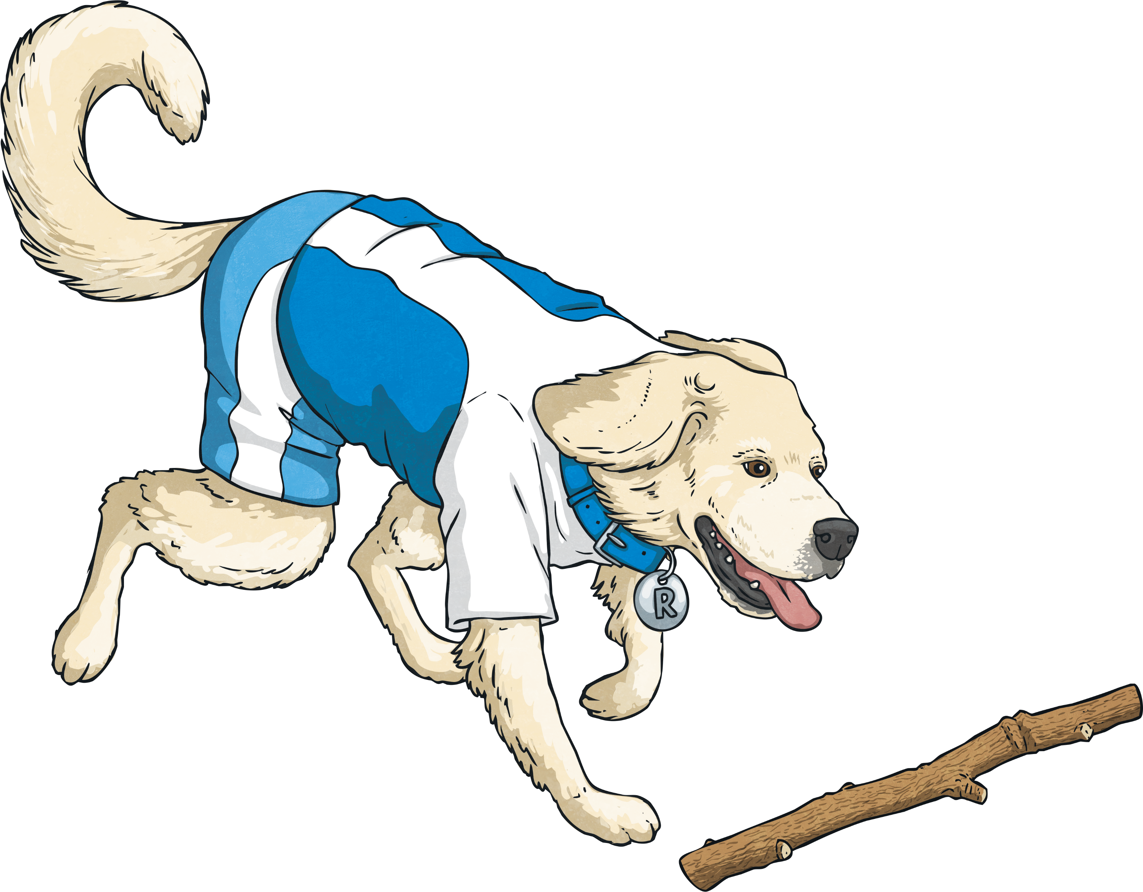
Summing Up Rex Retriever
Prove your understanding of what Rex Retriever does by answering the following questions:
What does Rex Retriever help you to do?
What sort of question might Rex Retriever ask?
How can you make sure you get full marks on
Rex Retriever questions?

