Slide 1
Year R Writing Information Meeting
February 2022

Slide 2
Developing confident and fluent speakers
We believe that the first step to support our children in becoming writers is to help them become fluent speakers.
Many children come to us having experienced up to 3 or 4 stories a day read to them from a very early age. This means for some children they have enjoyed thousands of texts before they have even started school.
In and out of school we encourage all our children to develop their love of shared stories and information books so they may explore and repeat much of the language they hear!

Slide 3
Developing confident and fluent speakers
Through many speaking and listening activities we encourage our children to develop and use new language.
Remember: if a child cannot say it... they cannot write it down!
At school and at home all children need to be exposed to a wide and varied vocabulary.
They need to hear a variety of words and understand the meaning of words

Slide 4
Quality talk and interaction
Here adults interact with your children through play based activities to encourage quality talk and support language development.
Our most confident speakers usually have this experience at home too!

Slide 5
The development of motor skills
Alongside speaking and listening activities, other activities are designed to help and improve motor skills (gross and fine).
Big and small movements are encouraged to develop and strengthen muscles in arms and fingers and continue to build on children’s early fascination with making marks.

Slide 6
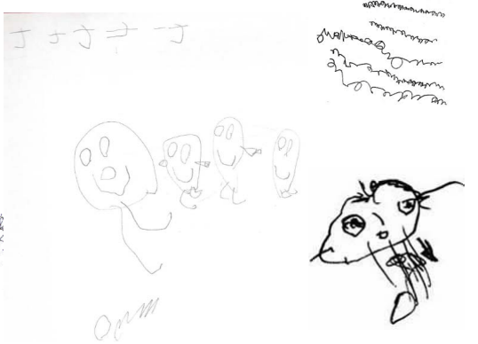
The Early Stages of Writing
Preliterate: Drawing & Scribbling
This stage takes many forms.
Children use drawings and scribbles.
To begin with a child may not immediately distinguish between drawing and writing.
As they develop they will begin to show drawing and writing in different forms .

Slide 7
The Early Stages of Writing
Preliterate: Drawing & Scribbling
As children progress through this stage they begin to understand that drawing and writing is a purposeful means of communication.
However, some children quickly become aware and anxious that their writing looks very different from that of adults and older children .
Some children readily read their scribbles and marks as if they were writing but some do not! So how can we build on children’s early enthusiasm and avoid creating anxiety, reluctance and fear in some?

Slide 8
The Early Stages of Writing: Top tips for encouraging children – even the most reluctant!
When children are engaged in early mark making and writing we put emphasis on asking if they found it fun first of all.
We don’t always insist on writing needing to have a meaning straightaway.
We don’t always write out every word a child has written in our own writing.
However, we talk a lot about the special stage a child is at on their journey. We recognise that attempts at writing are not perfect but are part of the long journey we are all on to become better writers.

Slide 9
The Early Stages of Writing: Top tips for encouraging children – even the most reluctant!
We encourage children to work with others and alone to enjoy mark marking and early writing.
We think about providing a wide range of mark making and writing tools so children can develop a real sense of which tools “feel” the best.

Slide 10
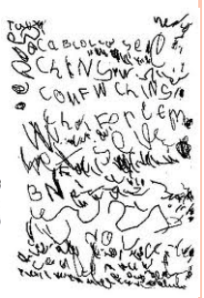
How writing develops…
Emergent: Random-letters or letter strings
Uses letter sequences, perhaps learned from his/her name
May write the same letters/shapes many times
Long strings of letters/shapes in random order

Slide 11
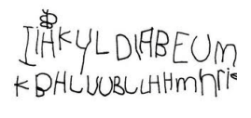
How writing develops…
Emergent: Letter-like forms
Shapes in writing actually resemble letters
Shapes are not actually letters
Look like poorly formed letters, but are unique creations

Slide 12
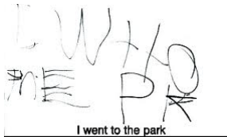
How writing develops…
Transitional: Writing via invented / phonetic spelling
One letter may represent an entire syllable or word
May not use proper spacing

Slide 13
Opportunities for Writing
Indoors and Outdoors…Rain or Shine!!!
Opportunities for writing are available in all learning areas e.g. construction – make a label or sign for a model role play – write down a message, take an order or issue a speeding ticket!
Writing Areas : There is a rainbow challenge and various tools and resources are provided to support the children with this.
Write anywhere! Purposeful Writing: The focus may be ‘The Tiger who came to Tea’ so the children would write descriptions and shopping lists.

Slide 14
Letter Formation, Phonics & Handwriting
These are key aspects of writing development and are therefore taught directly by the teacher.
Phonics and letter formation: Children need to develop a knowledge of the sounds and the letters which make each sound so that they are able to read and write. Phonics is taught daily in Year R, for 25 minutes at a time. The sessions are short, sharp and focused on a particular sound and writing linked to that sound.
Why phonics? Phonics has been highly prioritised by recent governments . It is a tool which children can use to help them to blend and segment words; so it is an important part of the process of learning to read, write and spell. Children work within a phonics phase carefully tailored to their stage of development.

Slide 15
Handwriting
Handwriting: In the Summer Term, adults work with small focus groups on their handwriting. They are mindful to correct misconceptions/incorrect formation as and when necessary so that it does not become a bad habit! Please support your child at home with this. There is a motor skills warm up (Pen Disco) prior to this session with further motor skills development sessions for all those who need them. Children in Year R follow programmes which support the development of muscle movements vital for writing. These often include activities on a large scale e.g. making large movements on big paper or wallpaper strips.

Slide 16
A recap on how writing is taught in Year R
All attempts at writing are recognised and valued – copies of some key pieces of independent work are captured and go in your child’s learning journey folder.
Children use different mediums to explore writing through play: Shaving foam, chalk / pastels, lolly sticks on carpets, paint, water, whiteboards, felt pens, interactive boards, pencils, pens, Magic fingers on palm, glitter, rice, pasta, sand, backs, floor
Summer Term - Whole Class Input: All children receive a teacher led input based on a chosen focus (The Tiger Who came to Tea) e.g. shared writing of a letter to the tiger (Teacher scribes).
Class based independent activity: Opportunity to apply this knowledge by writing own letter to the tiger.

Slide 17
How to help your child at home...
Talk - Make time to interact with your child in order to develop quality talk e.g. play with them, act out scenarios, model good quality speech and language, correct children’s speech and discuss the talk homework.
Read - Read and share a wide range of books to help your child develop a love of reading. Learn to read teddy words by sight recognition.
Develop motor skills – Play ball and target games, threading, posting and mini-treasure hunt activities such as picking out grains of rice from a tray of sand to strengthen muscles.
Write - Encourage any form of writing and mark making. Take part in the writing challenge.
Spell – Encourage independence - ‘have a go.’ When confident in reading the sight words begin to teach children to spell the high frequency words on teddy cards.
Encourage - Praise and value effort. Identify what the child has done well or what you like about their writing.
REMEMBER...reading, language, and spelling go hand in hand and link directly to a child’s ability to write.

Slide 18
End of Year Expectations (Writing)
Write recognisable letters, most of which are correctly formed
Spell words by identifying sounds in them and representing the sounds with a letter or letters
Write simple phrases and sentences that can be read by others.

