Slide 1
Year R Maths Information Meeting
January 2022

Slide 2
What happens in Oak Class?
Daily Maths sessions: 10min whole group and then split into differentiated groups for an adult led task (10-15mins)
Whole group session may involve: Numberblocks episode discussed, mental maths (counting/one more and less.) Moving onto addition, subtraction, doubles and halves.
Adult led group may involve: practical and written work on current topic (number, calculation, shape, measure etc.)
Rainbow Challenges: Include one maths activity. These will start after Easter.

Slide 3
End of Year Expectations (Number)
Have a deep understanding of number to 10, including the composition of each number.
Subitise (recognise quantities without counting) up to 5.
Automatically recall (without reference to rhymes, counting or other aids) number bonds up to 5 (including subtraction facts) and some number bonds to 10, including double facts.

Slide 4
End of Year Expectations (Numerical Patterns)
Verbally count beyond 20, recognising the pattern of the counting system.
Compare quantities up to 10 in different contexts, recognising when one quantity is greater than, less than or the same as the other quantity.
Explore and represent patterns within numbers up to 10, including evens and odds, double facts and how quantities can be distributed equally.

Slide 5
Other areas covered in class
Shape
Position and Direction
Repeating Patterns
Measure – height, length, weight
Time – sequencing, telling the time (o’clock)
Money

Slide 6
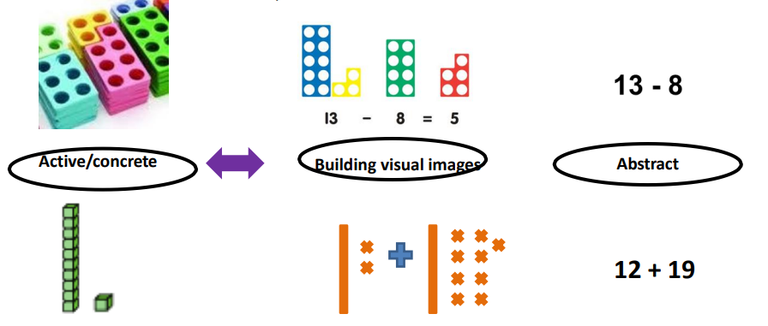
Concrete, Visual, Abstract (CVA)
System used throughout the school

Slide 7
How can you support at home?
Number: Songs and rhymes. Games like snakes and ladders, bingo, dominoes, card games (snap) etc.
Measure: Cooking, measuring height, telling the time, keeping a calendar etc
Shape: Hunts, pictures, sorting the shopping etc
Money: Shopping games, setting up a shop and letting the children see real money!
Extra ideas home in book bags tomorrow

Slide 8
Props around the House
Ideas taken from Maths for Mums and Dads Eastaway, R. and Askew, M. (2010)
A prominent clock- digital and analogue is even better. Place it somewhere where you can talk about the time each day.
A traditional wall calendar-Calendars help with counting days, spotting number patterns
Board games that involve dice or spinners-helps with counting and the idea of chance
A pack of playing cards- Card games can be adapted in many ways to learn about number bonds, chance, adding and subtracting
Dried beans, Macaroni or Smarties- for counting and estimating
A tape measure and a ruler- Let your child help when measuring up for furniture, curtains etc
A large bar of chocolate (one divided into chunks)- a great motivator for ‘sharing’ work
Fridge magnets with numbers on
Unusual dice- not all dice have faces 1-6, hexagonal dice, coloured dice, dice from board games all make talking about chance a little more interesting
A dartboard with velcro darts- Helps with doubling, trebling, adding and subtracting

Slide 9
Maths Homework in Year R
Homework is going to be set fortnightly – this is to run alongside daily reading and Teddy Bear Words.
Ongoing activity ideas based on the current topic in class
As we move through the year – number facts daily

