Slide 1
Reading Workshop
St Mary’s Bentworth - 2021

Slide 2
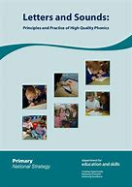
Children need to learn to read, before they can read to learn.
In Oak Class we use a systematic phonics programme called ‘Letters and Sounds’.
Alongside this programme, I use the ‘Jolly Phonics’ actions and songs.
In Oak Class we have a daily phonics session of approximately 30 minutes.

Slide 3
Changes to Phonics from September 2022
Government approved schemes only
No Letters and Sounds
Moving to Little Wandle*
1 hour of Phonics each day

Slide 4
At St Mary’s we…
Start by sending home books with pictures but no words.
When children begin to read CVC words (d-o-g), we start sending home books with words. Children then work through our school scheme at their own pace.
When your child is on ‘word’ reading books, they will also bring home Teddy Bear Words. These are sight words that the children need to learn. Please practise these regularly with your child and make sure they are in school every Friday when they will go through these with an adult. There are 10 Teddy Bear Word sheets in total.

Slide 5
Phonics Terminology
Phoneme – is a sound you can hear. There are approximately 44 phonemes in the English language. Phonemes are put together to make words.
Grapheme – a phoneme when it is written down. Graphemes can be made up of 1 letter ‘a’, 2 letters ‘sh’ (digraph) or i-e (split digraph), 3 letters ‘igh’ (trigraph) or 4 letters ‘ough’
Blending – reading a word by putting the graphemes together. I see the word cat, I recognise the graphemes c-a-t and I can blend the phonemes and hear the word says cat.
Segmenting – the skill needed to write a word, hearing all the phonemes in a word. I want to write cat and I can segment the word and hear I need c-a-t.
Sound buttons – we add these to words, to help the children with segmenting to read. I will show you on the board.

Slide 6
‘Letter and Sounds’ - Order:
Phase One is covered during nursery/pre-school
Phase Two and Three are covered during Reception
Phase Four and Five are covered throughout Year One
Phase Six is covered throughout Year Two in Spelling sessions
Phase Two
1. s a t p
2. i n m d
3. g o c k
4. ck e u r
5. h b f ff l ll ss
Phase Three
6. j v w x
7. y z zz qu
Then:
ch, sh, th, ng, ai, ee, igh, oa, oo, ar, or, ur, ow, oi, ear, air, ure, er

Slide 7
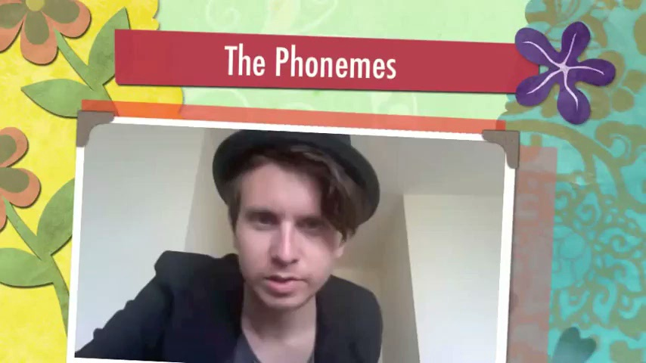
It is important that each phoneme is pronounced clearly and without a ‘uh’ on the end.
Mr Thorne has lots of videos on YouTube to help with pronunciation.
https://www.bing.com/videos/search?q=mr+throne+does+phonics+pure+sound&&view=detail&mid=5B7EF78A04C5BD0E42E85B7EF78A04C5BD0E42E8&&FORM=VRDGAR
We teach the children the sound each alphabet letter makes. Alongside this we teach them the name of each letter.

Slide 8
Tricky Words
These are words that don’t sound out.
The children just need to know how to read these words.
We teach these as we work through the phases.
These words will come home as Teddy Bear Words
To start with children need to be able to read these words.
They then learn to spell them in Year 1.
Phase Two:
the, no, to, go, into, I
Phase Three:
he, she, we, me, be, was, my, you, they, her, all, are
Phase Four:
said, so, have, like, some, come, were, there, little, one, do, when, out, what
Phase Five:
oh, their, people, Mr, Mrs, looked, called, asked, could

Slide 9
What happens in Oak Class:
We have a 30 minute phonics session everyday, first thing in the morning.
We try to listen to the children read individually at least once a week, once they are on ‘word’ books.
We share a class story every afternoon.
There are reading, writing and phonics based activities set out in the classroom each week.
We make learning as multisensory and active as possible, as we know this is how children learn best.

Slide 10
What can you do to support your child at home?
Read at home with your child. Little and often is best. Talk about the pictures, how characters are feeling, make predictions etc.
Practise the sounds your child brings home. Learn the action together and practise forming each letter correctly.
Practise the Teddy Bear Words.
In the car, play games. I can see a sh-ee-p. What can I see?
Use magnetic letters on the fridge to build words.
Play snap with tricky words.
Continue reading to your child, so they can hear and discuss a wide range of books.

