Slide 1
Celts
By Sullivan Freer

Slide 2
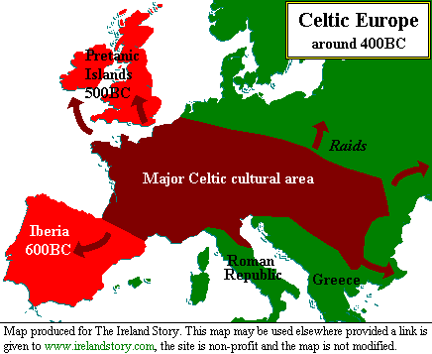
Origin
Celts spread across Europe at the iron age [120 BC].The Celts normally spoke Gaelic. Boudicca [ a famous Celtic leader ] was born in the Iberia tribe in Spain but when she was older she when to England to fight against the Romans. The Celts settled and mostly lived in France and Germany but over time expanded.

Slide 3
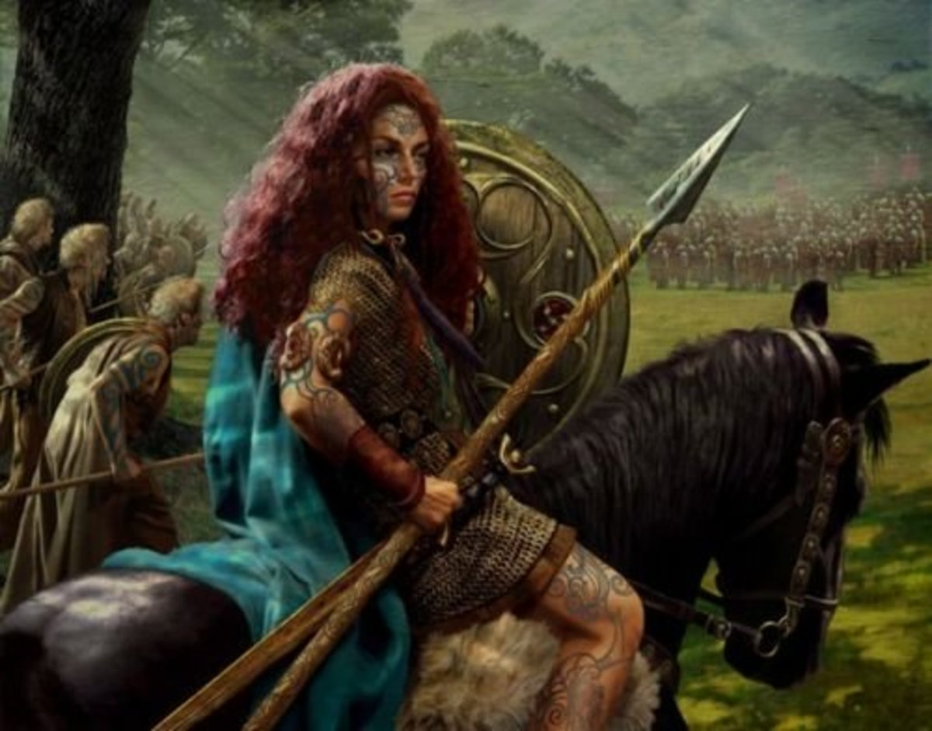
Boudicca
Boudicca Sometimes known as queen Boudicca because of her valiant efforts to defeat the Romans. Boudicca’s brother was a wealthy man and when he died he gave his land to Boudicca and the Romans. Sadly this was not enough for the Romans so they decided to go to war with the Boudicca [the Celts] Boudicca was angry about this so she lead a uprising and it grew to the size of 230,000 men. This came to a end when they got ambushed.

Slide 4
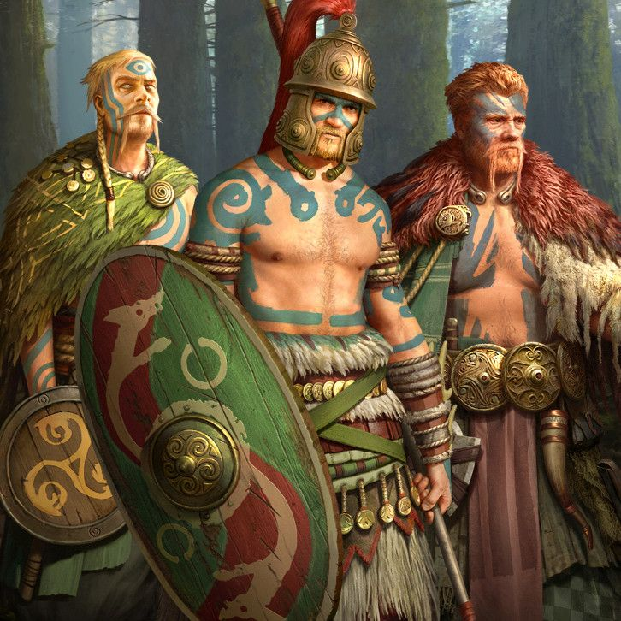
Celts Fashion
When Celts went into battle they wore blue war paints, they did this so they could strike fear into anybody who looked at them. This also links to there aggressive battle styles which nearly destroyed the romans. They wore jewellery and amulets like a tork. A tork is a piece of jewellery that is like a necklace and is made of metal or gold and it a sign of wealth because it was very expensive.

Slide 5
Life as a Celt
A Celts life was hard living in the shadow of the Romans. They hunted for food and they had to adapt to life. Celts liked looking vibrant so they used berry's to dye their clothes. To Make decisions they went to a Druid [ A Druid was a person who talked to God to see what was the right thing to do] so they were sure it was alright what they were doing and God approved of it.

Slide 6
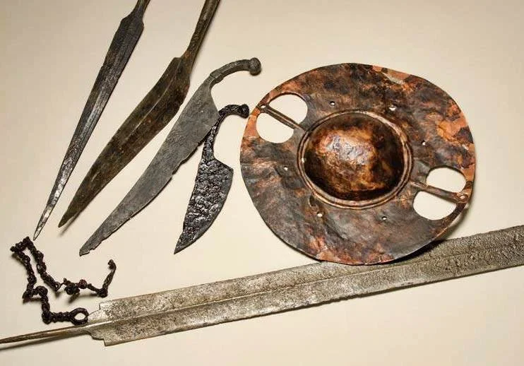
Weapons
Celts made their weapons out of bronze. They used daggers swords, they battle on horse back or foot. They copied the Romans and made chariots for battle as well.

Slide 7
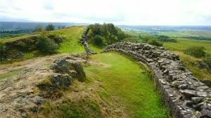
Hadrian's wall
Hadrian’s wall was a wall that was built by the Romans to protect there land from Celts and other rival tribes .People have found out it reaches 70 miles from the Irish sea to north sea. Soon after the Antonine wall was built they built it to establish that this was there land and it was theirs to live on.

Slide 8
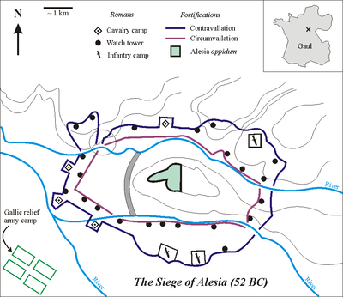
Gaelic Wars
These wars lasted 7 years when they did regular raids against each other leading up to the battle of Alesia this ended in a roman victory and there leader [Vercingetorix] was captured and stayed in prison for 6 years.

Slide 9
Fun Facts
Did you know Celts were not always called Celts and they were called Britons.
The Name Celts came from the Greek word Keltio which meant barbarians.
The Celts wore special bronze helmets to make them taller and scarier. A historical helmet was the was the waterloo helmet. It was discovered in 1868 at the river Thames [waterloo bridge].

