Slide 1

Charming chocolate
By Evie
19/3/2021

Slide 2
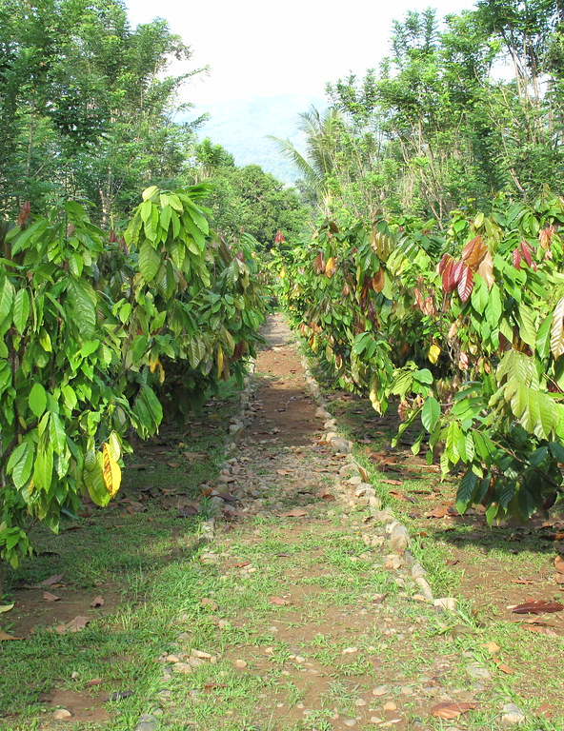
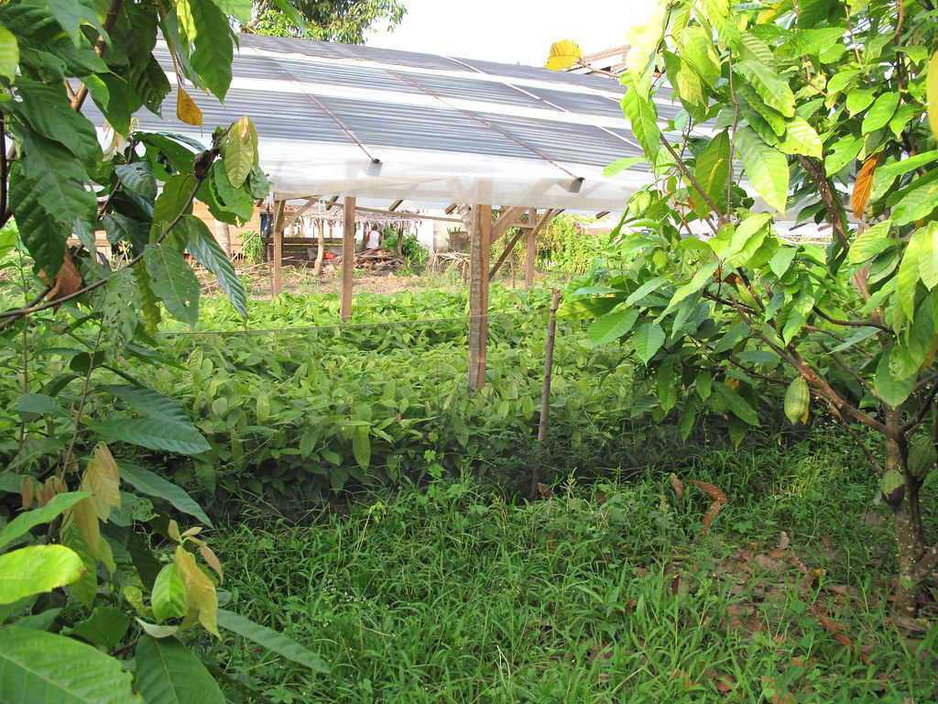
Basic chocolate facts
The popularity of people who either love like or adore chocolate is 81.7% of the world, Germany and England eat 50% of the worlds chocolate.
Cocoa beans grow inside fruits and the fruits grow on trees. There are millions of massive cocoa farms in Western Africa that are anchors of land. The first chocolate bar came from England and they made hot coco first in ancient Mexico and with the Aztecs.

Slide 3
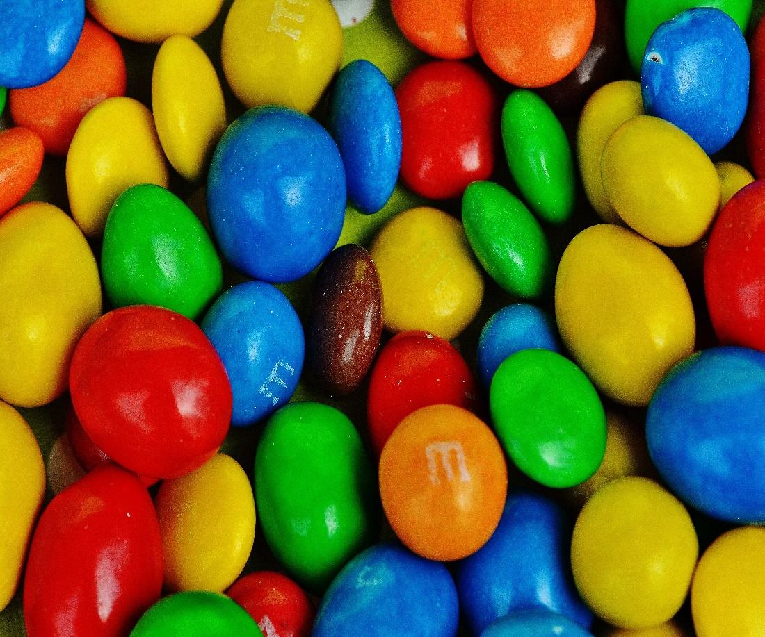
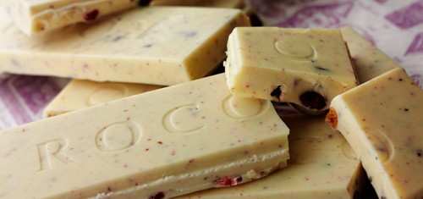
Fun and fab facts
M&M’s were invented between the 1930’s – 1940’s so that world war 2 soldiers could enjoy chocolate without it melting against there warm body heat.
White chocolate is not actually a chocolate because it has no cocoa solids and only cocoa butter and in order to make chocolate you need at least both of the cocoa products
An average human will eat 11 kg of chocolate a year
The melting point of chocolate is 30℃ -32℃

Slide 4
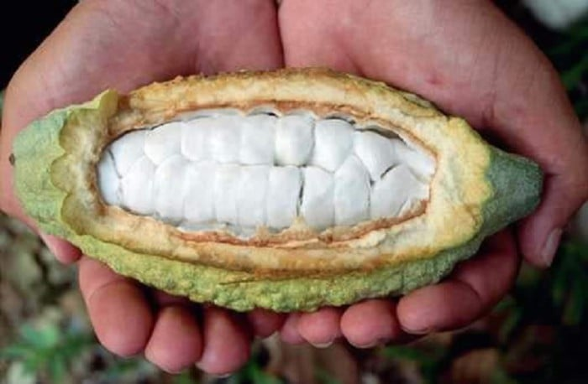
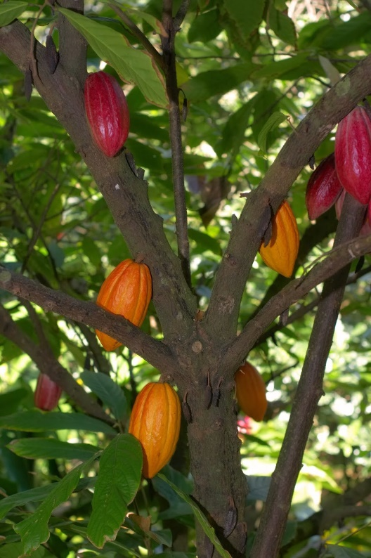
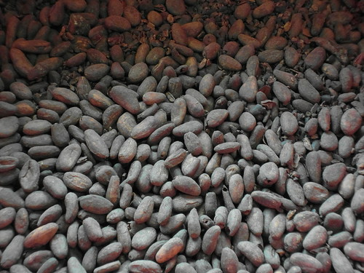
Fruits and trees
Chocolate is made from cocoa beans and these rich wonderful beans are grown on the inside of fruits and the fruits that hold the chocolate beans grow on trees. There are about 20-40beans in each cocoa fruit and it takes 900 cocoa beans to create 1kilo of chocolate .
The trees grow on farms which the farmers look after, but even though they do a great job maintaining the trees they often don’t get well paid

Slide 5
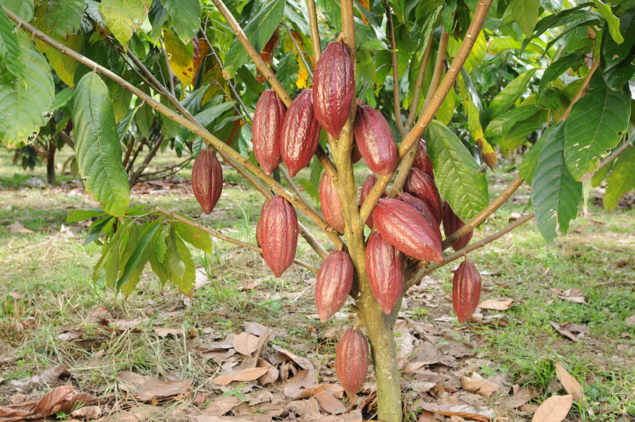
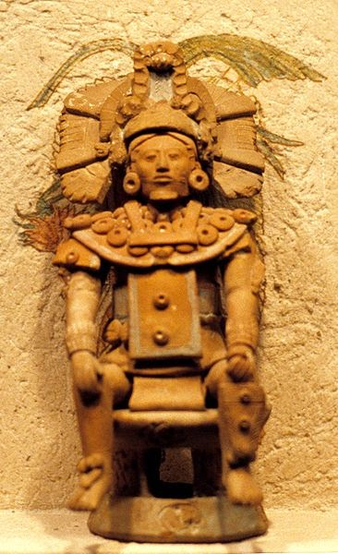
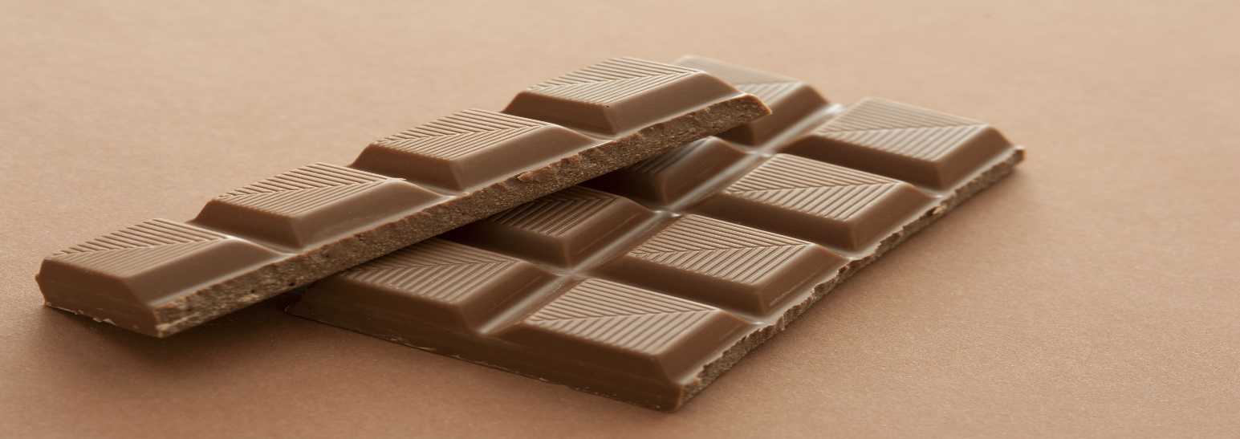

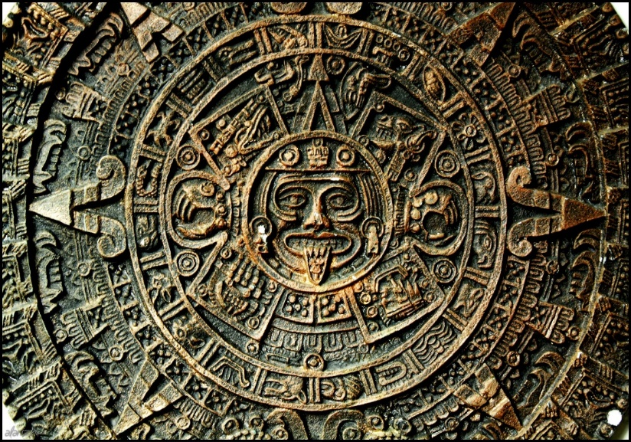
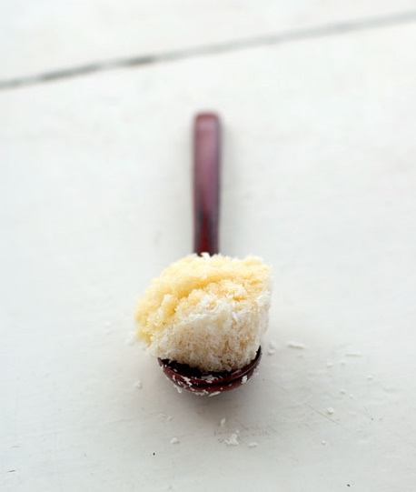
fabulous photo farm
Cocoa tree
Chocolate bar
White chocolate ice cream
Ancient Mexico
Hot coco
Aztects

Slide 6
Quiz! QUIZ! Quiz! QUIZ!
Where did hot chocolate come from?
Why did they use M&MS in world war 1?
Where does most cocoa grow?
Why is white chocolate not real chocolate?
How many beans are in each cocoa fruit?
Is there A)15.5m B)200k C)150k cocoa farms in Africa?
Aztects
So the chocolate didn’t melt against body heat
On western African farms
Because it is only cocoa butter
20-40
15.5m

