Slide 1
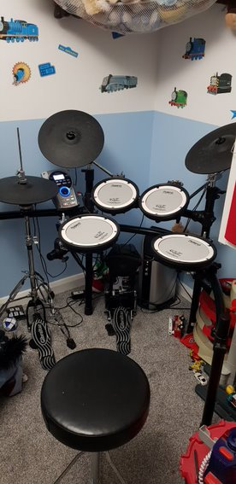
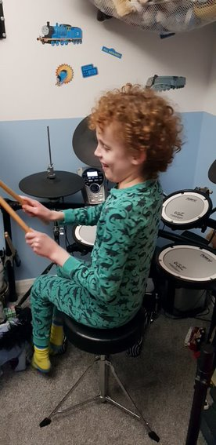
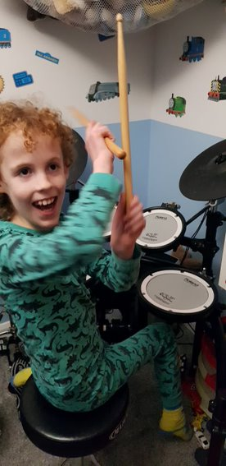
Drums

Slide 2
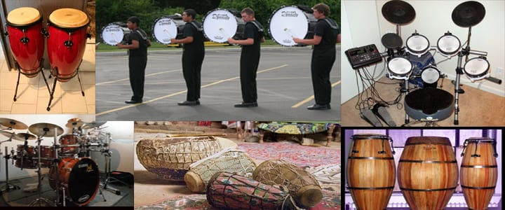
Drums are percussion instruments. They can be played on their own or 2 or more at a time.

Slide 3
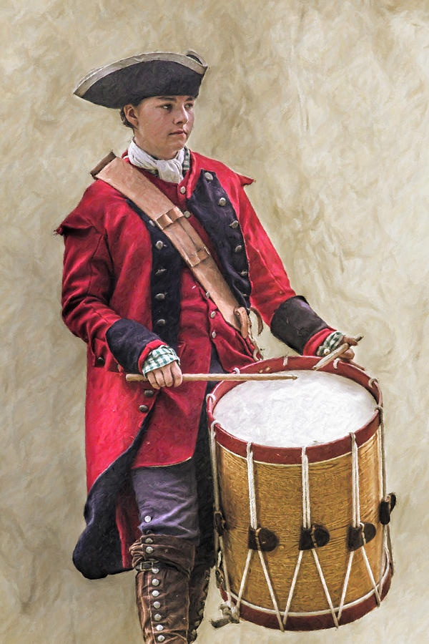
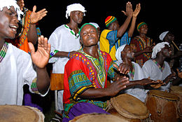
Drums were used in war to send messages between soldiers.
In Africa and India drum messages were sent between villages.

Slide 4
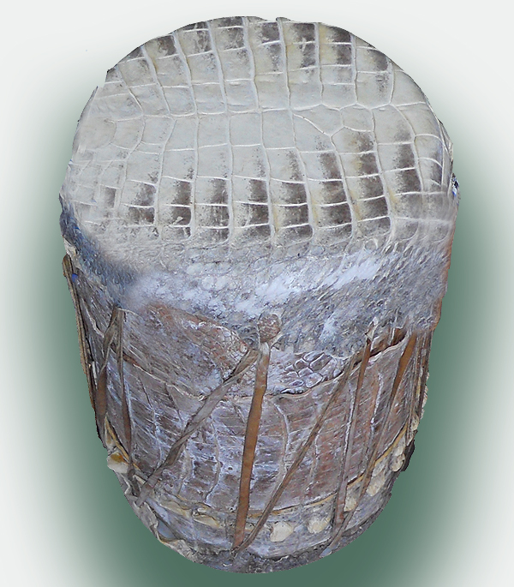
The earliest drum was made of alligator skin and clay and was found in china in 5500BC,

