Slide 1

FENNEC FOXES
BY EVA

Slide 2

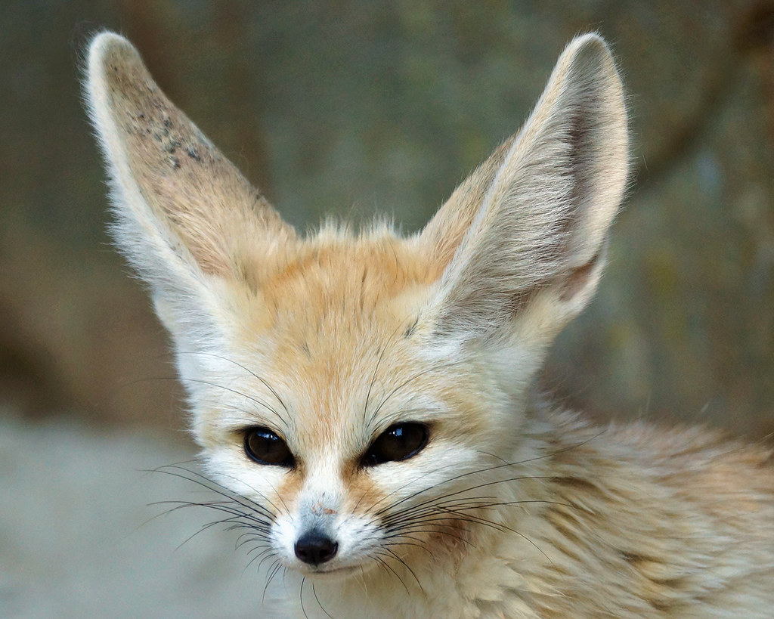
FENNEC FOX NAMES fennec foxes have 2 different names
. Fennec fox
. Vulpes Zerda vulpes zerda is the scientific name . Isn’t that cool!

Slide 3
THERE SOOO CUTE AND LOVELY

Slide 4
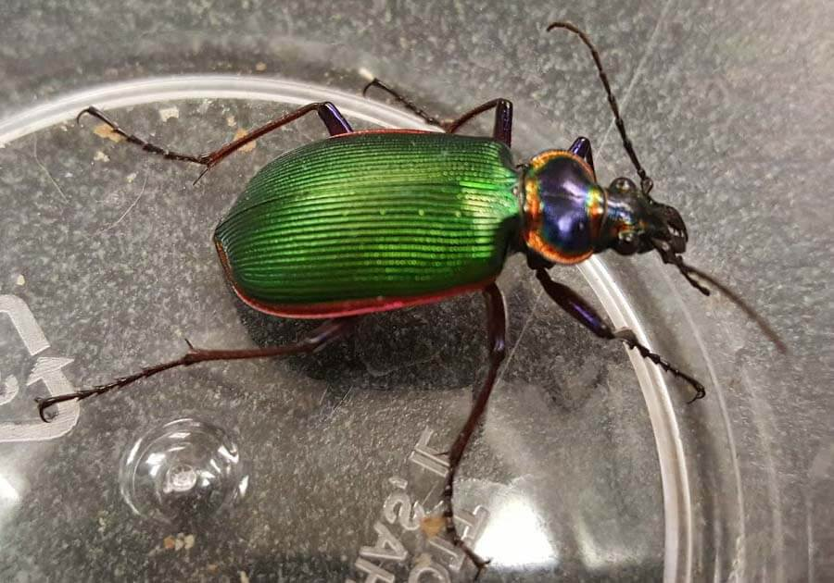


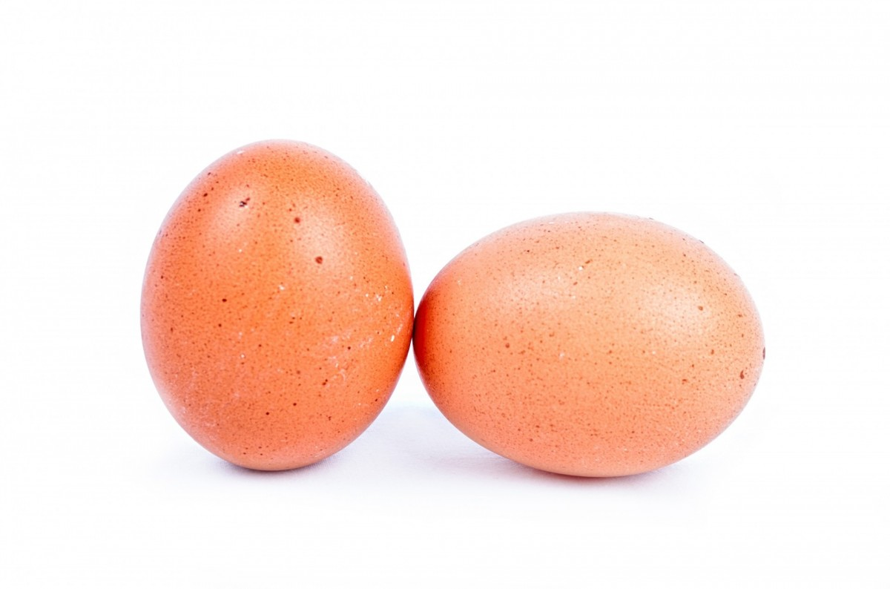

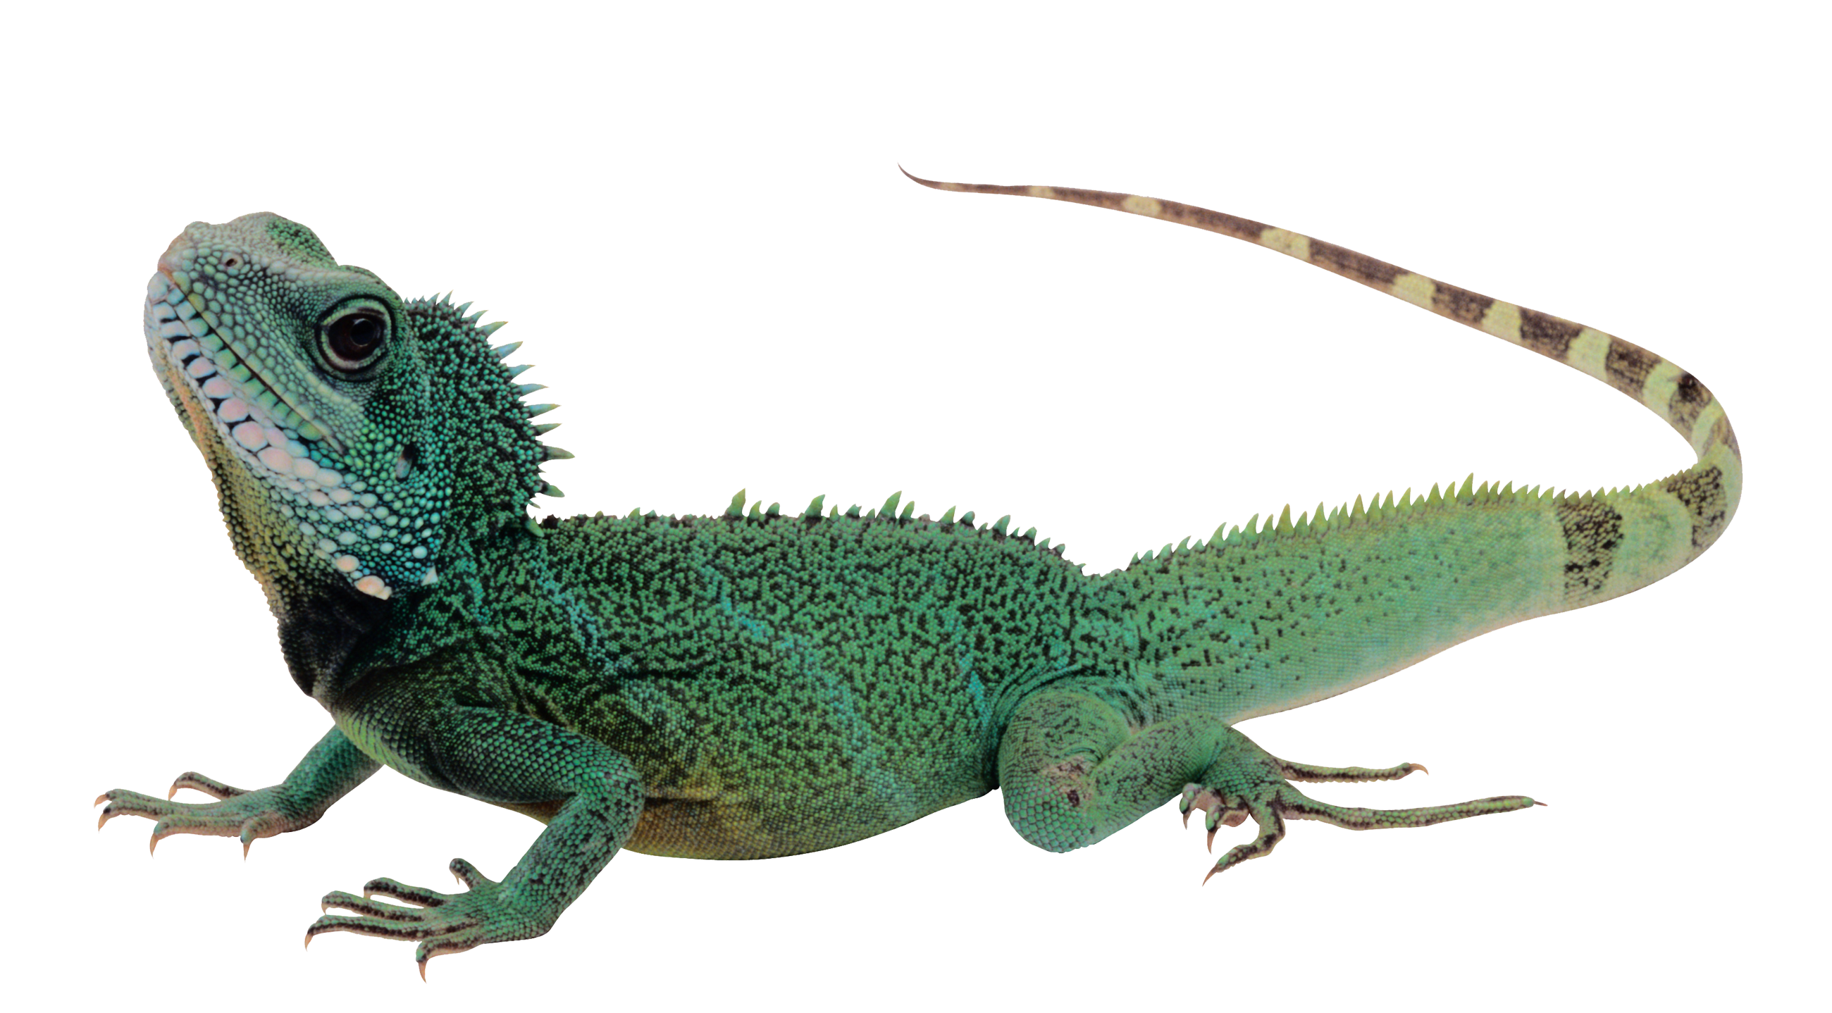
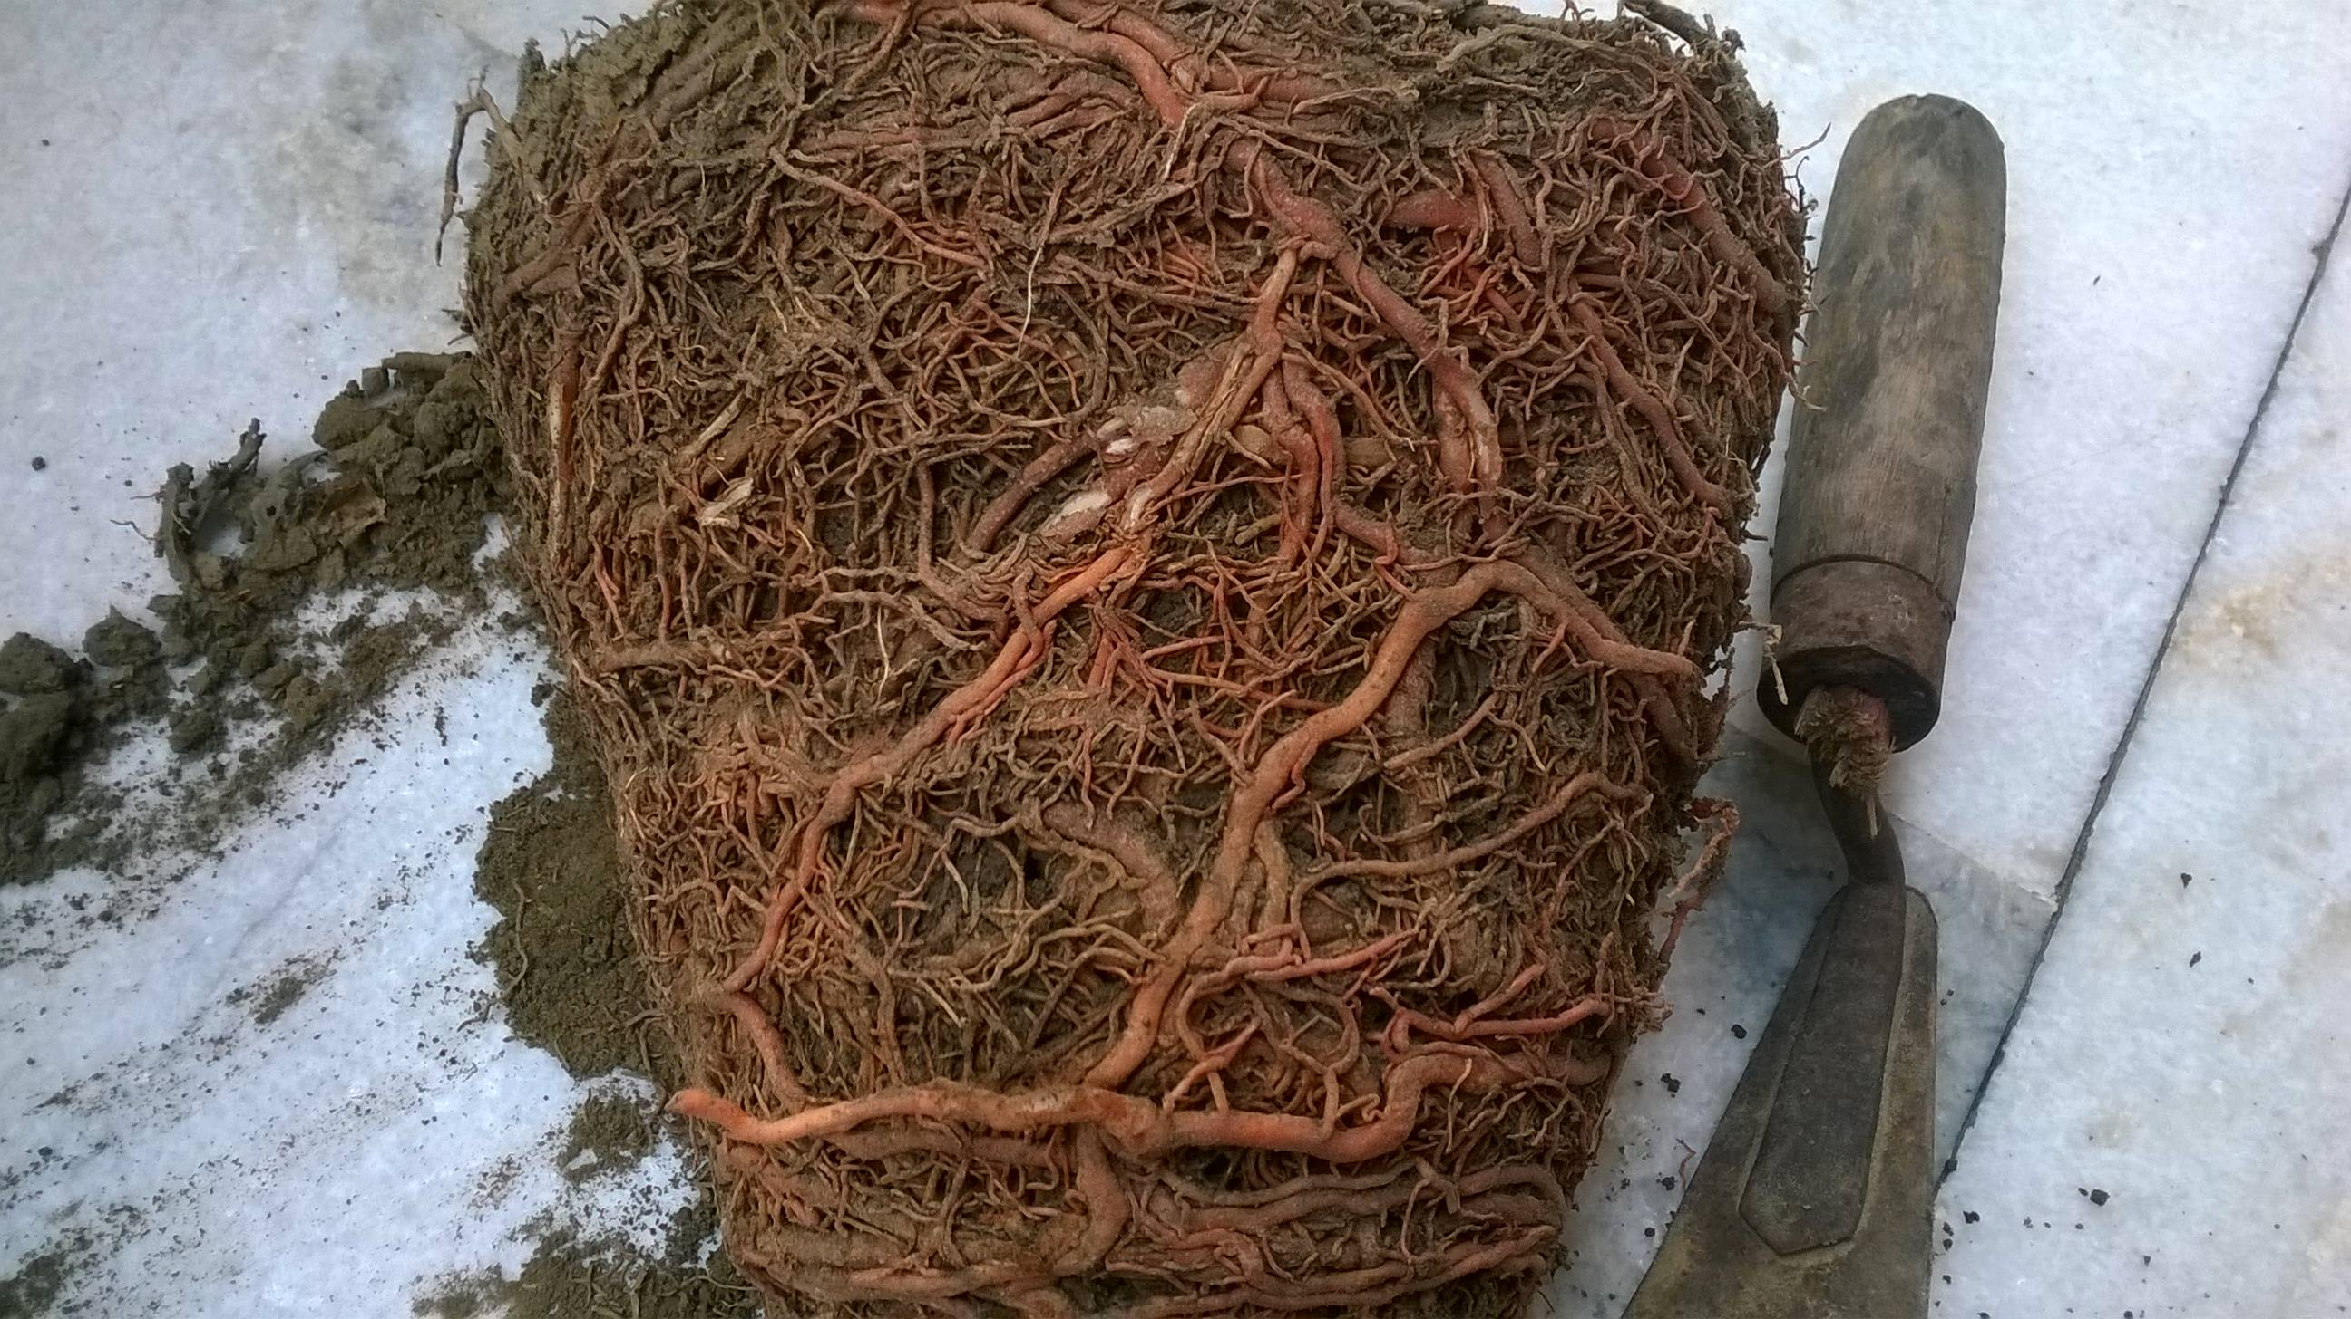

WHAT DO THEY EAT?
Fennec foxes eat a wide variety of foods including
Insects, rodents, snails, lizards, fruit, roots and eggs. WOW! It’s not much
of a variety but I guess it is absolutely fine for them.

Slide 5
They live in north Africa and can jump a pawmasing height of 0.6 meters!!!!!
They can live up to 10 years in the wild and 13 years in the zoo. Sadly they are hunted so most don’t live that long . In a liter there can be 2-5 kits and when they have fully grown they are still only pint sized !!!!

Slide 6
There pointy ears are 4-6 inches and they also radiate body heat!
It would be amazing if our ears could do that would’nt it !!!

Slide 7
Thanks for reading!
Hope you enjoyed!!

