Slide 1
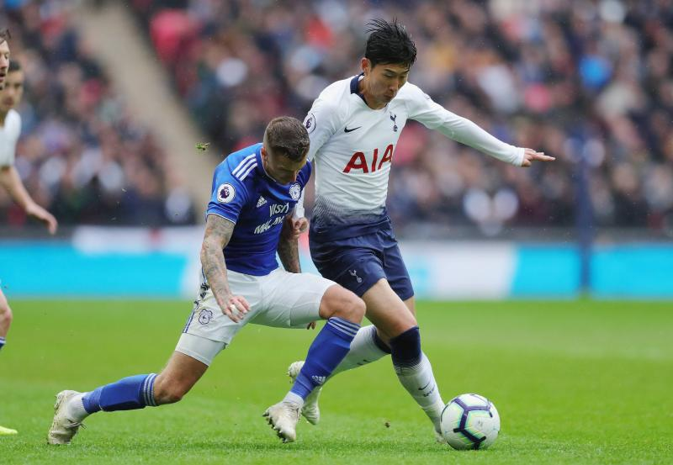

FOOTBALL!!

Slide 2
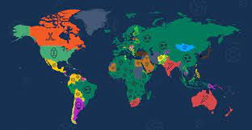
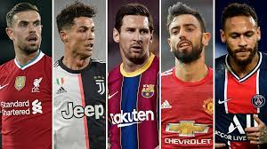
AROUND THE WORLD
The game football is also known as soccer in north America ,south Africa and Australia
Ronaldo and Messi are the most widely players in the world
It is the only game in the world that you cant touch the ball with your hands
It continues to be the most popular sport

Slide 3
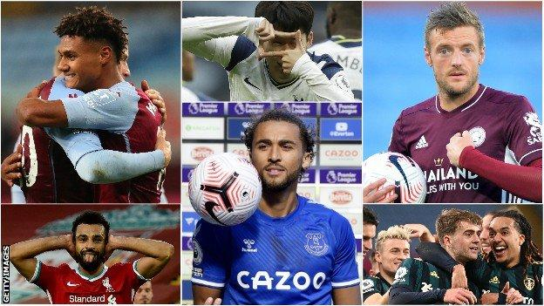
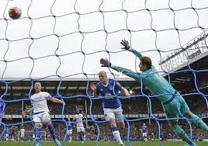
HAT TRICKS
The quickest hat trick ever scored was scored by Sadie Mane 3 goals in 2 minutes
A hat trick occurs when a player scores 3 goals attempted by another person
Hat tricks are usually scored In the champions league by all of the champions

Slide 4
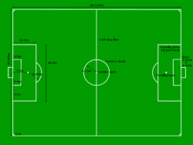
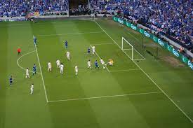
ON THE PITCH
Only 11 footballers are allowed on the pitch
The length of a football pitch is 100yds while the width is 53 and a half
Football pitches are only mad up of natural grass
Harry Rednapp is the only manager this year to have managed 4 different clubs

Slide 5

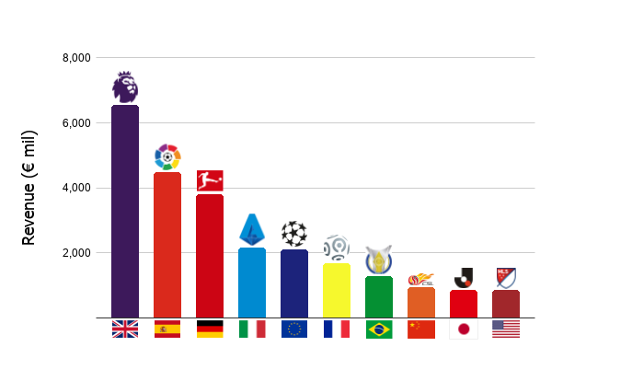
LEAGUES
Football started in china
The top 5 leagues are:
Premier league
Fa cup
Championships
Champions league
Europa league
There are 32 teams in the NFL
Walter camp invented football
Walter camp is also known as the father of football of football

Slide 6
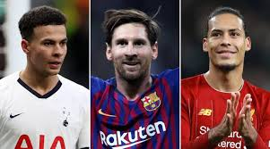
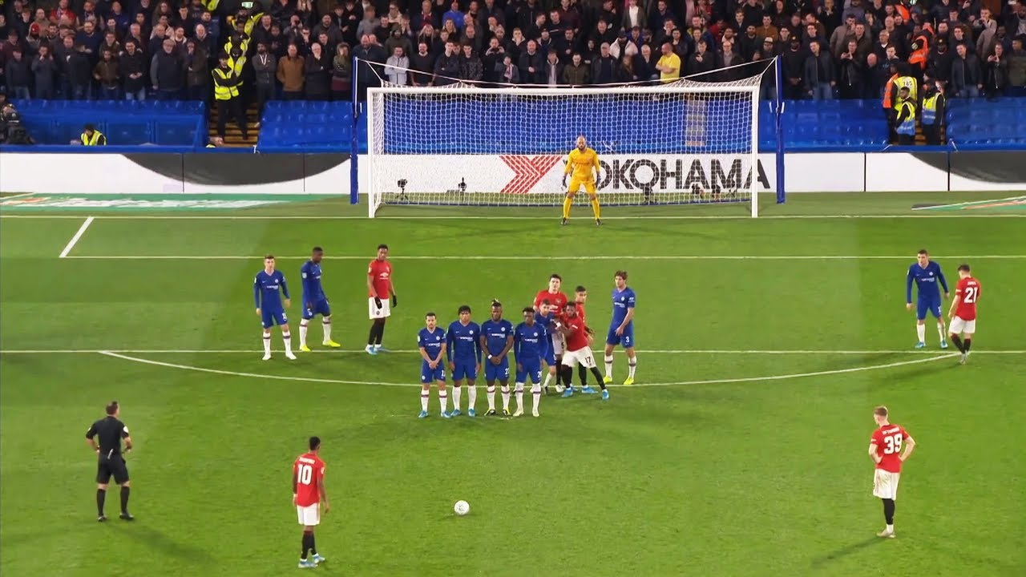
FOOTBALLERS
Many players get payed 25 million pounds per year
TYPES OF FOOTBALL
Association football
Soccer
American football
Canadian football
Rugby union football
Rugby league football
College football

Slide 7


THANK YOU FOR READING
BYE!!!

