Slide 1
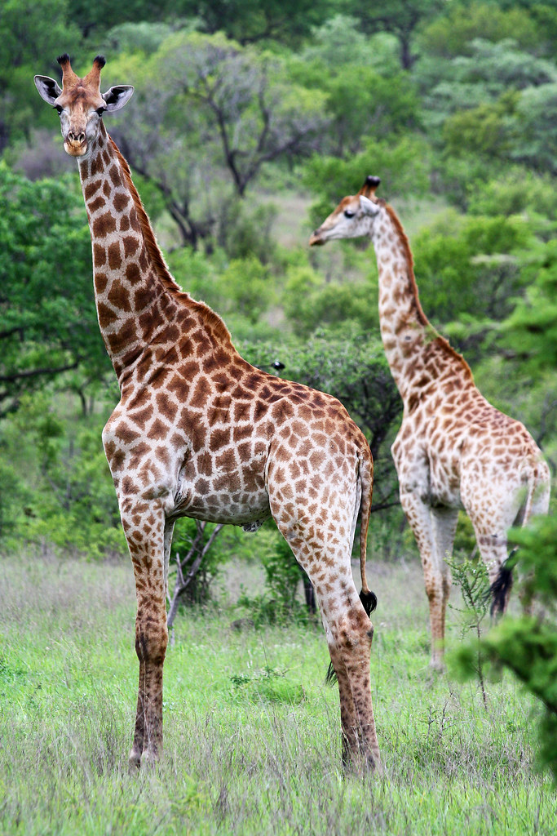
Giraffes
By Holly S

Slide 2
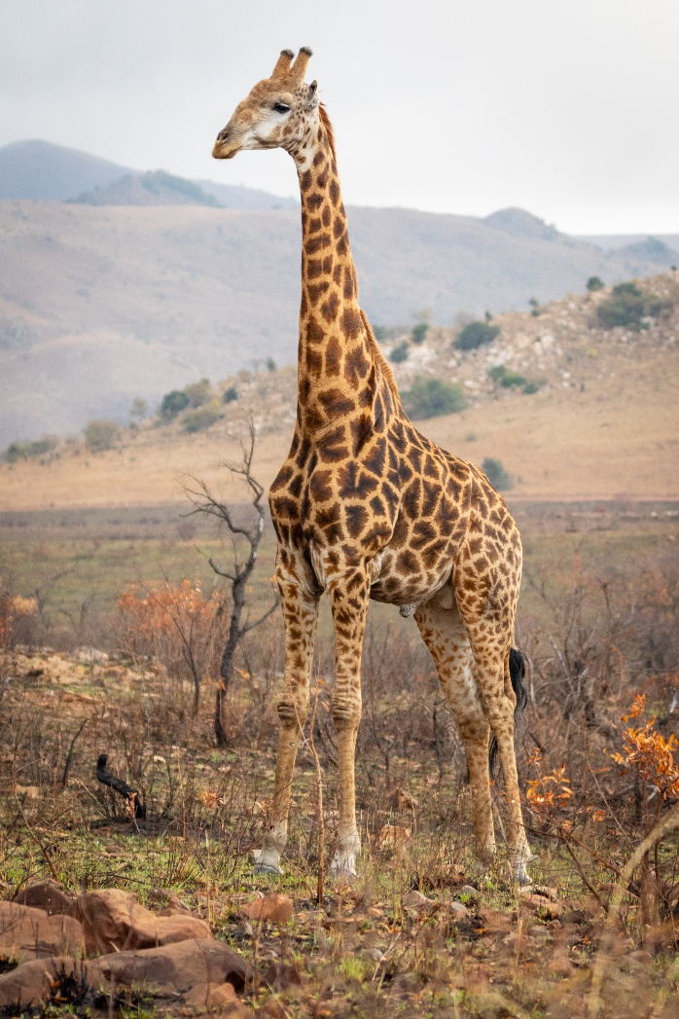
Giraffes are one of the tallest mammals, and can run up to 35 miles an hour.
Their necks are too long to reach the ground, giraffes only need to drink once every few days.
Giraffes spend most of their lives standing up, they also have up to
200 spots or more and every giraffes spots are different.

Slide 3
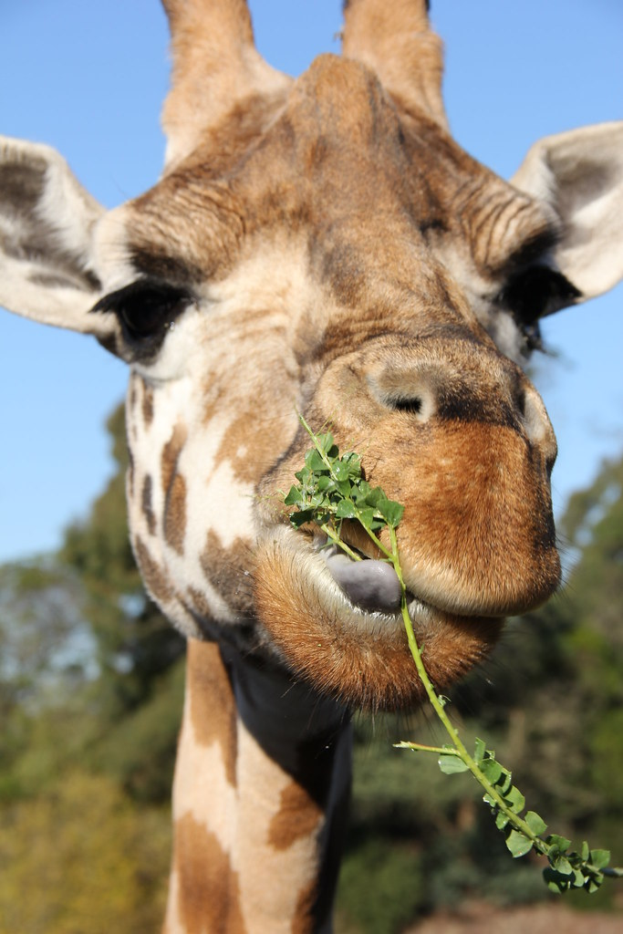
There are 68,000 giraffes left in the wild, and are sadly vulnerable.
Giraffes have 3 hearts, and hum at night to keep the herd together.
Their tongues can grow up to 53cm, and are black to help not get sunburnt when eating leaves and twigs off an acacia tree.

Slide 4
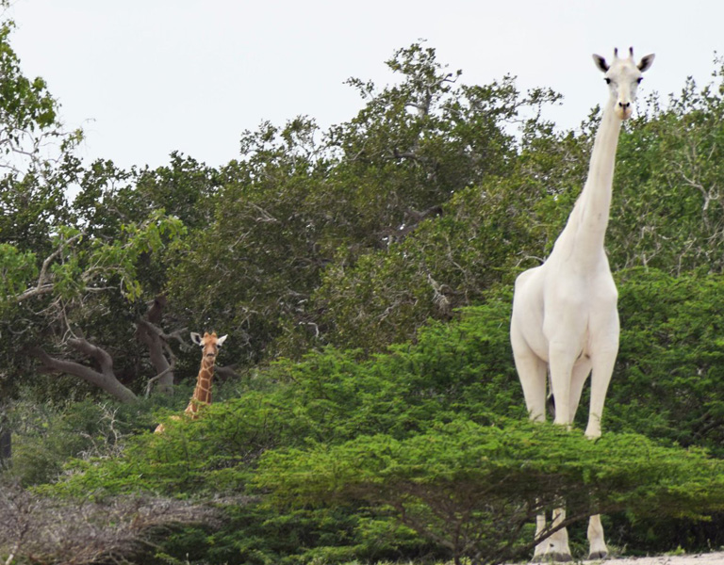
There is only 1 more albino giraffe left in the world, and its child was sadly killed by poachers.
Their incredible eyesight can spot hungry beasts from far away.
Female giraffes are called cows, male giraffes are called bulls and the babies are called calves.

Slide 5
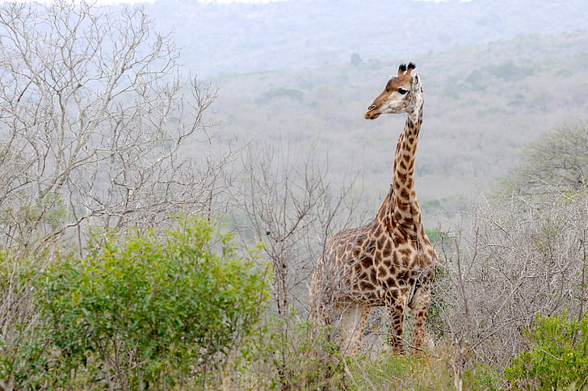
Giraffes feet are the size of dinner plates, and their heart weighs
11kg.
Male can grow up to
5.5m, which is taller than 3 people standing on top of each other.

Slide 6
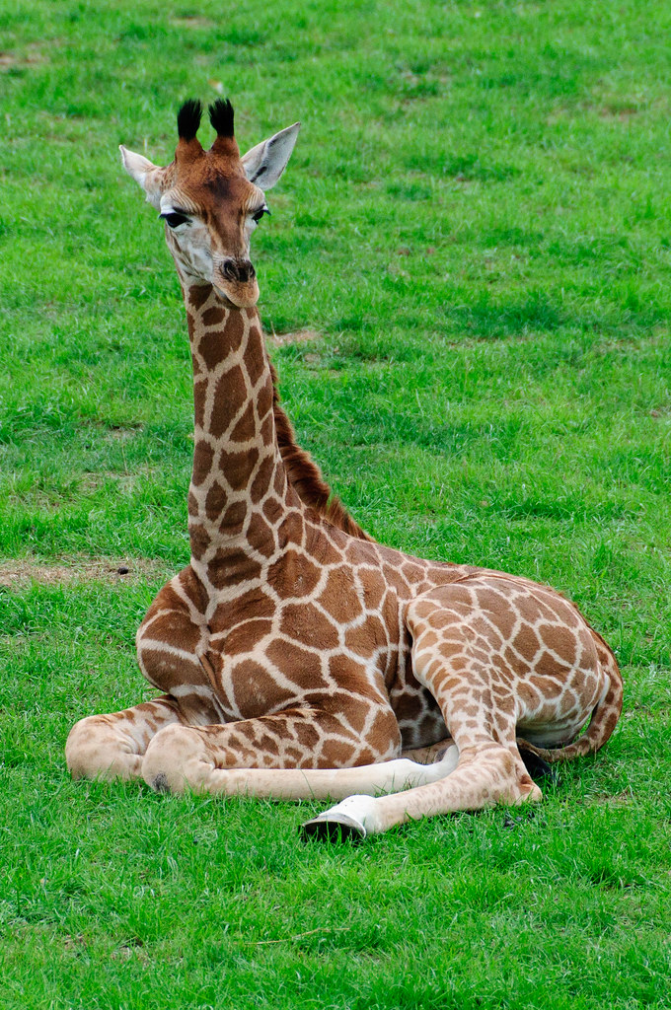
They sleep 20 minutes to 2 hours every day, their mouths are hard on the inside to stop thorns from cutting their mouths.
Their tongues are the size of a humans arm.
Giraffes are extinct in 7 different countries in Africa, Burkina, Faso, Eritrea, Guinea,
Nigeria, Mali, Senegal.

Slide 7
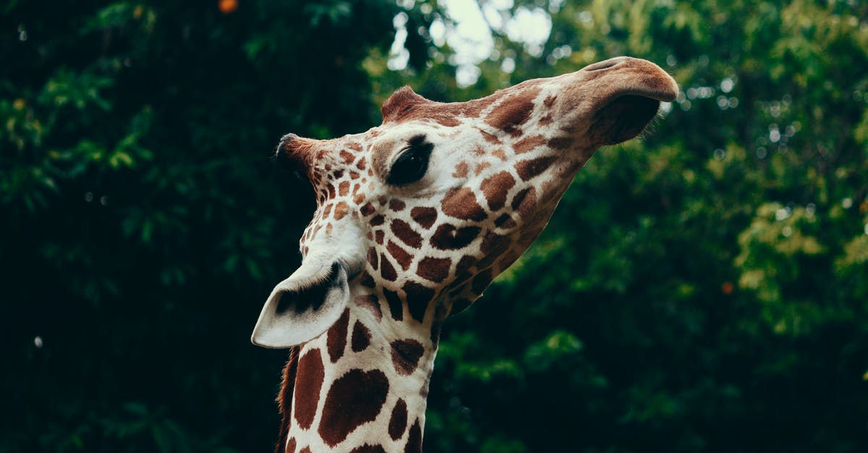
Thank you for reading, please come again.

