Slide 1
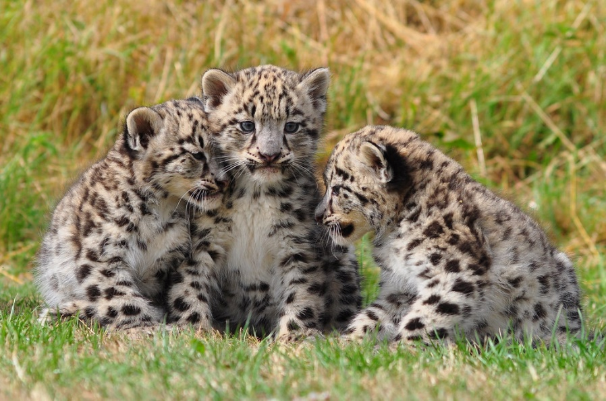
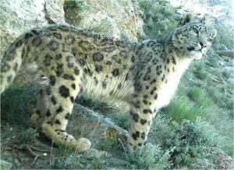
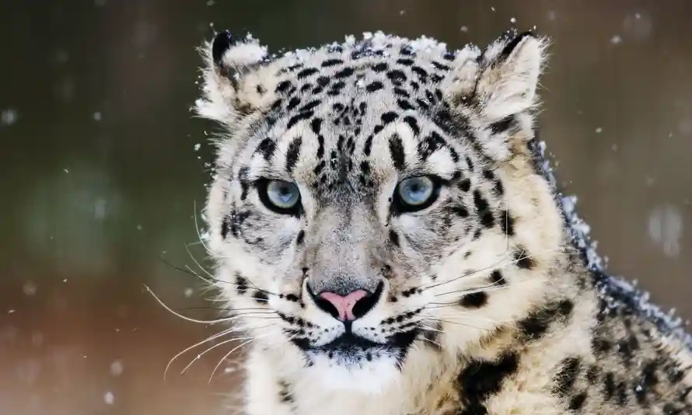
Lets learn about snow leopards!!!!
What is a snow leopard? Well lets find out.
A snow leopard is a large cat.

Slide 2
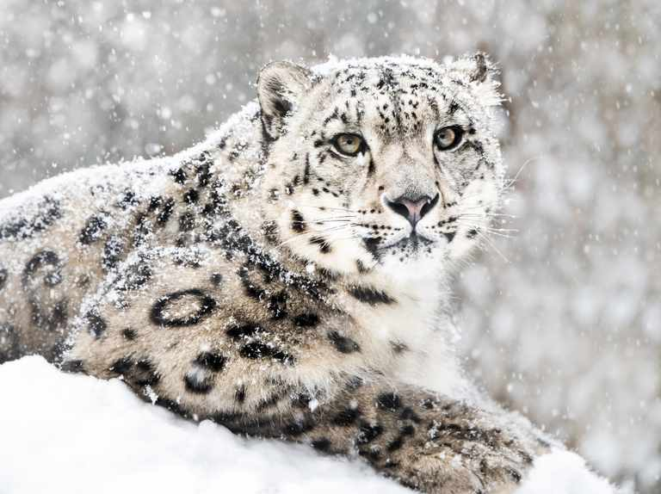
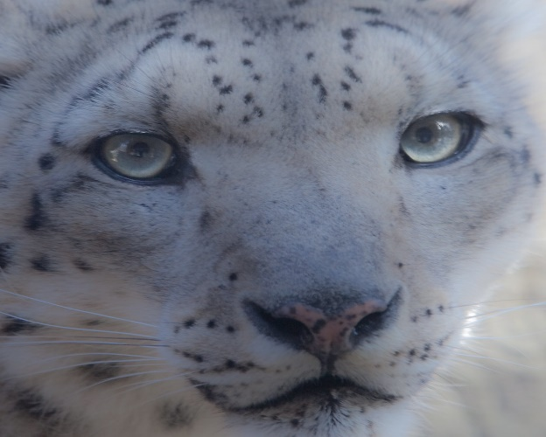
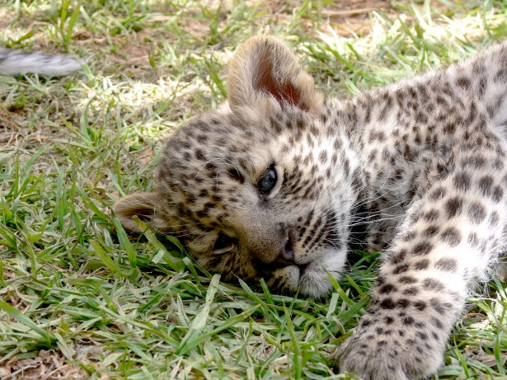
Where do snow leopards live?
Well lets find out. Now where do we start we start here. Snow leopards live in all different countries like the central of Asia and southern Russia and also China ,India too and all of those countries !!!!!!!!! Snow leopards are mostly found in central Asia.

Slide 3
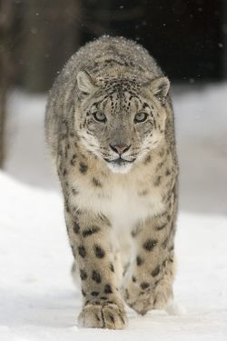
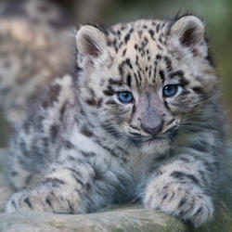
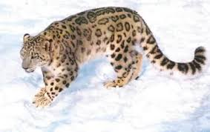
Snow leopards Habitats
Snow leopards eat slowly usually taking 3 or 4 days to consume a prey animal. Their main prey is blue sheep. They can NOT! Roar!!!!!

Slide 4
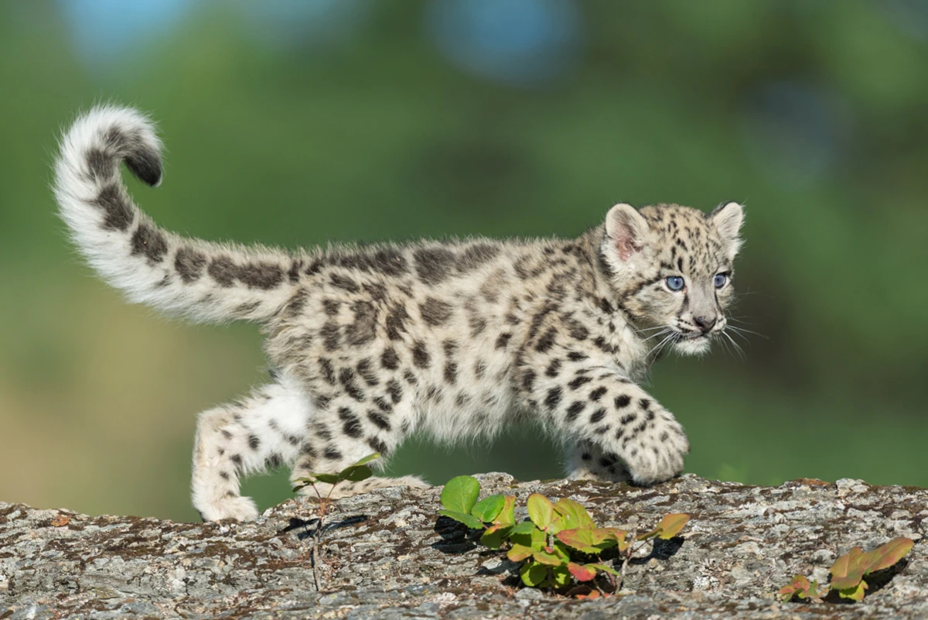
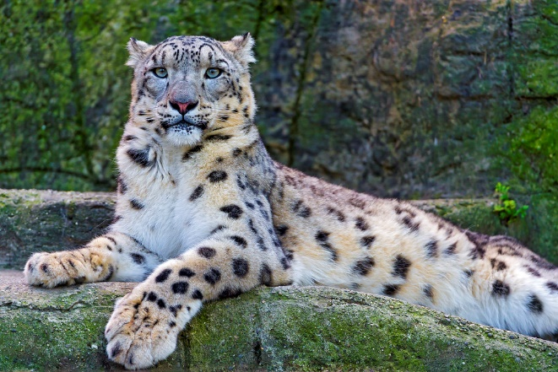

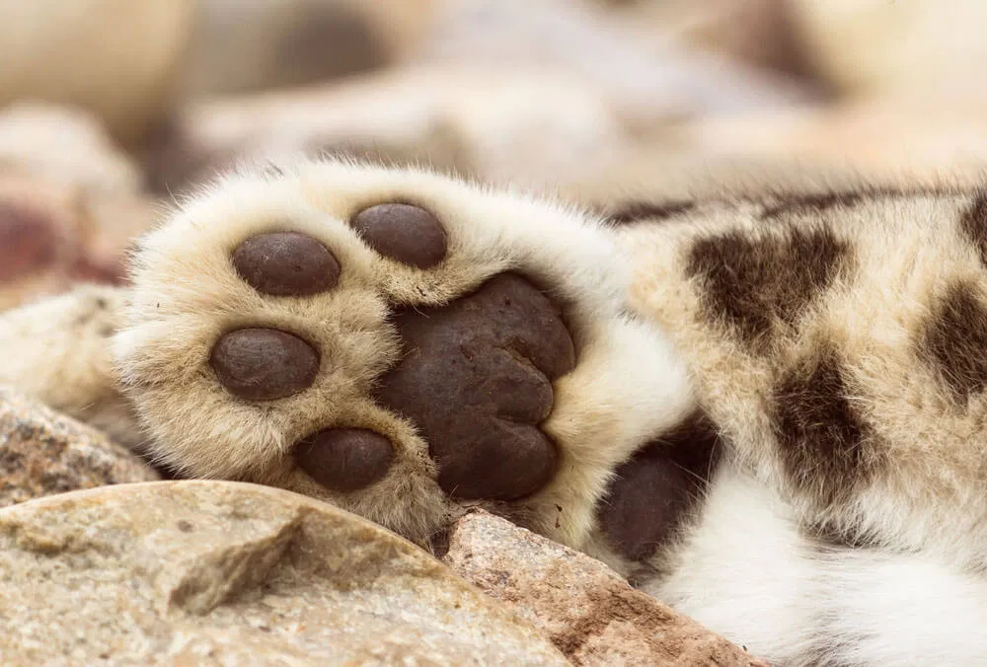
Snow leopards
Shoes!
Snow leopards wear natural snowshoes their
shoes keep their feet warm.

Slide 5
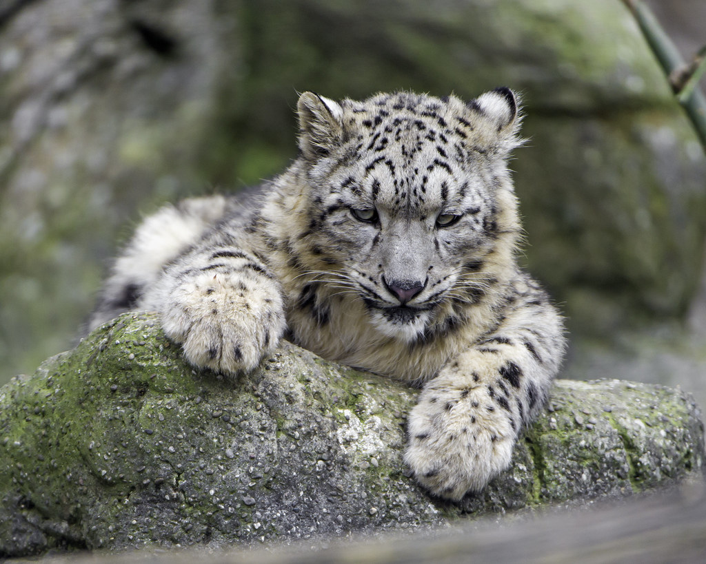
Snow leopards are from 75 to 150cm long not included they tail.

