Slide 1
Mary Berry
facts

Slide 2
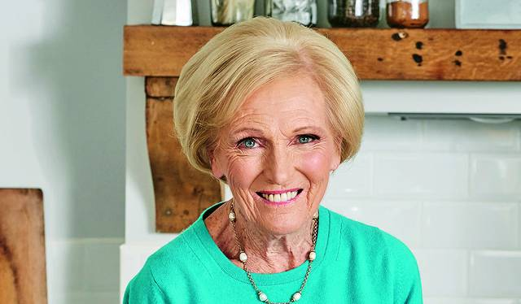
Mary Berry was born on the 24 of March 1935.she is 86 years old. Mary had 3 children. Mary’s first job was to show how to use a electric oven. She has been hosting a tv show for 40 years. Her real name is Mary-Rose Alleyne Berry.

Slide 3
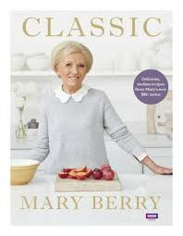
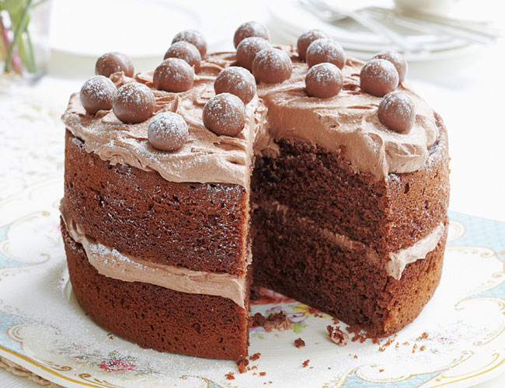
Mary’s favourite cake is a malted chocolate cake. Some people call her queen of cakes.
Mary’s first cooking book is Hamlyn all colour cooking

Slide 4
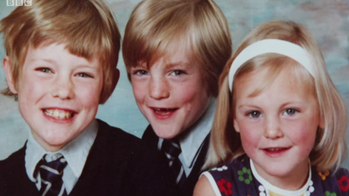
Mary had three children but one got in a car crash. At the age of 13 her spine was twisted, her left arm was thinner then her right arm and she has got polio and she spent 3 months in hospital.

