Slide 1
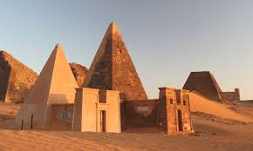
Thutmose I amazing facts
Thutmose I built tomes and temples (a lot)and a tome for himself (in the valley of kings).
He ruled from 1493 to 1506.
His mother is called Senseneb.
His father is unknown but was believed to be Amenhotep.
Previous pharaoh was Amenhotep.
Next pharaoh was Thutmose I.
He was born in 1493.
He died in 1554..

Slide 2
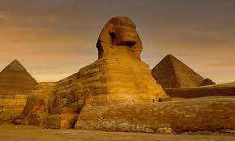
In Egypt there are 138 pyramid.
Largest pyramid in Egypt is the great pyramid of Giza,[which is 146 meters tall ]
20000 people built Giza.
It took them about 20 years to build Giza.
Now its core is of 2300000 blocks of limestone and granite.

Slide 3
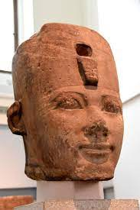
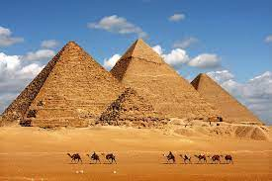
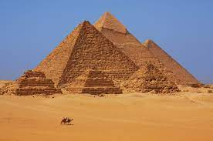
Great photo farm.

