Slide 1
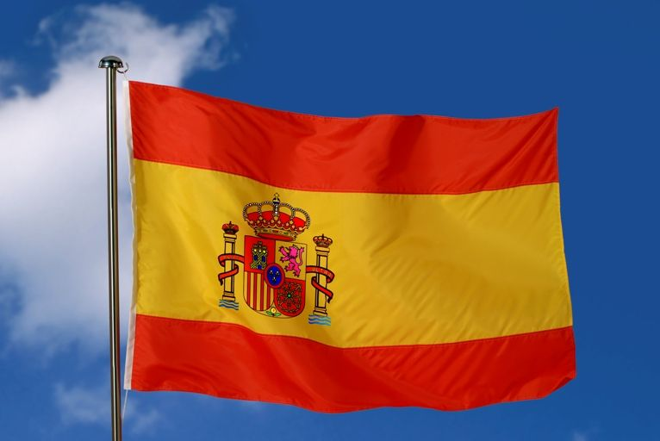
SPAIN FACTS

Slide 2
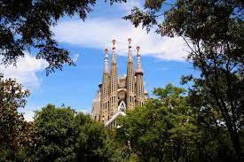
Facts
Spain is a country on the European continent , which has a population of 48 million . The capital of Spain is Madrid , with 6.6 million inhabits. The main language spoken is Castilian, Spanish , Galician, and Basque The most famous buildings include: Alhambra, Familiar, Mosque-Cathedra of Cordoba.
Religions : Mainly Roman and Catholics but also Christian
The highest point 12,000 feet ,which is the peak of mount Everest .

Slide 3
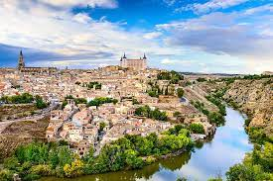
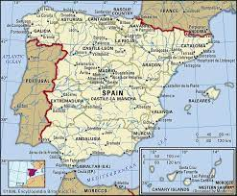
From 711 to 1492 Islamic Moors ruled in Spain . In 1492 Christopher Columbus discovered America and the Spanish rulers start forming their Empire.
Did you know ? Spain was first called Hispania. Spain is famous for beaches alcohol and drinks , paella and Spanish football.

Slide 4
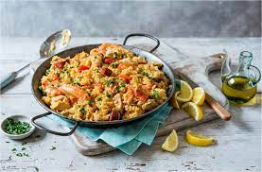
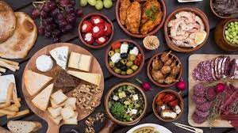
Paella is perhaps the most famous Spanish dish of all.

Slide 5
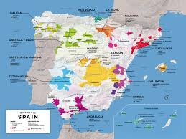
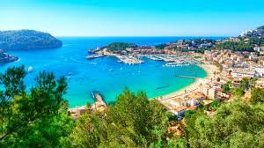
The three largest cities is Spain are Madrid which is the capital city of Spain , Barcelona and Valencia .
Did you know the most popular beaches are in Barcelona .

Slide 6
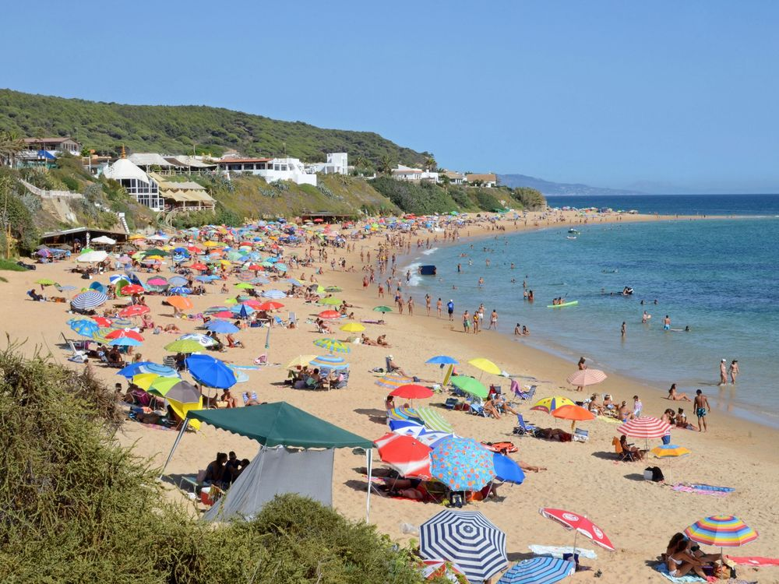
Thanks for reading

