Slide 1
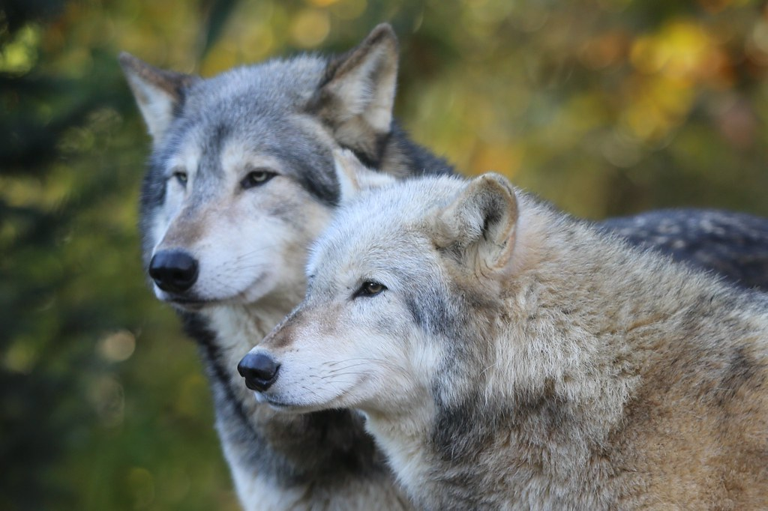
WOLVES
Facts

Slide 2
INTRESTING FACTS
  . wolves have only existed for 300 years
  .Wolves were evolved from dogs and tuned into wolfs
  .I hate to burst your bubble but wolves don’t howl at the moon its just a myth .
  .

Slide 3
FACTS
Wolfves only bred in April they have 13 to 16 cubs a mishear between girls and boys balk and white.
You can only find them in Europe Asia north America and tundra.
They have a special data of only eating meat and drinking water .
They have a role of they always stay in a pack and when they walk it is in a line ,the leader goes at the back so they can make sure that noon's left behind and to make sure everyone safe and there isn’t any danger .
They live for 13 years unless they get killed .

Slide 4
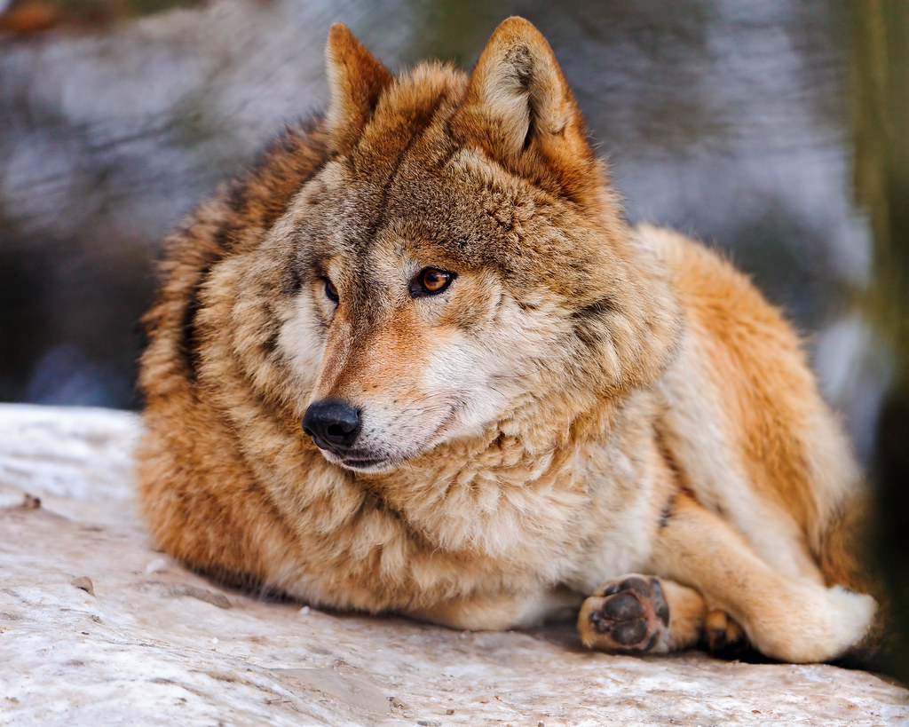
FACTS
Did you no that a wolf is as strong as a human there mussels are 1500 so they can hunt and defend .

Slide 5
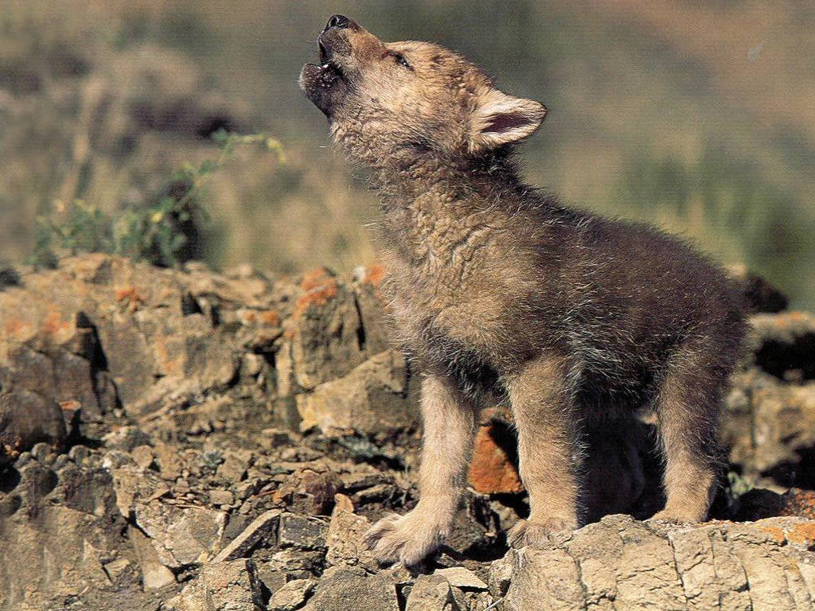
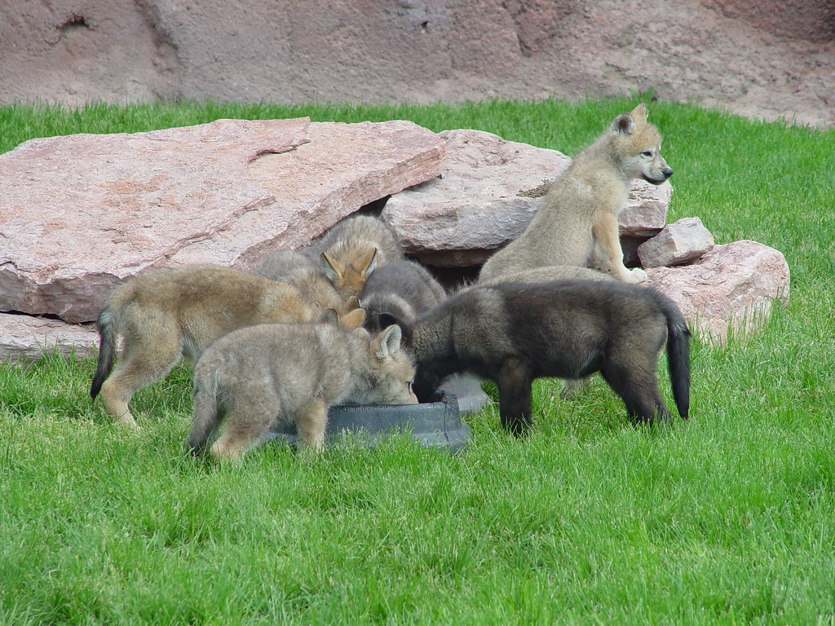
PIKCHES did you no that wolves are one of the most dangerous animals because they can kill a human but that is very rare .

Slide 6
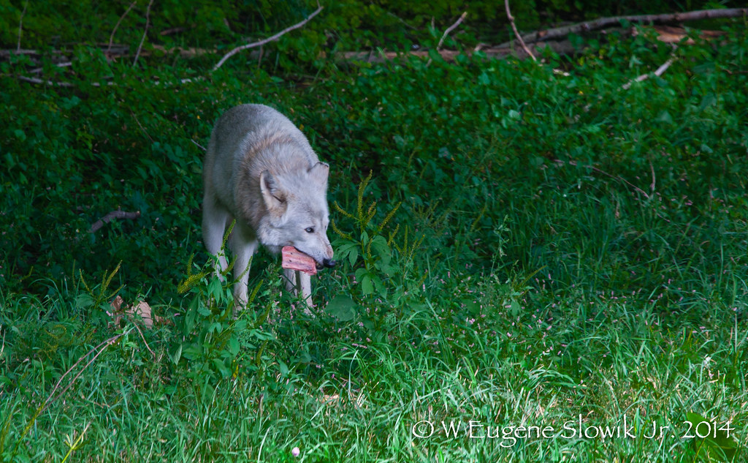
WHAT DO THEY EAT
They eat meats that they hunt for example fox , bird and dear. Wolves drink from lakes streams and rives .

Slide 7
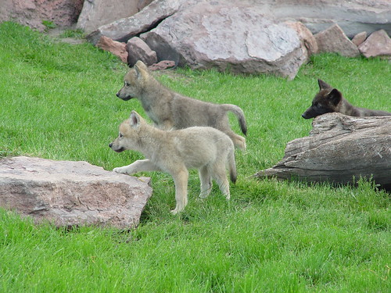
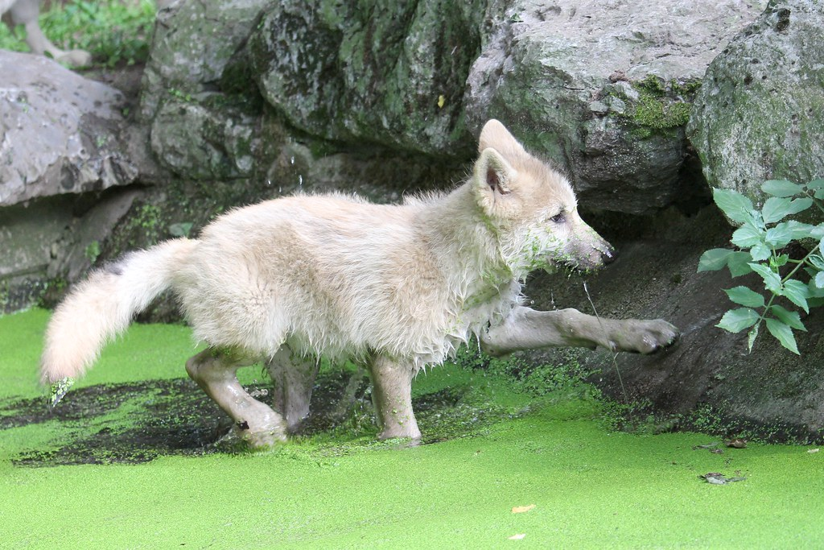
PICHES

Slide 8
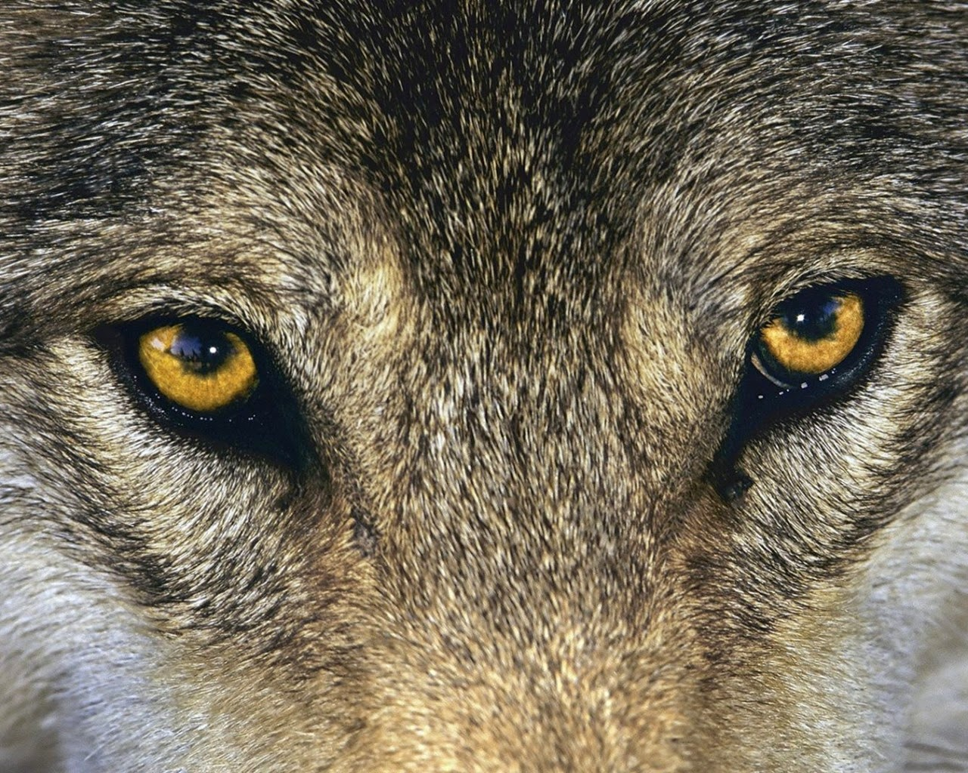
What colour eyes do they have
They can have orange , purple and brown eye couler.

Slide 9
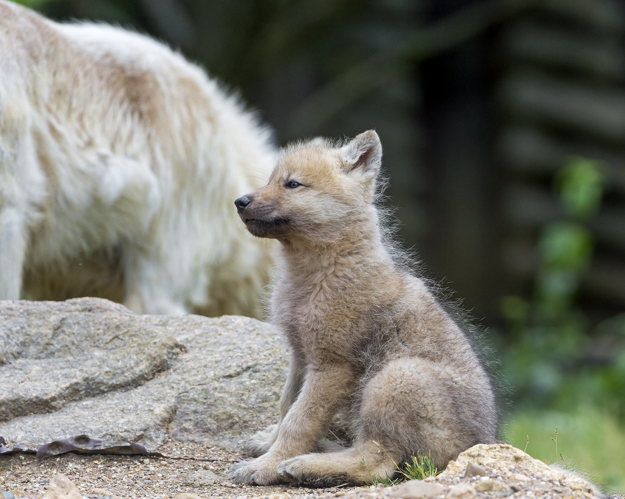
NEWBORN
New-born wolves are called cubs there fur sticks out because they are growing there coat
as fur .

Slide 10
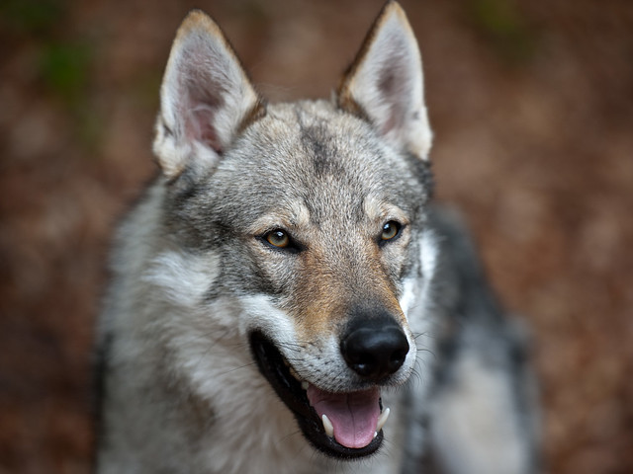
True or foals
Is this a wolf !

Slide 11
It wasnt
weirdly it wasn’t false ! It is not a wolf ☺☹ did you get it right or wrong .
I hope you got it right if not do not worry it was a tricky one.it is because wolves evolved from dogs .

Slide 12
THANKU FOR READING
I HOPE YOU ENJOYED
I hope you learned lots from this presentation bye .

