Slide 1
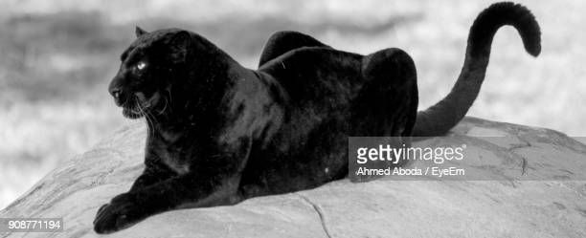
Black Jaguars

Slide 2
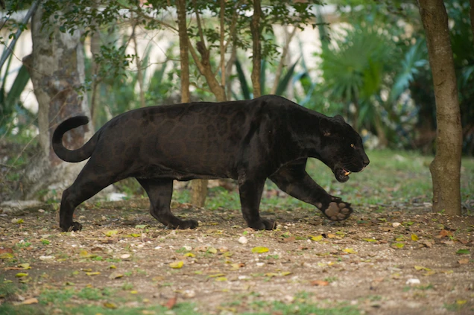
6 Amazing quick facts
Life span: 12 to 15 years
Speed: 80kph
Mass: 56 to 96kg
Height: 63 to 73cm
Length: 1.2 to 2m
Gestation period: 93 to 105

Slide 3
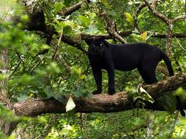
Did you know the Black Jaguars favourite food is dear, Fish and Capybara.

Slide 4
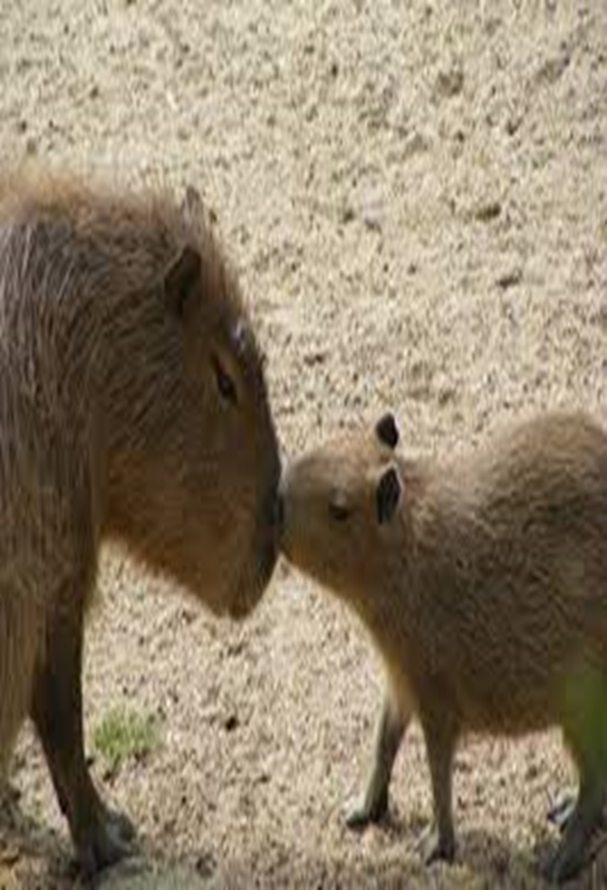
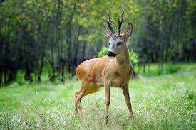
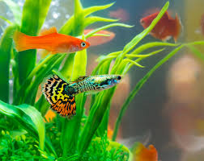
Pictures of a Black Jaguars favourite food

Slide 5
TRUE OR FALSE!
1.
How many Black Jaguars are left in the wild?
A.760
B.600
C.900

Slide 6
TRUE OR FALSE!
2.
Do people confuse the Black Jaguar as a Leopard or Panther?
A. Leopard
B. Panther

Slide 7
TRUE OR FALSE!
3.
What does Albino Jaguar mean?
All white Jaguar
Normal Jaguar colour
Black Jaguars

Slide 8
ANSWERS!
600
Leopards
All white jaguar

Slide 9
Thanks for reading
Arthurs
Black Jaguar presentation!

