Slide 1
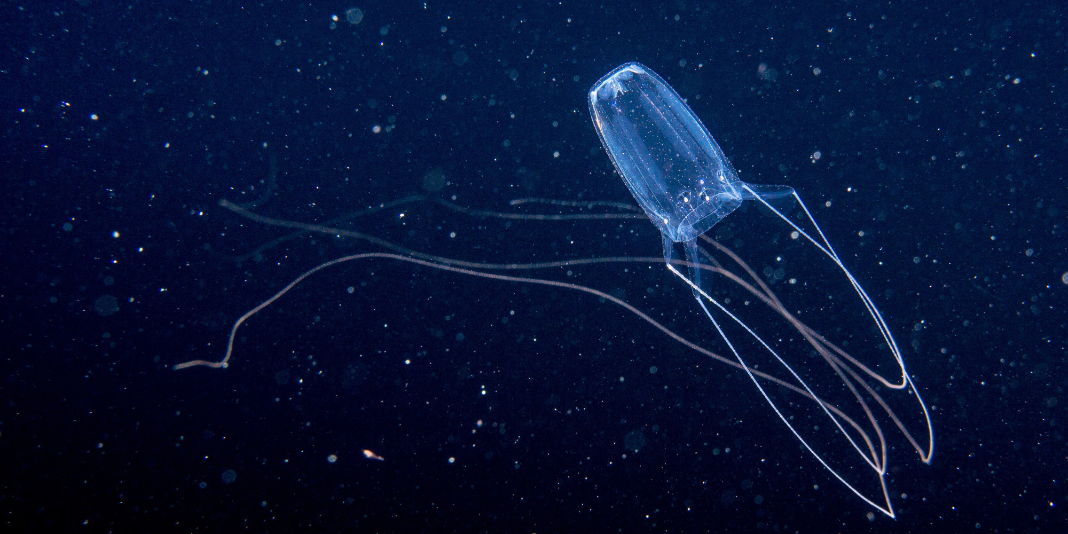
BOX JELLYFISH
BY ISABELLA INDELICATO Y5
ISABELLA INDELICATO Y5

Slide 2
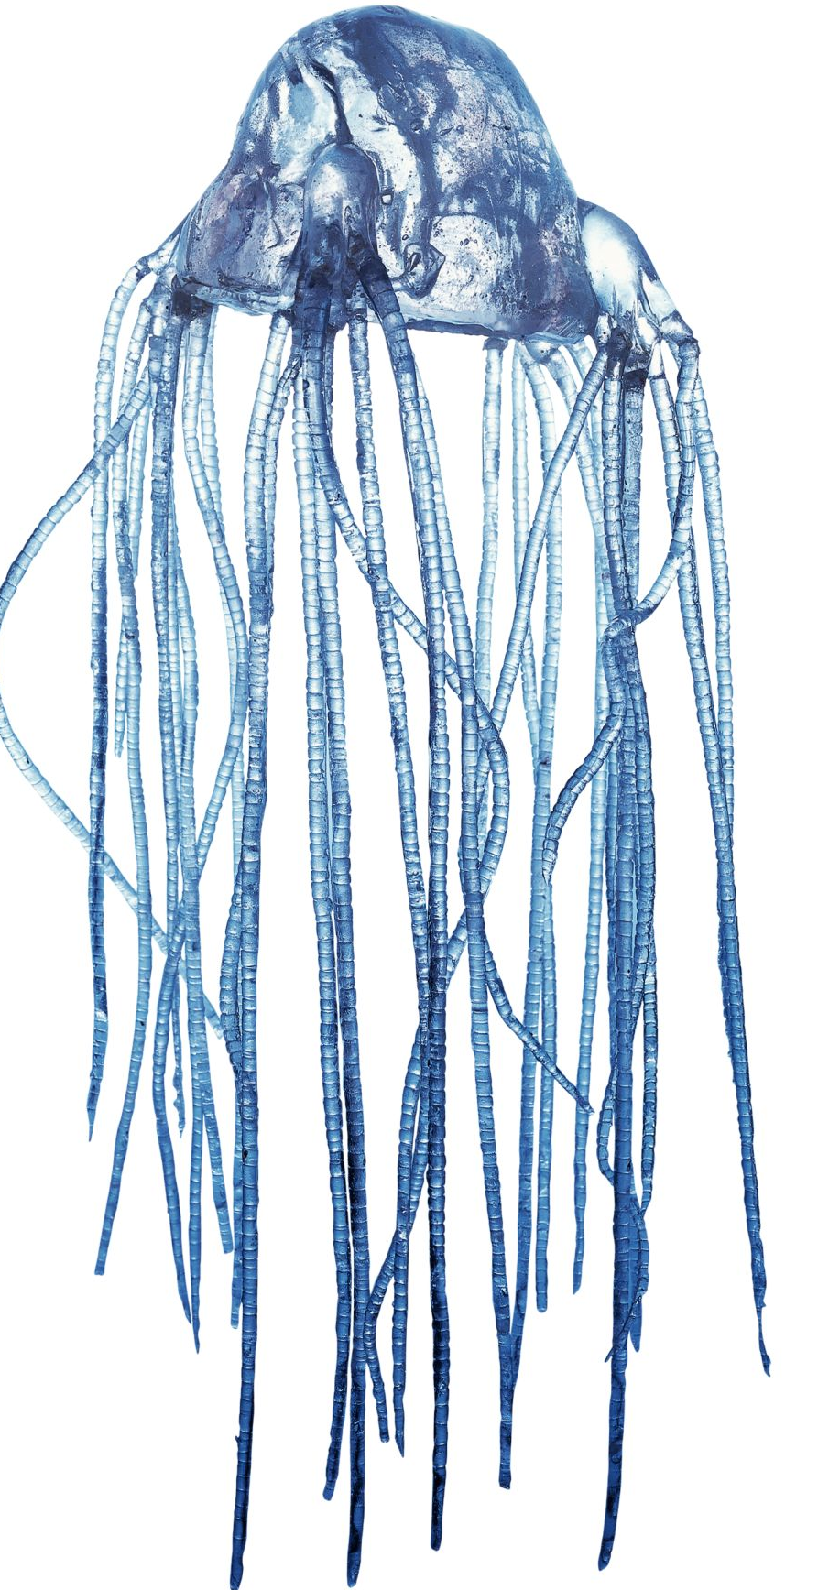
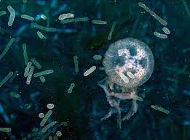
COOL FACTS!
The box jellyfish are not only the most venomous a
nimal in the but the most venomous animal on earth
Other names for the box jellyfish are ‘sea wasps’ or
‘marine stingers’.
They lay eggs but they don’t give birth to live young.
As they are box shaped they have at least 15 tentacles on each side.
The tentacles grow up to 3 meters long!
Box jellyfish with eggs

Slide 3
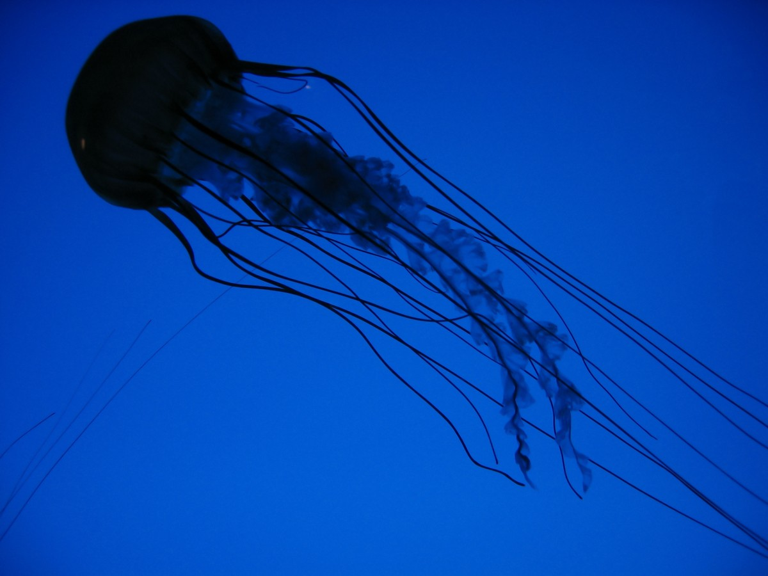
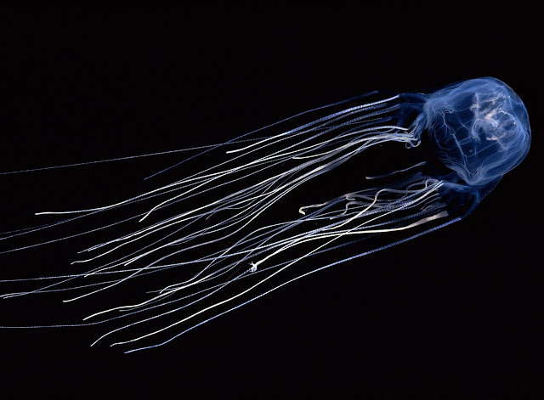
What do the box jellyfish look like?
They are a light blue colour and as all jellyfish are transparent.
They are very similar in look to other jellyfish so hard to tell if you could get badly stung.

Slide 4
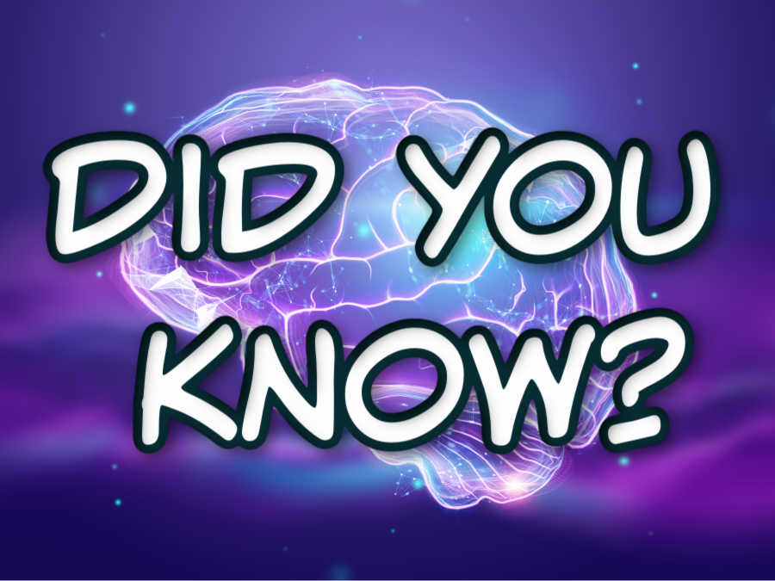
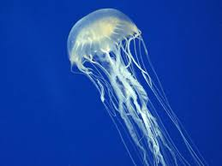
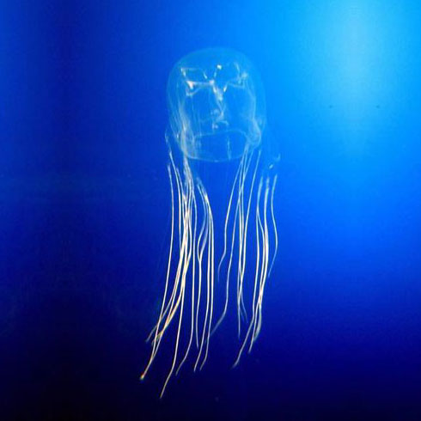
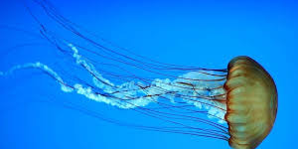
Did you know…?
Box jellyfish have no eyes, no bones, no hearts and no brain!
Each tentacle is covered in thousands of tiny stinger cells
As the box jellyfish is transparent it won’t show up to swimmers until its too late

Slide 5
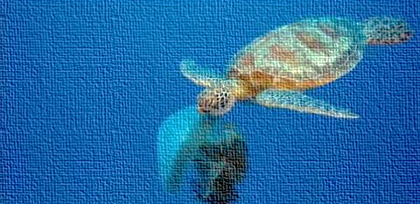
Did you know their average life span is less than a year! Considering they are the most venomous animals on the planet turtles can be predators to the jelly’s!

Slide 6
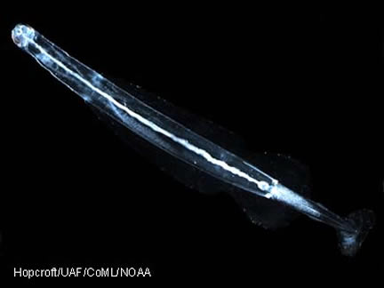
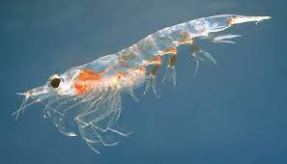
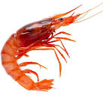
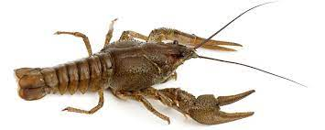
What do box jellyfish eat???
Box jellyfish tend to eat:
Arrow worms
Shrimps
Prawns
Crayfish
Small fish
Arrow worm
Shrimp
Prawn
Crayfish

Slide 7
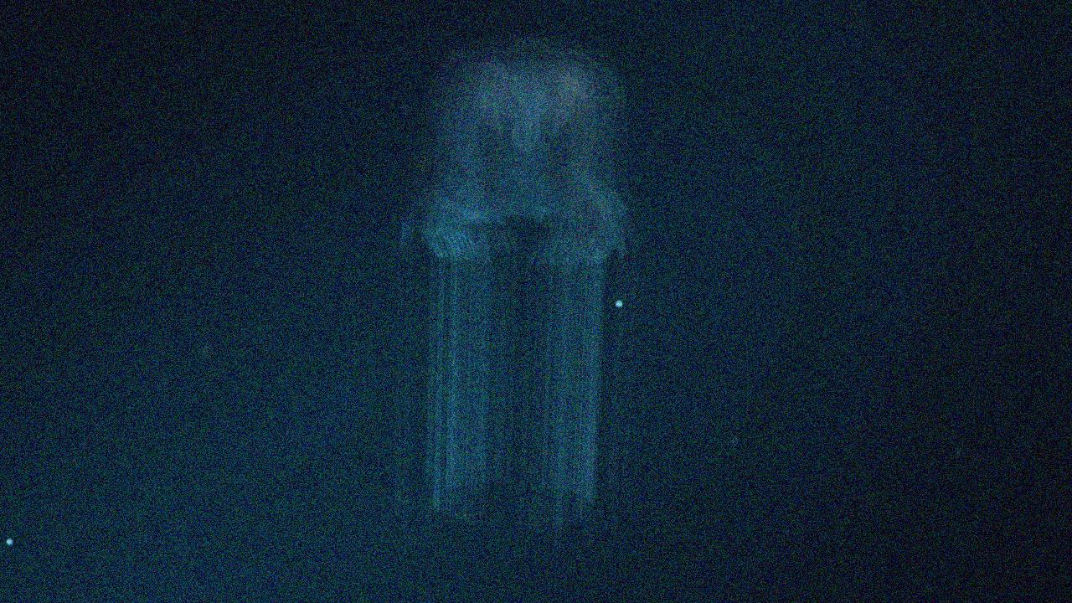
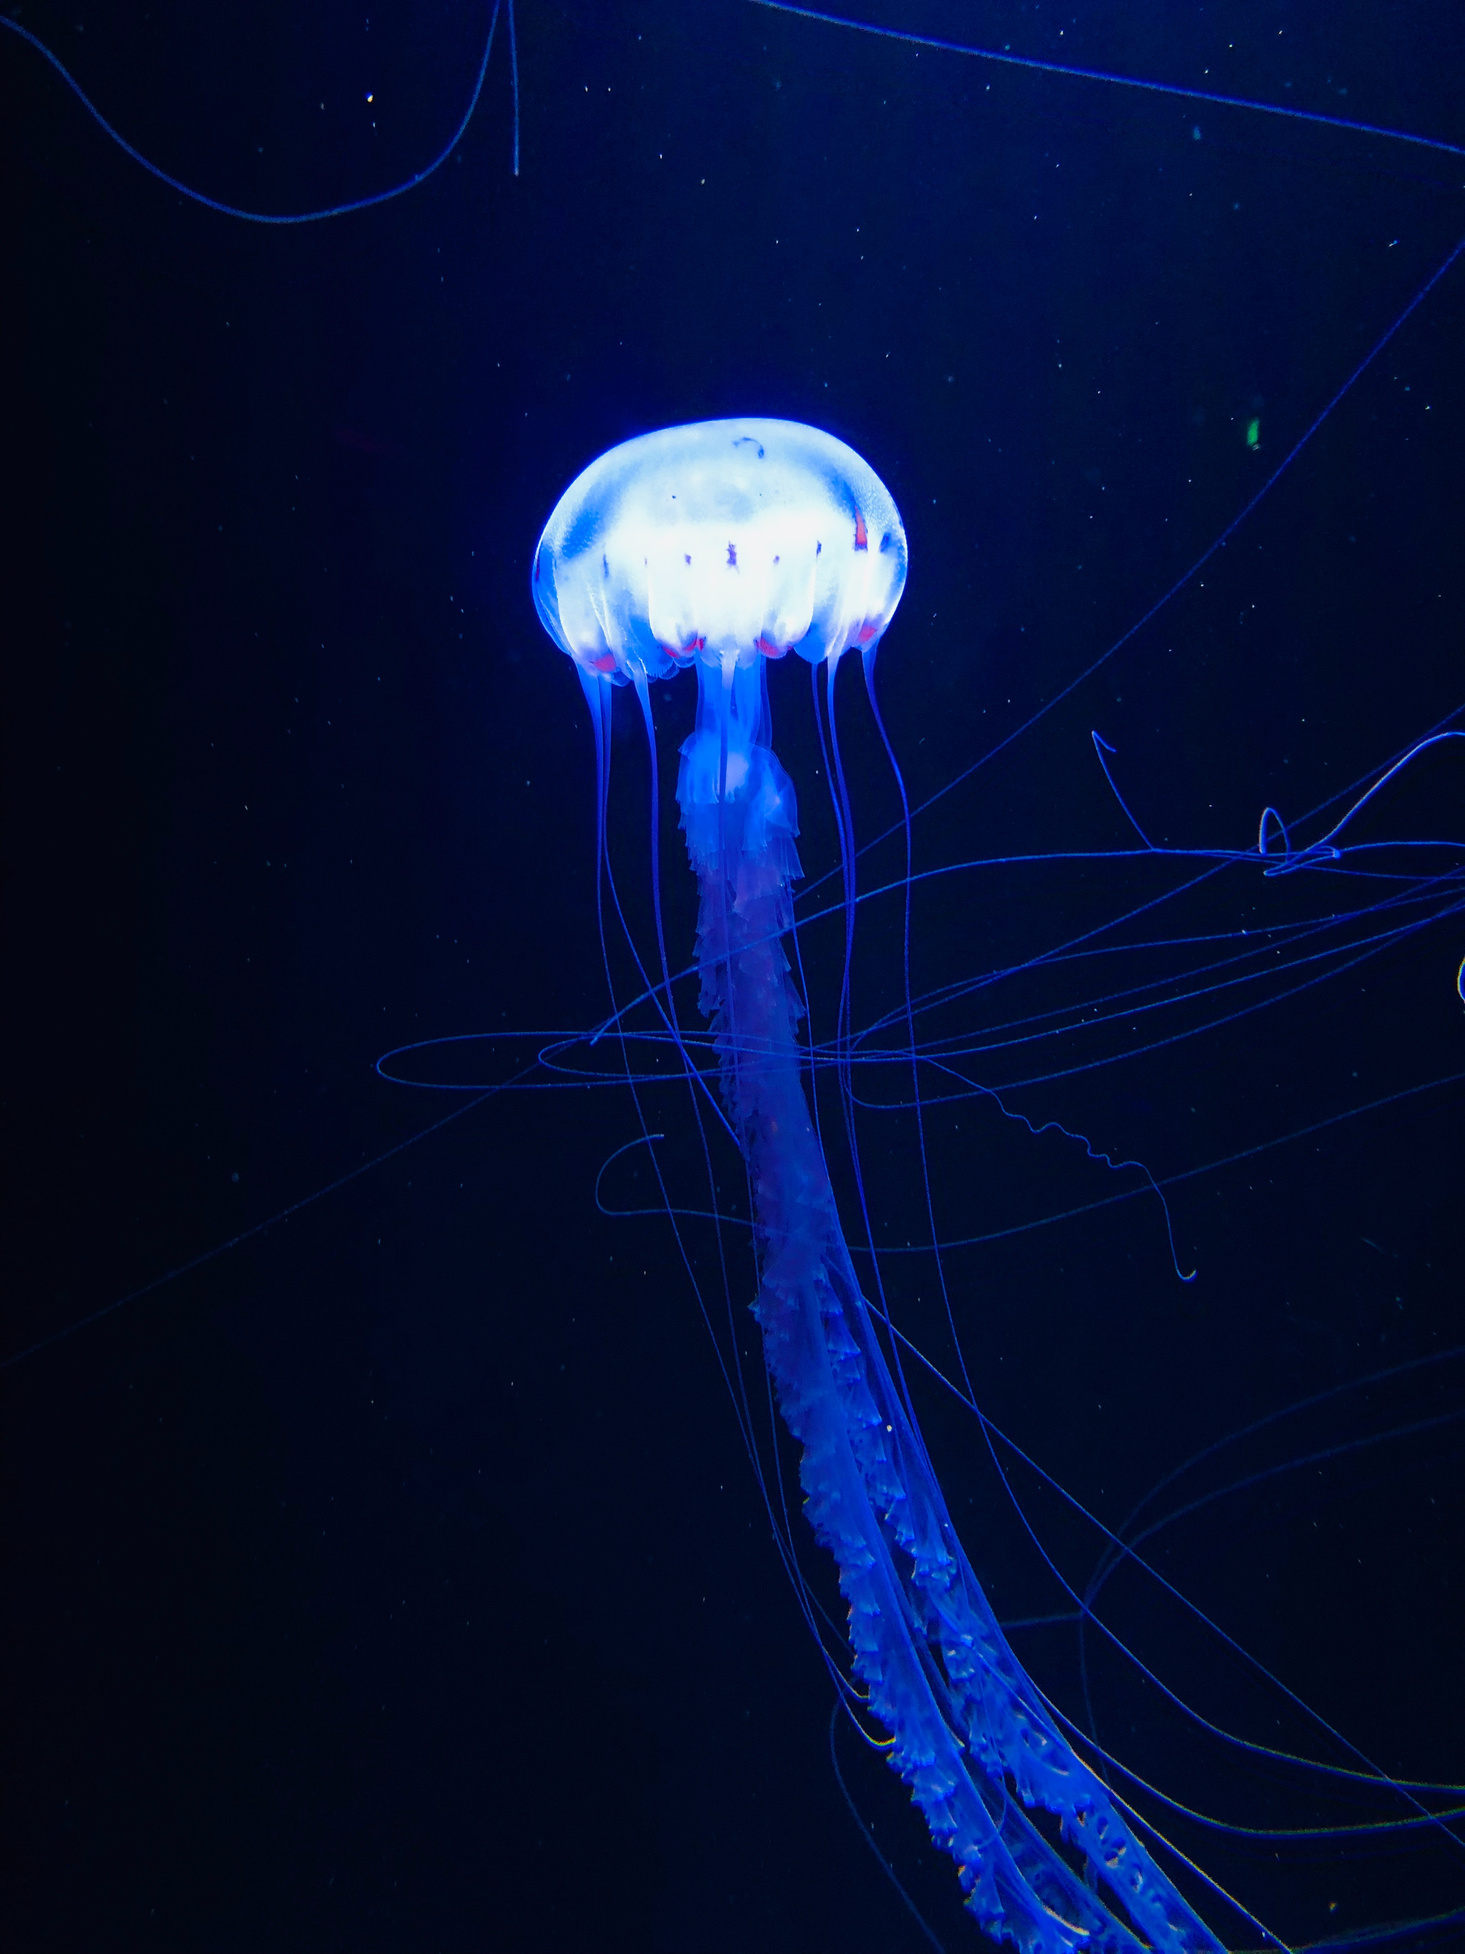
DO BOX JELLYFISH SLEEP?
Box jellyfish do sleep 20 hours a day but that doesn’t mean they can still sting…

Slide 8


QUIZ!
How long do Box Jellyfish’s tentacles grow up to?
Name 2 names given to box jellyfish.
What animals are predators to the box jellyfish?
Name at least 3 or 4 animals box jellyfish eat.
How many tentacles do they have on each side?

Slide 9

QUIZ ANSWERS!
There tentacles grow up to at least 3 metres!
Marine stingers and sea wasps.
Turtles are predators to the jelly’s.
Crayfish, Krill, prawns, shrimps E.C.T
15

Slide 10


TRUE OF FALSE?
Answer these true or false questions
True or false?:
Box jellyfish sleep 10 hours a day.
They are dark blue in colour.
They lay eggs.
The eggs are a circle type shape.

Slide 11




Thank you for reading! I hoped you learned lots about box jellyfish!

