Slide 1
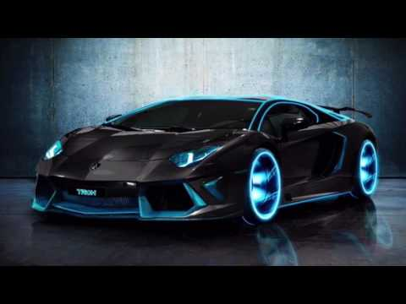
Alfie’s Lamborghini power point hope you enjoy!

Slide 2
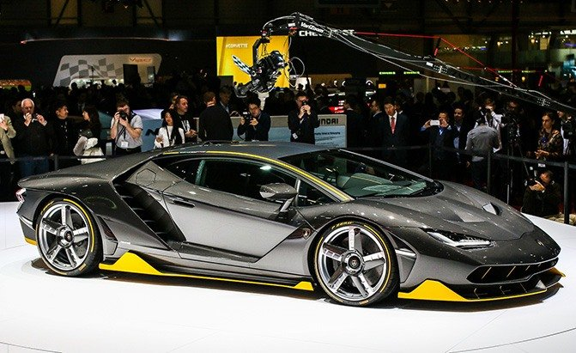
Number one
Did you know you can race with a hired Lamborghini?

Slide 3
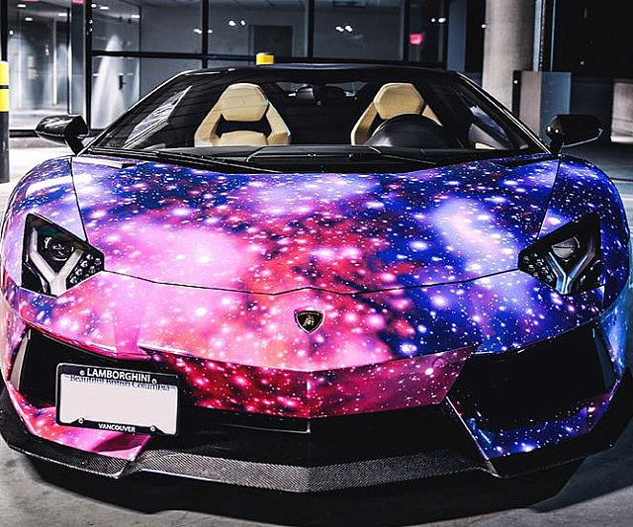
number two
Did you know that Lamborghini started to make tractors?

Slide 4
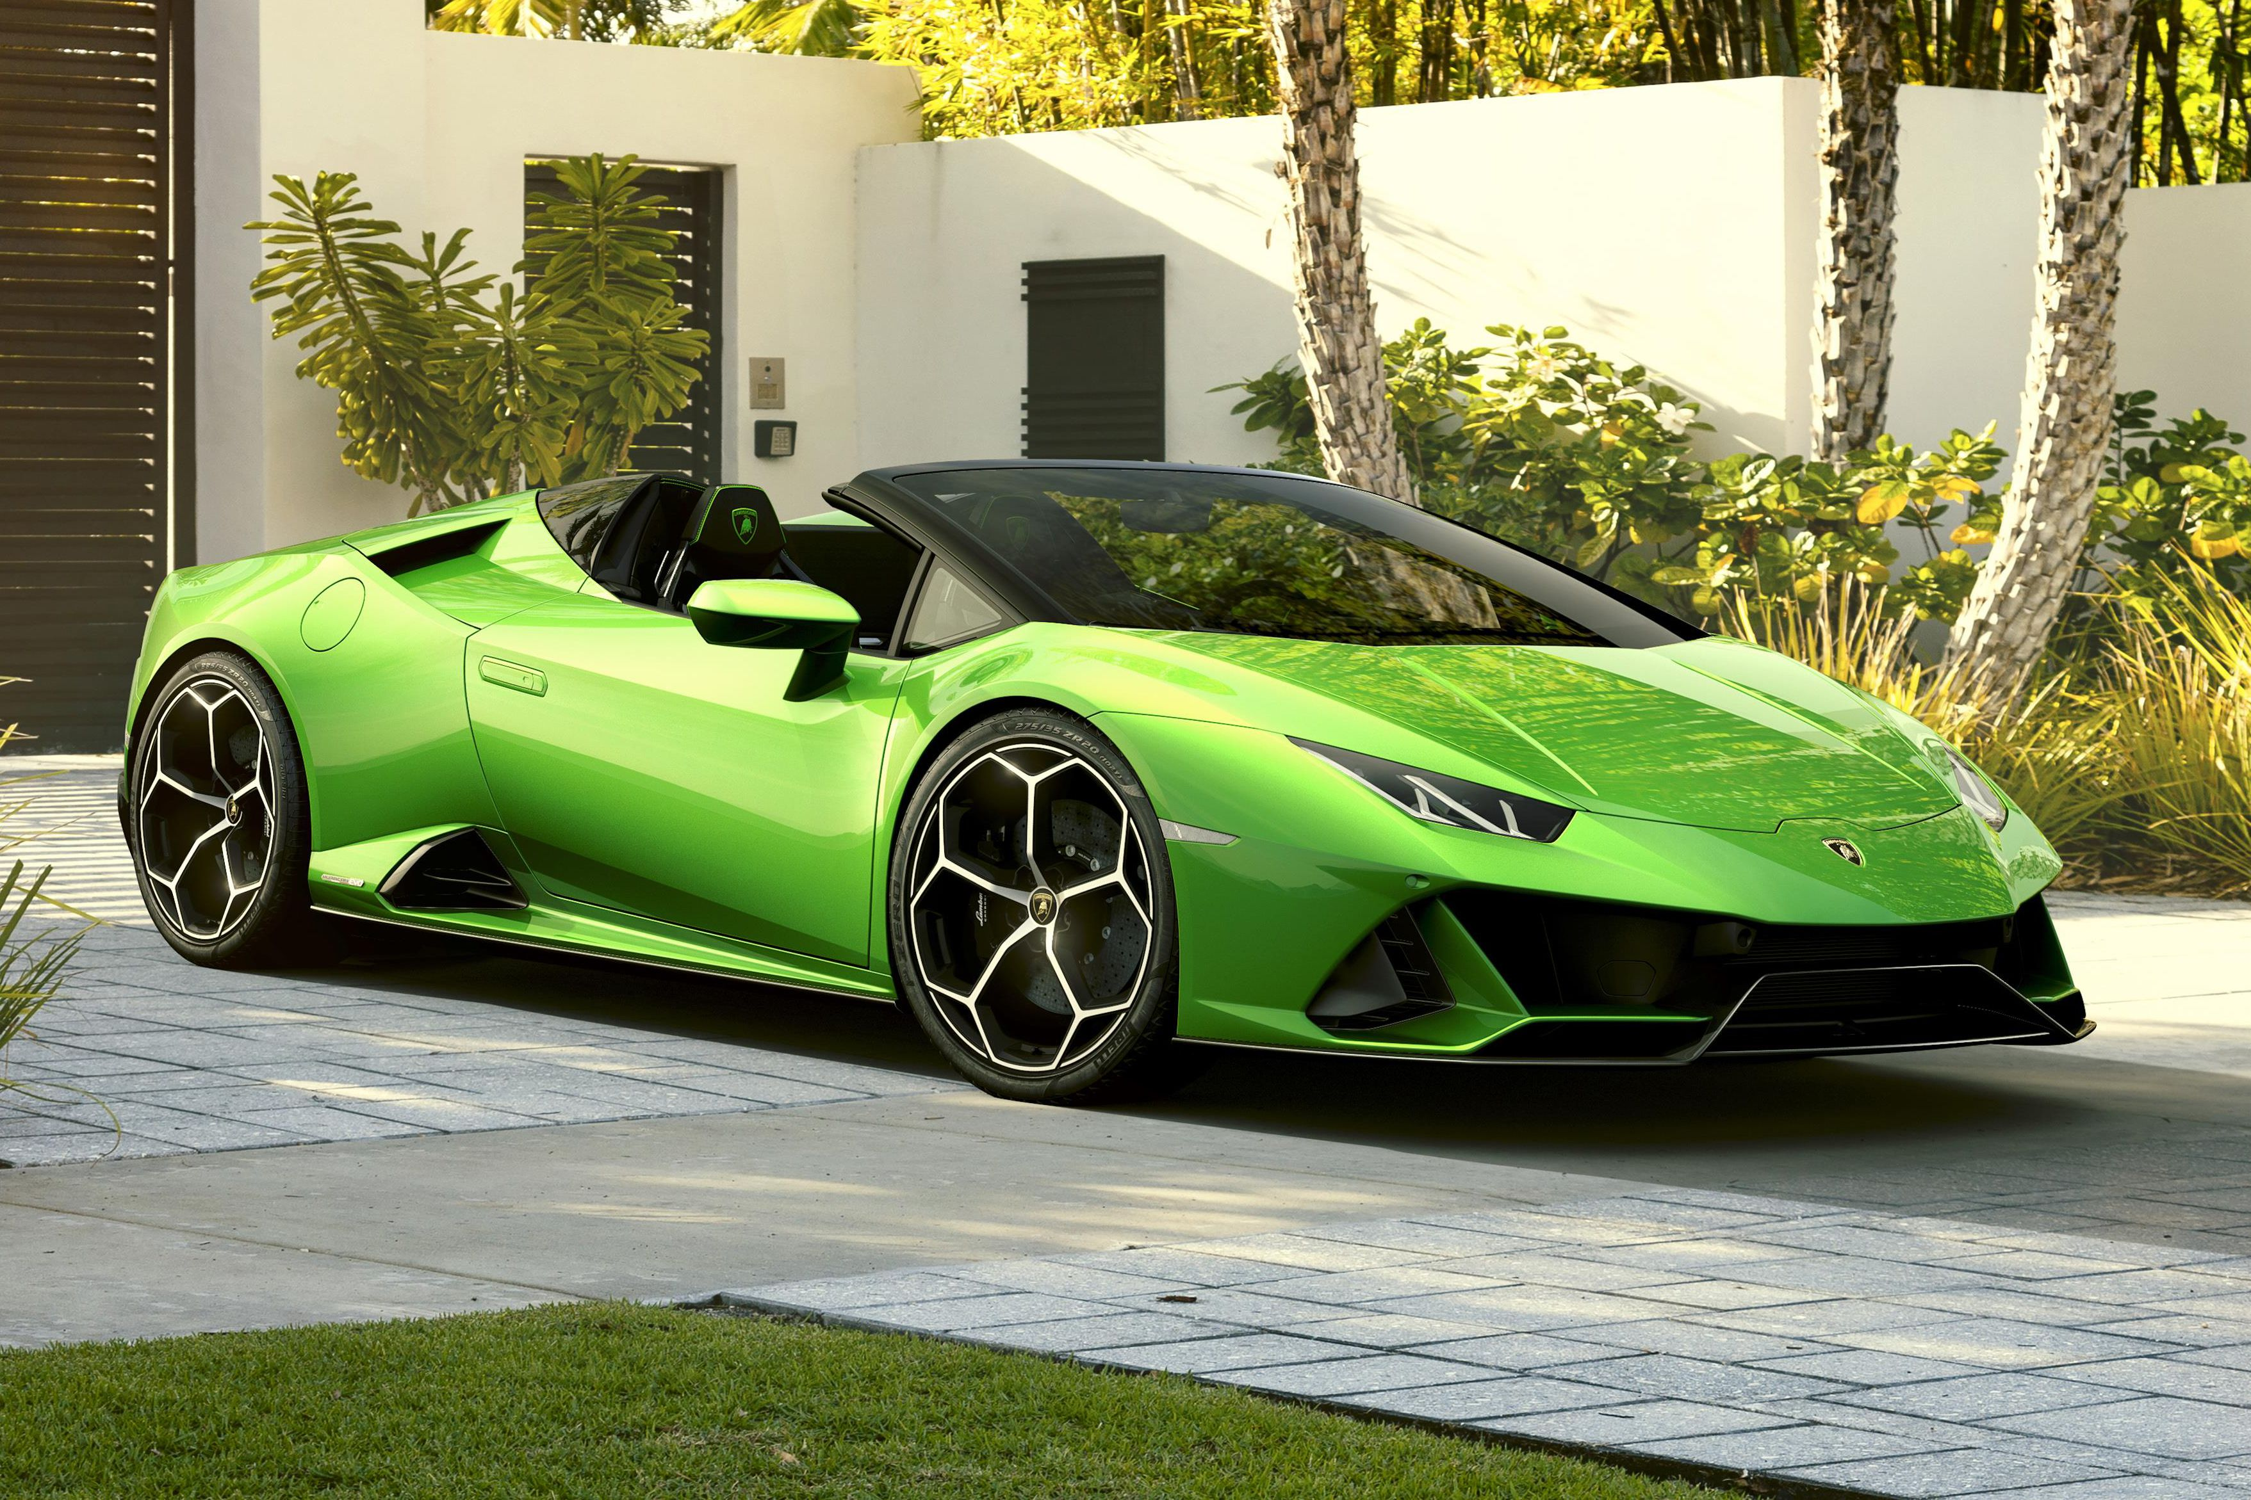
Number three Did you know Lamborghini engines were made out of boat engines?

Slide 5
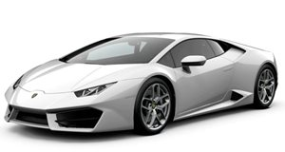
number four
The latest model is the urus SUV!

Slide 6
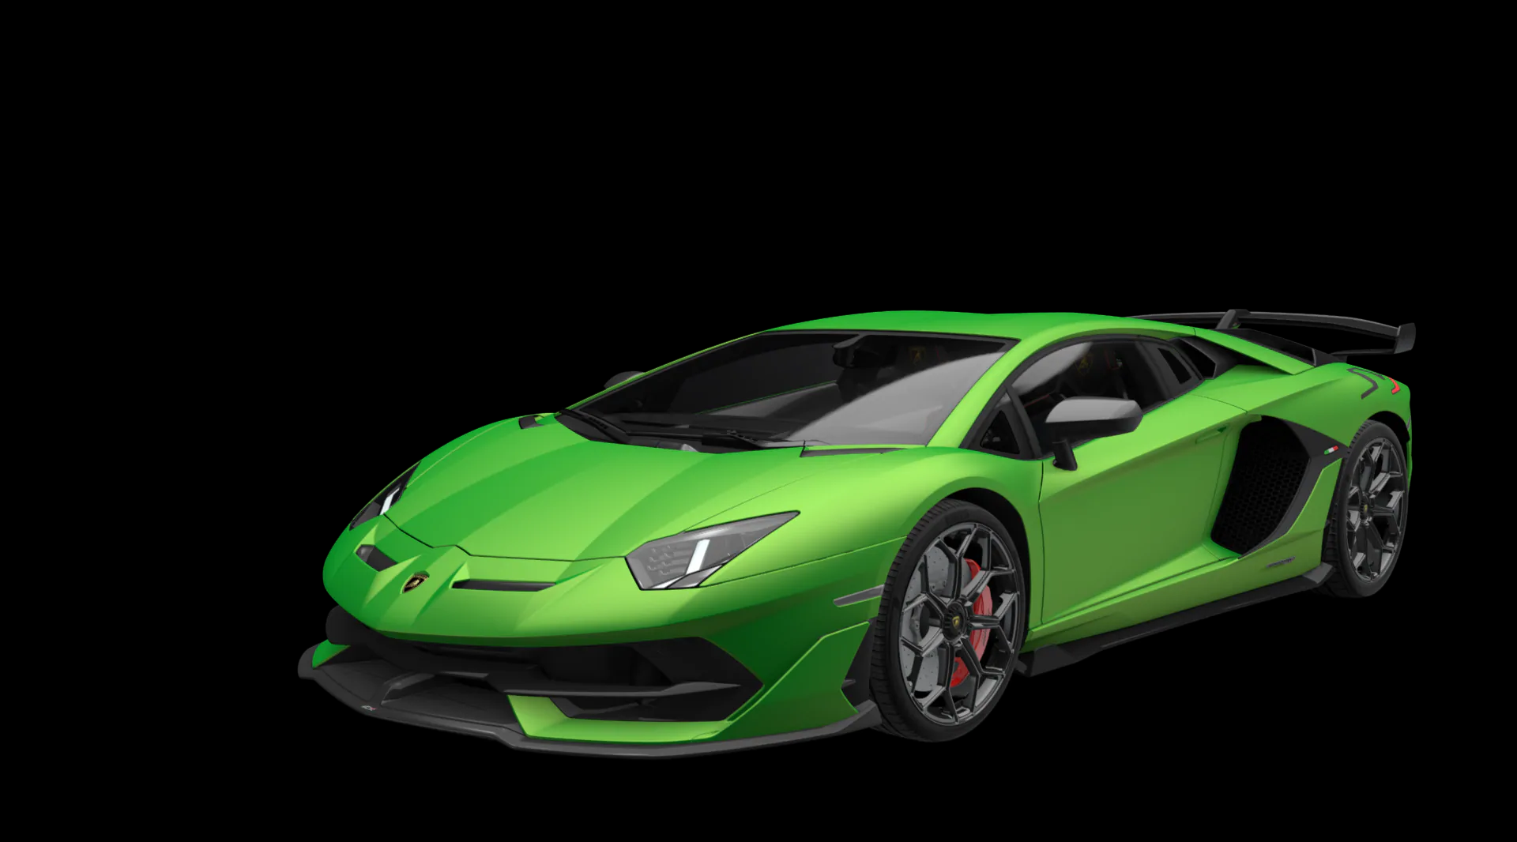
Number five
Did you know the Lamborghini Centenario is the rarest car in the world?

Slide 7
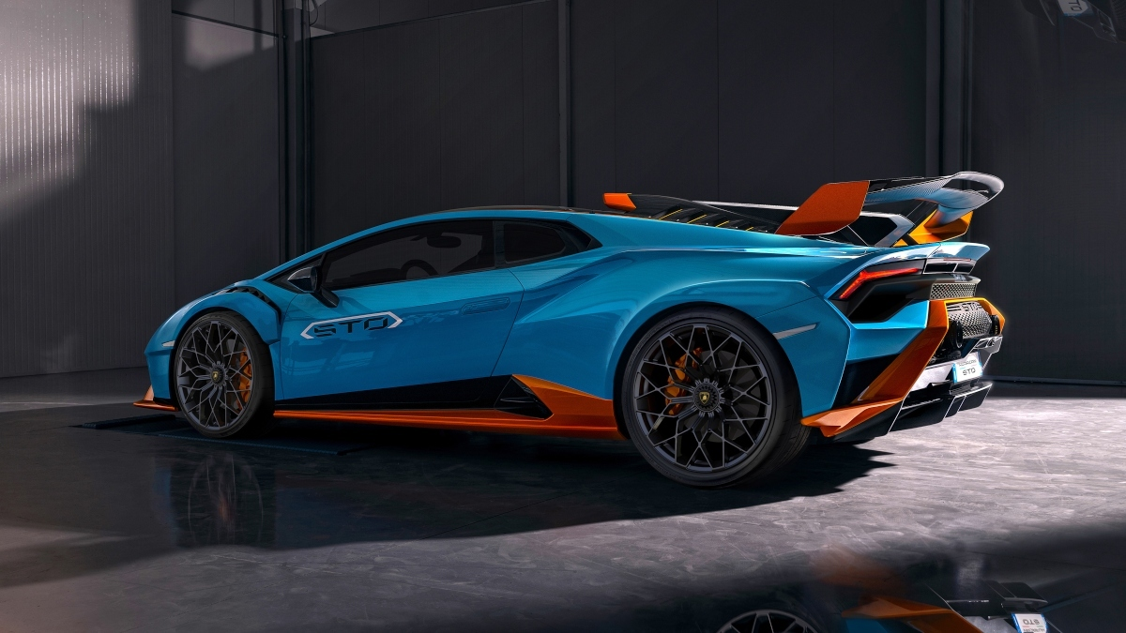
Number six
The person who invented Lamborghini surname is called Lamborghini!

Slide 8
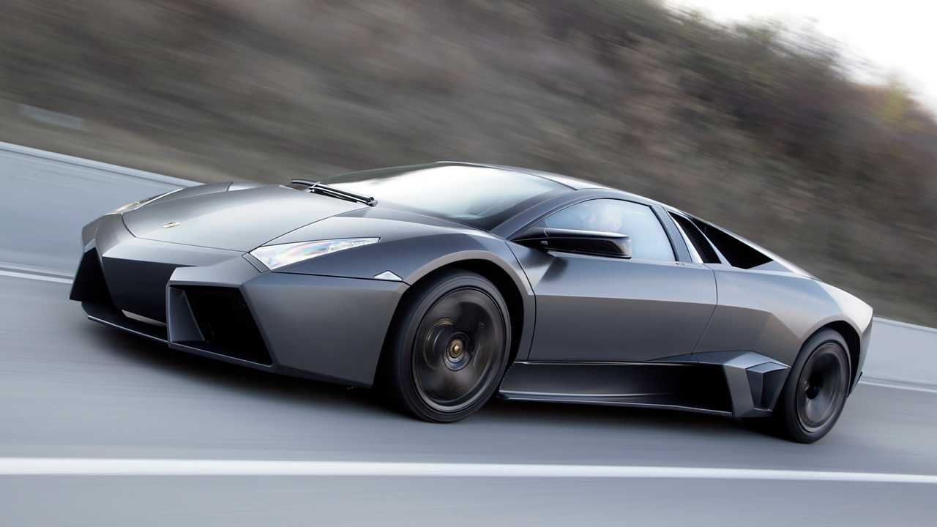
Number five Did you know the fastest Lamborghini goes 221 mph?

Slide 9
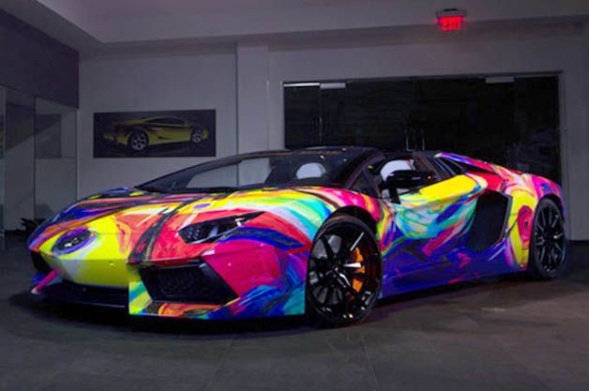
Thanks for watching my Lamborghini power point with me, bye!

