Slide 1
Changes to spelling homework
Parent Forum – 27th September 2018
Welcome!

Slide 2
Why?
The spelling expectation has risen with the current curriculum.
Our spelling is not as consistently good as it could be.
This is preventing children achieving ARE and ARE+ in writing.
Spelling words that are sent home are learnt by rote, and are not always applied in future writing.
Spelling lists do not help children to apply spelling or phonics rules to unknown words in their writing.
Already this term, we have had an expert in spelling come to guide our new strategy, and, where she has seen this format applied, she has seen great improvement in independent applied spelling.

Slide 3
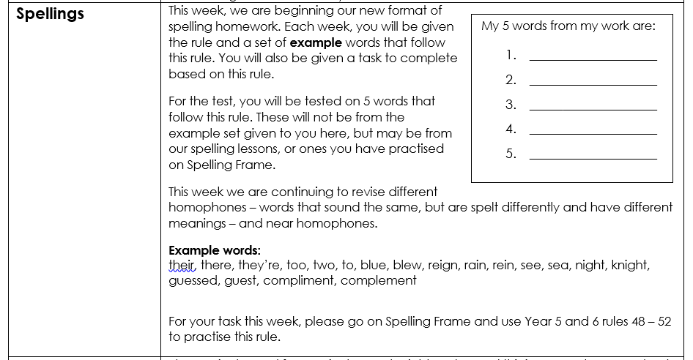
What?
Instead of a list of words sent home, children will be given a task linked to the spelling or phonics rule/s they are learning that week. For example, correct a passage with mistakes made using the rule, find x amount of words that follow that rule, use Spelling Frame to help you know a range of words.
There will be a set of example words that follow the rule given – these will not be the words tested.
Children will be given unknown words during the Friday test that follow the rule they have been learning. This will help develop the children’s ability to spell unknown words.
Lime and Elder will continue to have 5 spelling errors from their own work to learn, as this is crucial to aiding ‘catch up’ with everyday words.
Common exception words, and word list words will not be tested weekly, but it is expected that the children work on these words at home, as ongoing learning.

Slide 4
When?
We will be sending this format out in this week’s homework.
This will be today, as we have an Inset day tomorrow. This is good, as it gives everyone an extra day to have a go at this format.

Slide 5
What do you think would help?

