Slide 1
Parents Forum
Spelling and Reading Passports

Slide 2
Spelling

Slide 3
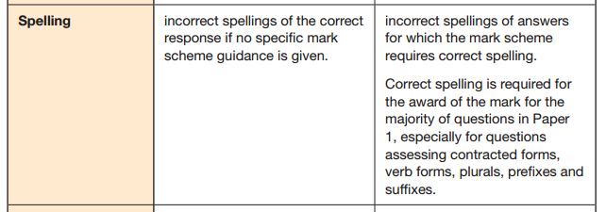



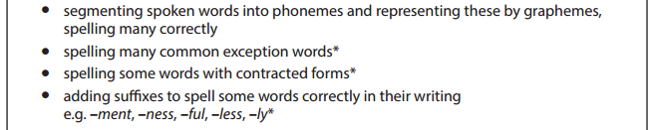

Why do we need to focus on spelling?
The goalposts for spelling have shifted with the introduction of the ‘new’ National Curriculum (NC14)
Last year was the first year that the new curriculum was tested at the end of Key Stage 1 and 2.
In the Grammar, Punctuation and Spelling test (GPS), spelling is tested alone, but spelling must also be accurate in the short answer paper for marks to be awarded. From the KS2 GPS mark scheme
In the teacher assessed writing, assessment has become ‘total fit’,
not ‘best fit’. This means that every objective in the Interim Assessment
Frameworks (IAF) must be evidenced to enable a child to be ‘working
at the expected standard’.
We found that spelling was an area that let us down in writing, mainly due to the shift in expectations.

Slide 4
Let’s have a go!
Which of these spellings are Year 1, Year 2, Year3/4, Year 5/6, KS3?
beautiful amateur medicine participation correspond therefore clothes questionnaire house possession mischievous said children whole
our consider miscellaneous occasionally
everybody accommodate improve today immediately separate technique friend murmur pronunciation

Slide 5
Let’s have a go!
Which of these spellings are Year 1, Year 2, Year3/4, Year 5/6, KS3?
beautiful amateur medicine participation correspond therefore clothes questionnaire house possession mischievous said children whole
our consider miscellaneous occasionally
everybody accommodate improve today immediately separate technique friend murmur pronunciation

Slide 6
What are we doing?
Spelling lessons and spelling homework
All classes now have spelling or phonics lessons at least two times a week. These spelling lessons correspond to the spelling lists that are sent home as homework. For example, Year Six have been learning about homophones ending in ‘ce’ or ‘se’ in their spelling lessons, and have related words for their spelling words.
By using spelling lessons, we are encouraging the learning of the rule rather than a set of words on a list. Learning the rules of spellings e.g. homophones with ‘ce’ are nouns (licence) and those with ‘se’ are verbs (license) is crucial, as this is how we can enable children to spell unknown words.
We are still sending spelling lists home, however these may now sometimes consist of, for example, only five given words following the rule. The other five in the test would then be ‘mystery’ words, where the children have to apply the rule being taught. An accompanying spelling task to practice the rule would also be sent home with the list.

Slide 7
What are we doing?
Marking spelling in books
The application of spellings and rules learnt into their written work is absolutely crucial for the children to be able to do. As we have seen, without this, they cannot meet Age Related Expectations (ARE).
In books we are now using orange pen or highlighter to indicate spelling errors. Where the word is an adventurous word, we will give the child the spelling. Otherwise we will indicate by highlighting or circling the section of the word that is in error, and give the child the opportunity to have another go, with support as needed. The amount of spelling errors indicated is at the teachers discretion – we do not want to cover a child’s hard work in orange pen and demoralise them!
High frequency words, and words that should be known (age dependent e.g. ‘said’ in Year 5) will always be picked up, and the child will need to write them out a certain amount of times in their book.
In Year Six, as the year progresses, spelling errors should not be indicated by the teacher as part of the marking (to allow for accurate assessment), however, children can verbally be told how many errors they have. They then have to seek them out and correct them.
In Year 2, as the year progresses, spelling errors can be indicated by the teacher (e.g. by highlighting), but children must correct them independently.

Slide 8
What are we doing?
Keep up/ catch up
We need to be aware of those children who find spelling difficult, and may be behind with their year group spelling, especially with the more challenging spelling requirements of NC14.
At St. Mary’s, we do not want children to be constantly trying to catch up with the expectations of their year group. Therefore, spelling lessons and spelling homework, will be linked to their current year group and catch up work will be completed within the school day. This ensures that the children are able to keep up with their age related spelling expectations, but also fill any gaps from previous years.
Now that we have the experience from last years assessment, this is the area that we will be refining and structuring to meet the needs of our children over the course of this year.

Slide 9
Spelling Pedagogy
We are creating a spelling pedagogy document for St. Mary’s, to ensure consistency and high expectations across the school.
The pedagogy outlines what happens in each class with relation to the teaching and learning of spellings, and also the marking of spellings within school exercise books.
The final element to be added will be the keep up/catch up section. It is extremely important that we get this section correct for our children, therefore this will be worked on throughout the year to ensure it fits our children, vision and values.

Slide 10
Reading Passports

Slide 11
Why the continued focus on reading?
We are already really good at reading at St. Mary’s! Our children are enthusiastic about reading and enjoy reading for pleasure.
We have a well stocked library, where books are changed three times a year by the School Library Service (SLS), and all classes have a reading area/bookshelf with age appropriate books.
However…we have noticed that children can become stuck in bubble of reading the same author or genre for a long time, and we need to encourage breadth and depth in our children’s reading.
So we have come up with a plan!

Slide 12
Our Reading Journey!
Shhh! The children do not know this yet! Please keep it under wraps until we launch with the children. Please do not take any of the resources – there is a precise amount for the children currently in the school!
We have developed our own ‘Reading Journey’ for St. Mary’s. Each child will be given their own reading passport, which will take them on a journey around different places:
Oak – Hampshire, Ash – Great Britain, Lime – Europe, Elder – the Rest of the World
Each class has ten different locations to ‘visit’ within their overall map. Each location has two books to read. Some of these are specific titles, others are a free choice within a genre/ authors collection.
When the children have read a book from their passport, the passport will be ‘stamped’ (sticker!) If the children complete the whole journey (20 books) they will be awarded a special certificate in Sharing Assembly.

Slide 13
How will it work?
We do not envisage this being a quick ‘journey’, children can take up to the end of the school year to read around all their locations.
Children, with parental support where needed, can decide how they want to complete their journey e.g. focus only on the reading journey books until complete, read one passport book followed by one of their own choices etc. We do not want this to turn into an onerous task for children – they need to complete it in a way that is best for them.
Reading for the reading journey is recorded as usual in the Home/School Link books. Children in Lime and Elder can write in their thoughts about the books if they like.
Each classroom will have a map with pins to track where each child is on their reading journey.

Slide 14
What could the snags be?
Children have already read one of the specific books in their passport.
  Teacher will give another title of the same genre/ author.
Oak Class – will they have to read the books themselves?
  Some books will need to be read with by an adult, with the children reading any words/ sections they can.
Over to you!

