Slide 1
Parents Forum
Monday 27th June

Slide 2
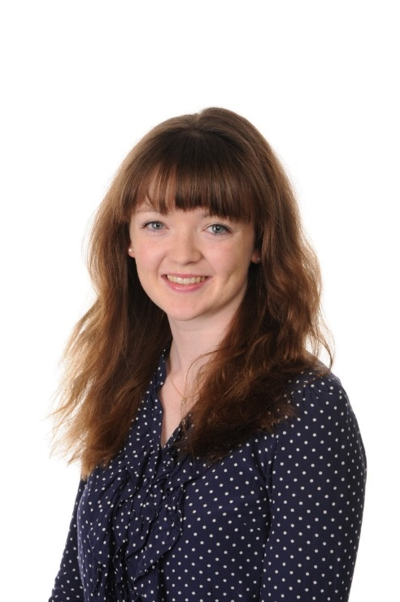
Mathematics: St Mary’s approach to the new curriculum
NOTE:
To change images on this slide, select a picture and delete it. Then click the Insert Picture icon
in the placeholder to insert your own image.
Our Mathematics Co-ordinator

Slide 3
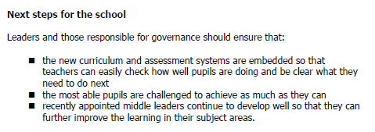
High Achievers
Ofsted feedback and what it means for us

Slide 4
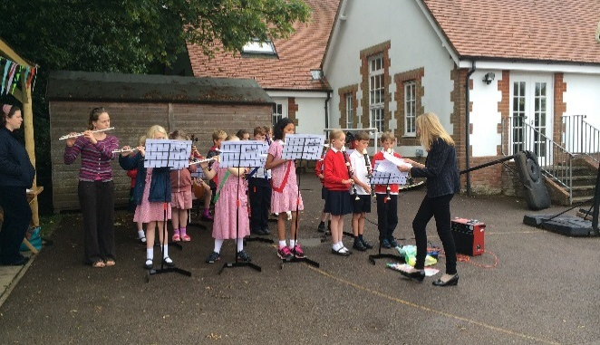
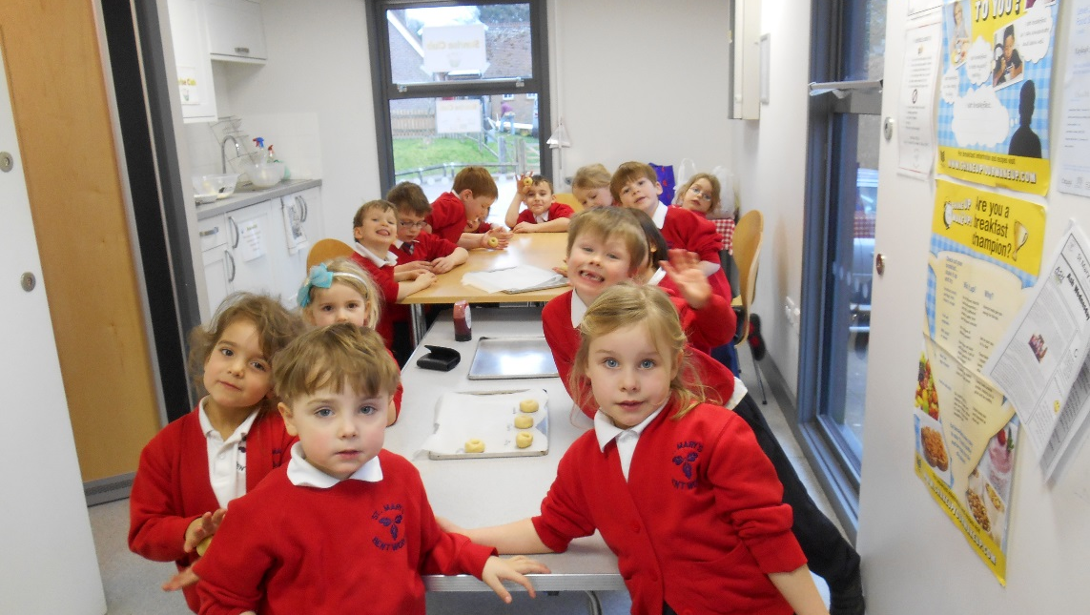
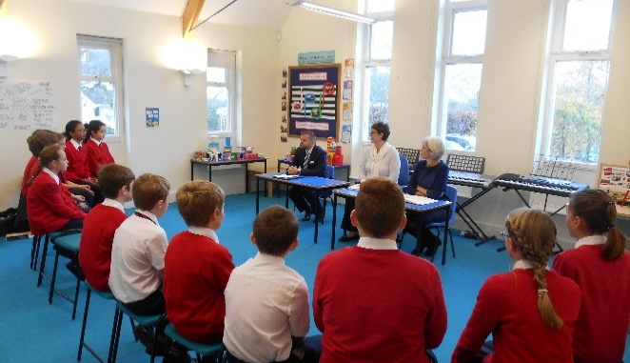
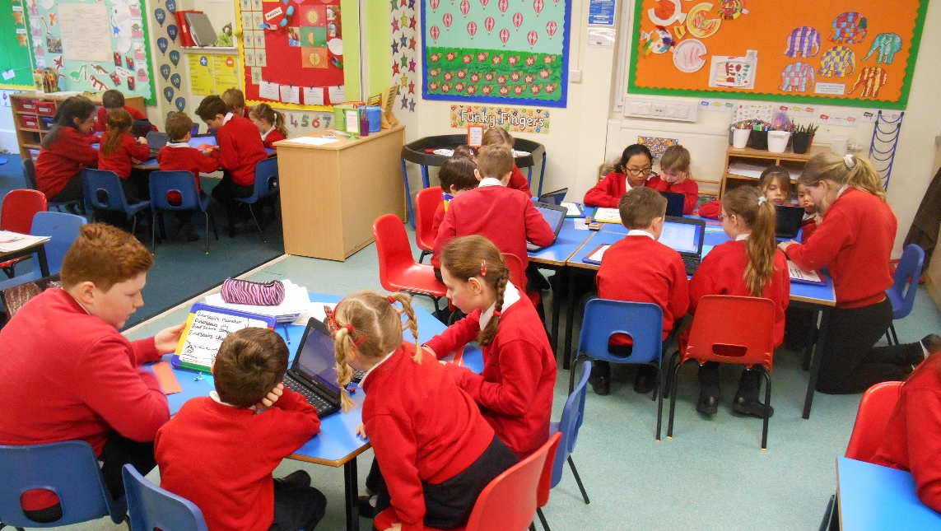
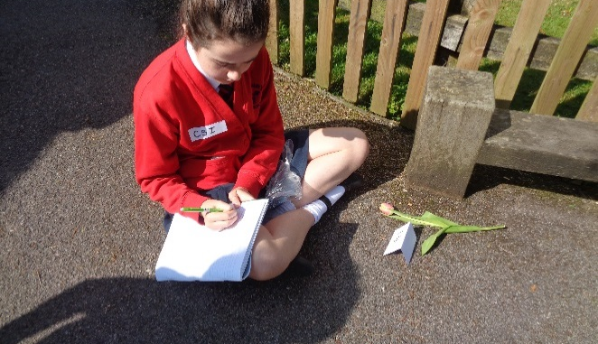
NOTE:
To change images on this slide, select a picture and delete it. Then click the Insert Picture icon
in the placeholder to insert your own image.

Slide 5
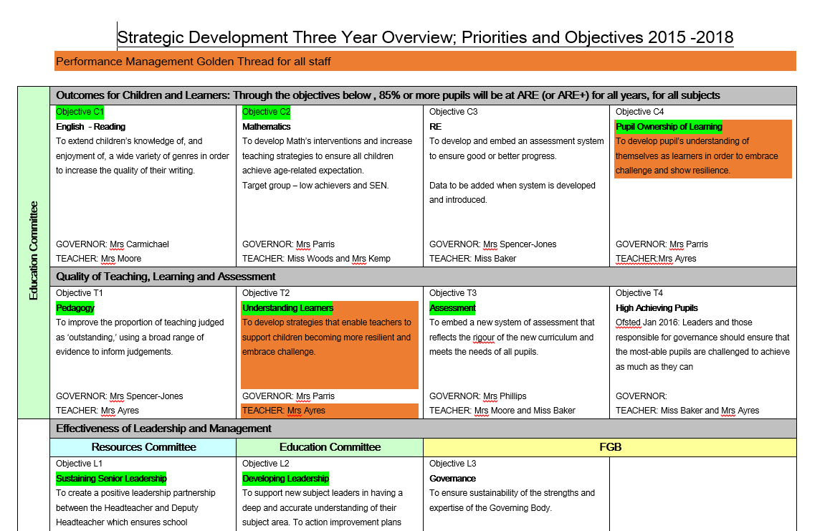
School Development Plan

Slide 6
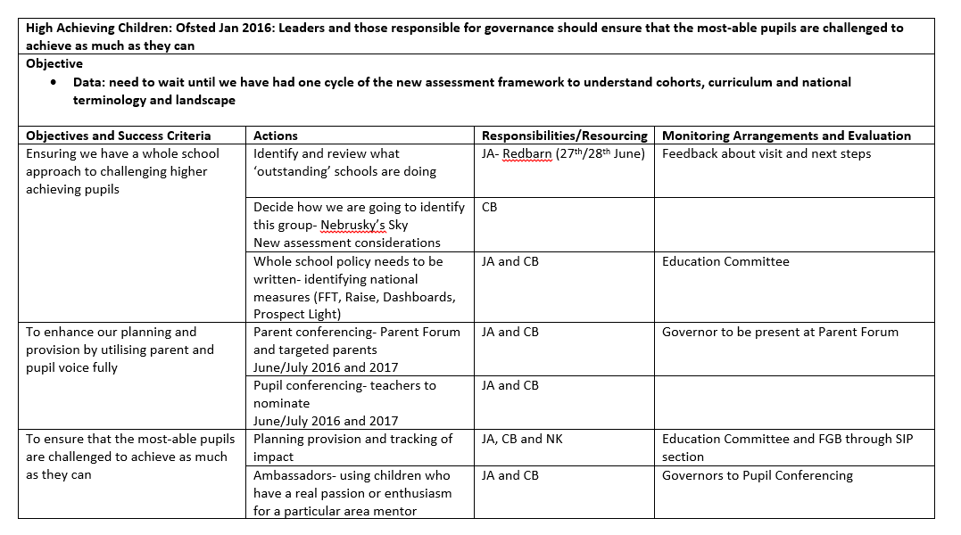
High Achievers Action Plan

