Slide 1


The New Curriculum and Assessment at
St Mary’s Bentworth CE Primary School

Slide 2
Today’s information session:
Changes to the curriculum
Raised expectations
Key objectives
Test paper examples – don’t worry you don’t need to answer them all! (34 slides!)
Statements from the key objectives
Tracking progress
What to expect from Annual Reports and parents evening
The bigger picture!

Slide 3
Changes to the New Curriculum
Higher Expectations!!!!
•Stronger emphasis on vocabulary development, grammar, punctuation and spelling
•Spoken English has a greater emphasis, with children to be taught debating and presenting skills
•Five-year-olds will be expected to learn to count up to 100 (compared to 20 under the current curriculum) and learn number bonds to 20 (currently up to 10)
•Simple fractions (1/4 and 1/2) will be taught from KS1, and by the end of primary school, children should be able to convert decimal fractions to simple fractions (e.g. 0.375 = 3/8)
•By the age of nine, children will be expected to know times tables up to 12x12 (currently 10x10 by the end of primary school)
•Calculators will not be used at all in primary schools, to encourage mental arithmetic
TheSchoolRun.com www.theschoolrun.com/

Slide 4
Changes to the New Curriculum
Key objectives and key performance indicators
Found on the school website – Parents – Useful information
New Tests - including Year R baseline (47 yes/no questions)
http://earlyexcellence.com/eexba/
GOV.UK website
www.gov.uk/government/collections/national-curriculum

Slide 5
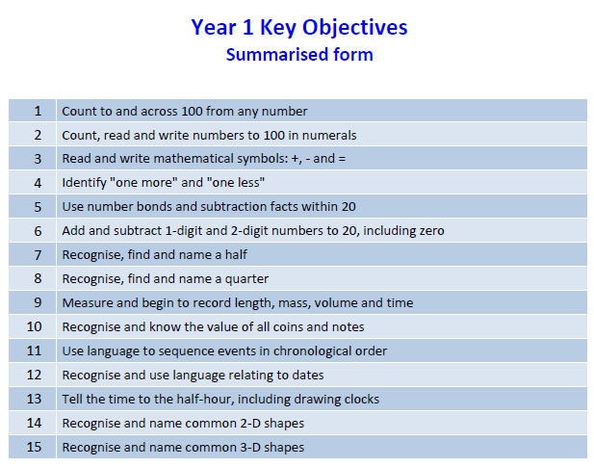
Maths example

Slide 6
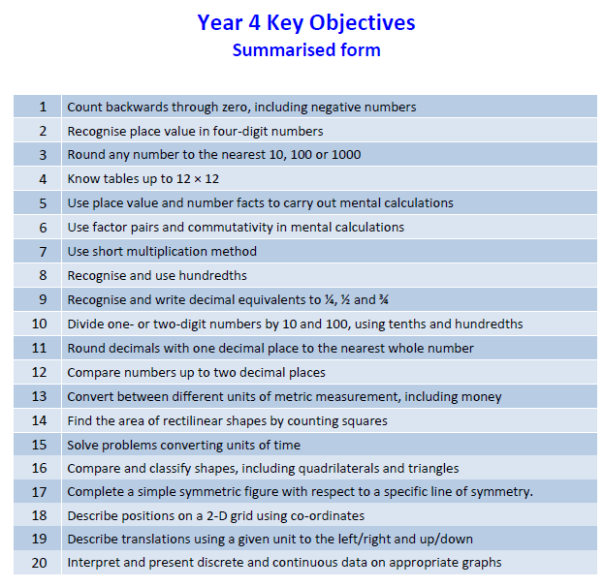
Maths example

Slide 7
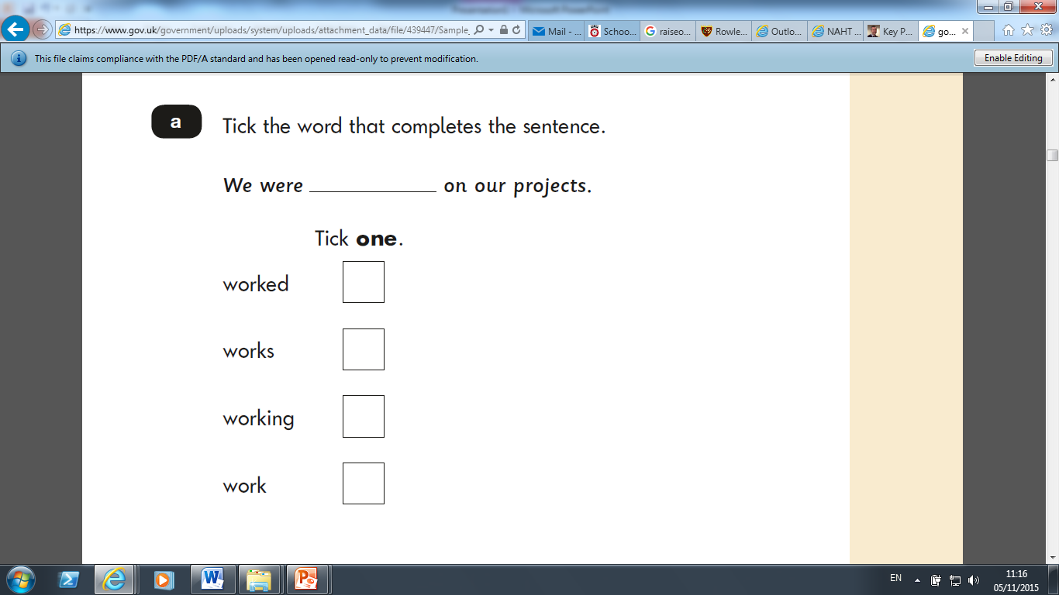
YEAR 2 GRAMMAR
Key Stage 1 Grammar

Slide 8
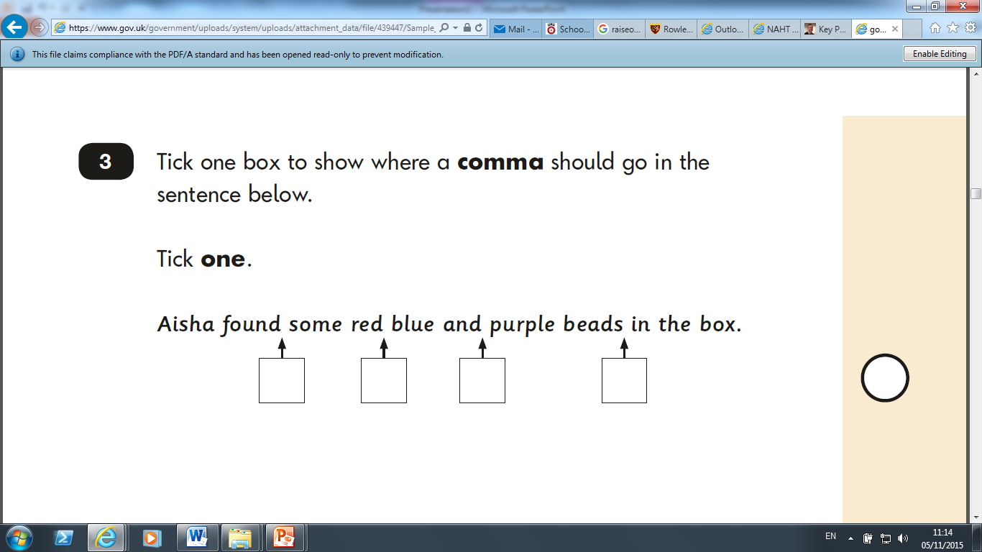
YEAR 2 GRAMMAR

Slide 9

YEAR 2 GRAMMAR

Slide 10
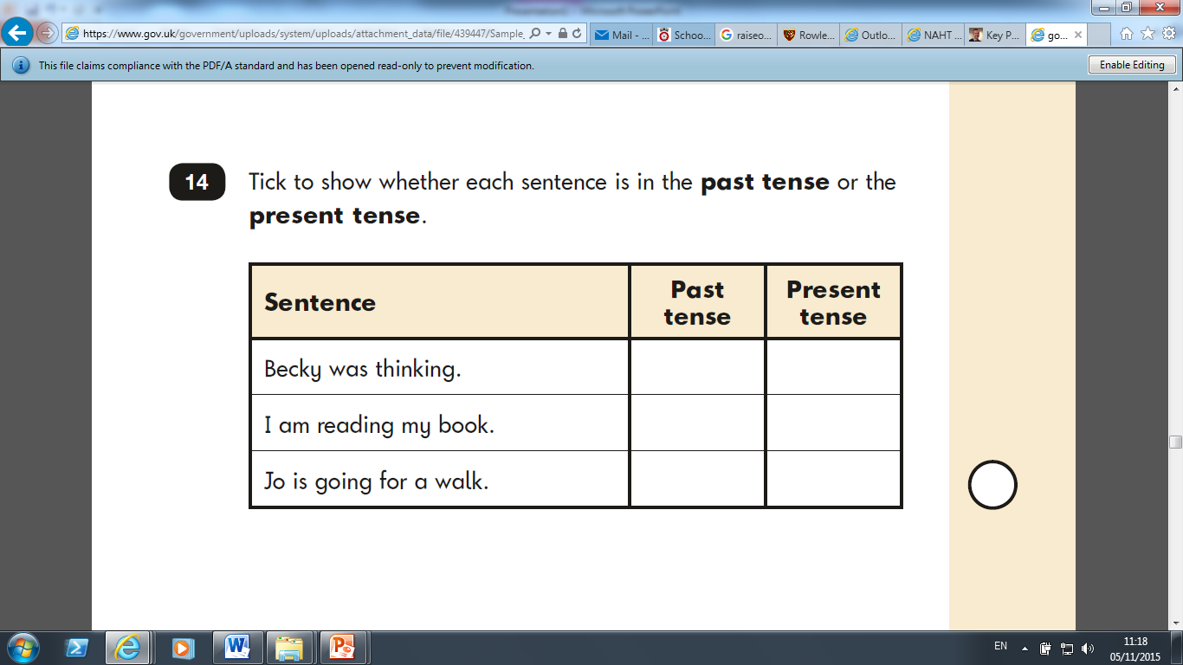
YEAR 2 GRAMMAR

Slide 11
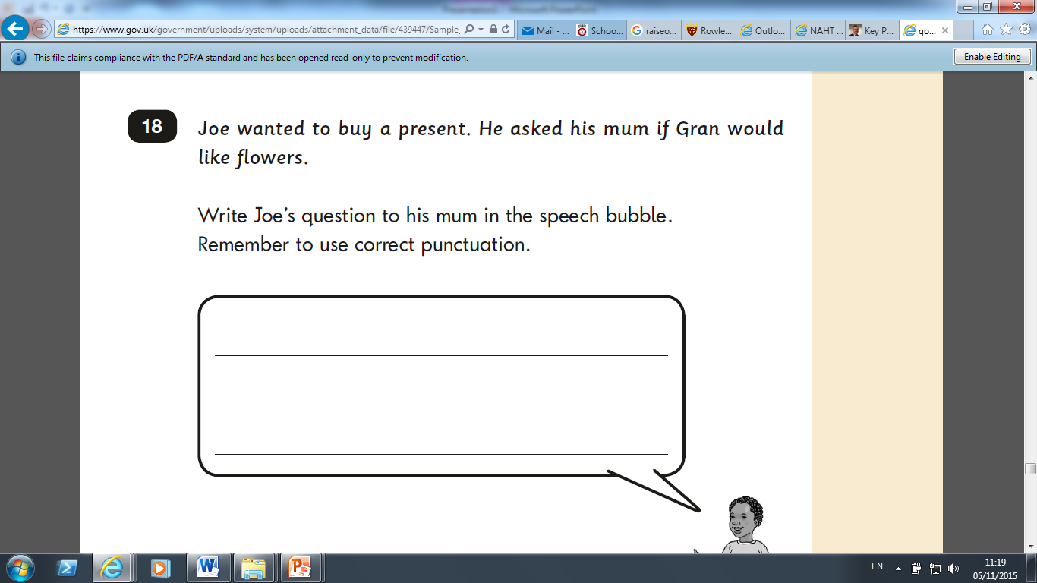
YEAR 2 GRAMMAR

Slide 12
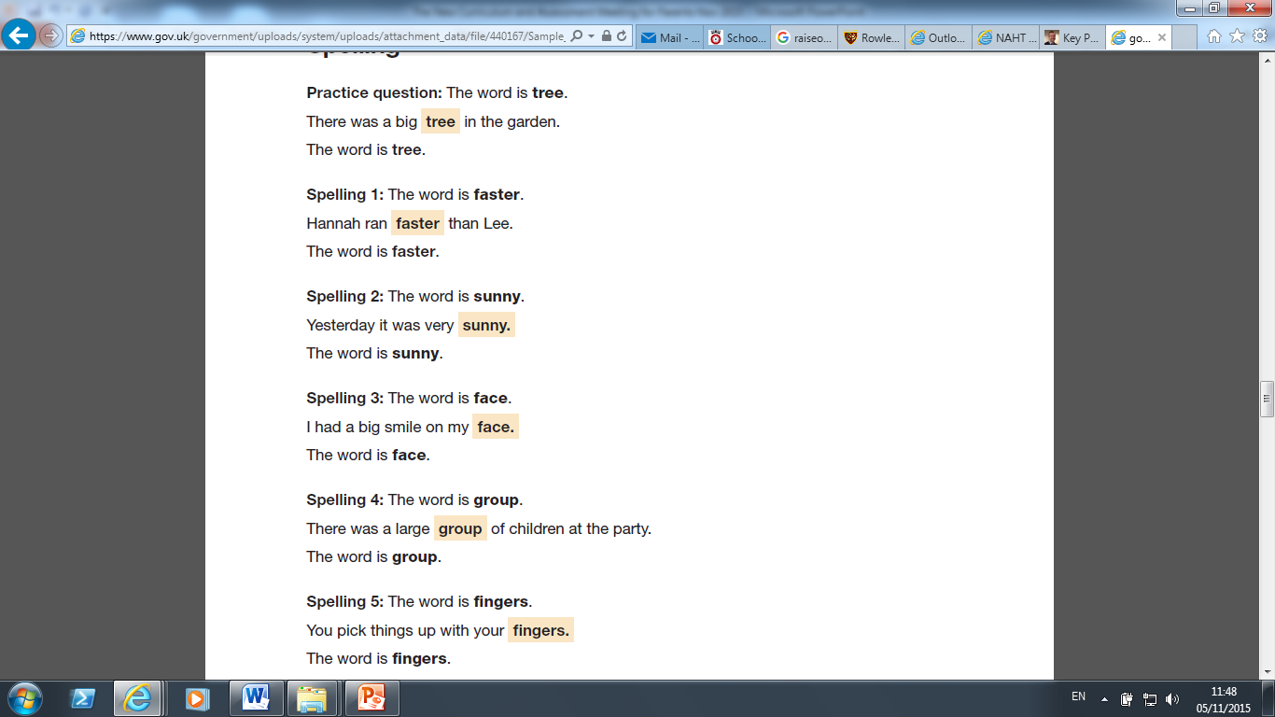
YEAR 2 SPELLING

Slide 13
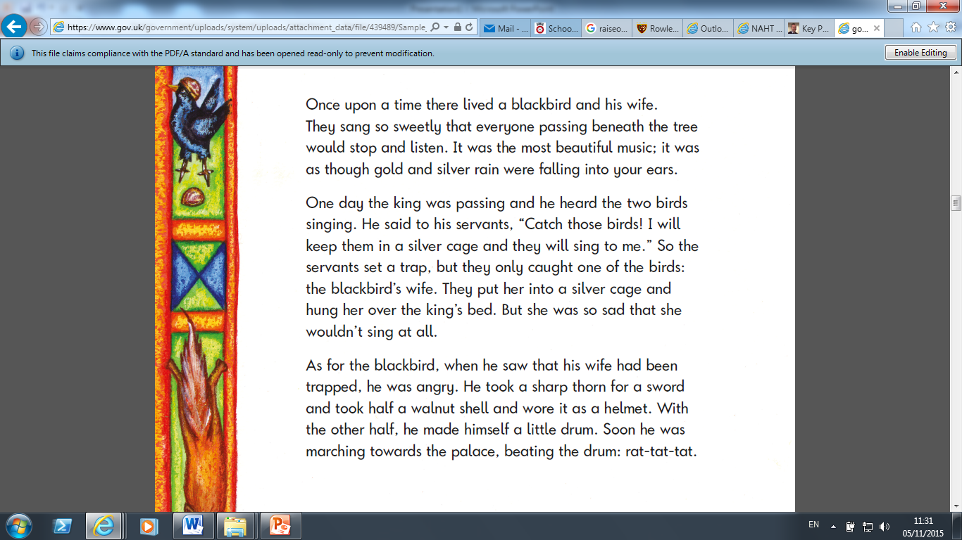
YEAR 2 READING

Slide 14
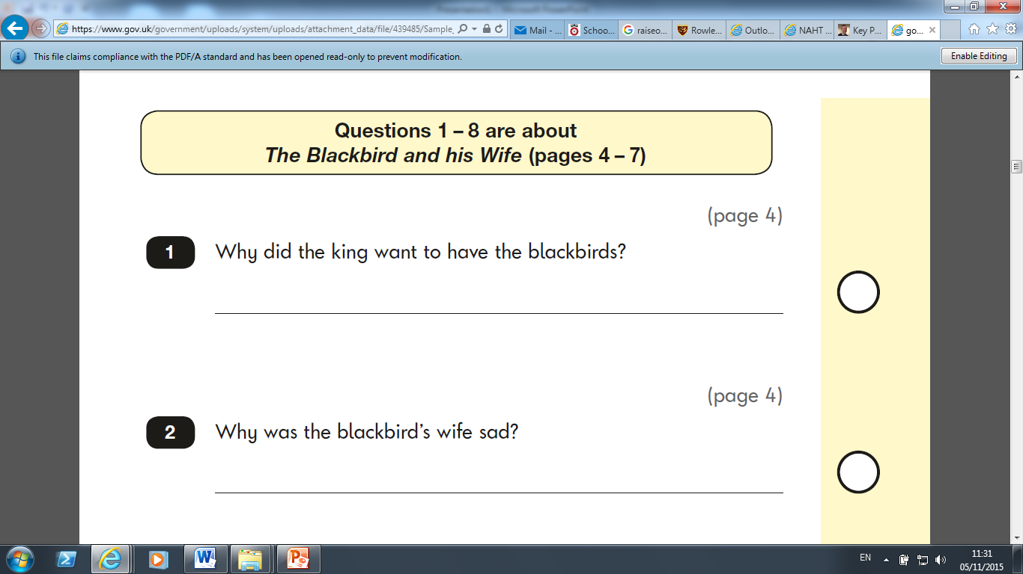
YEAR 2 READING

Slide 15
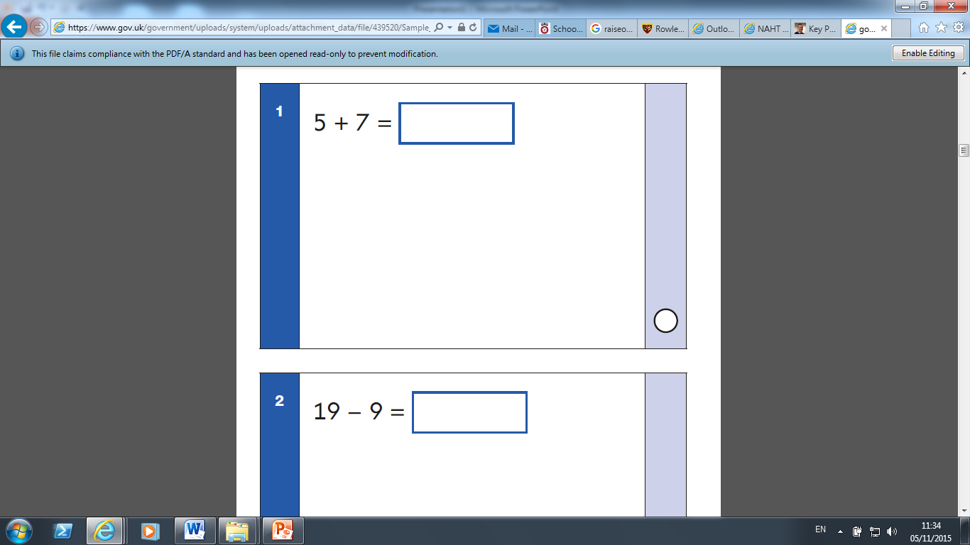
YEAR 2 MATHS

Slide 16

YEAR 2 MATHS

Slide 17
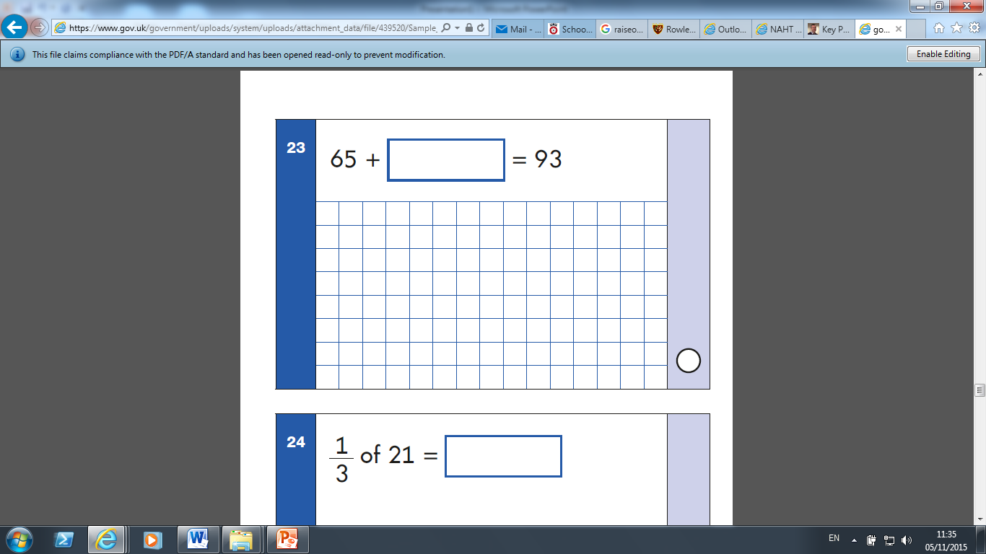
YEAR 2 MATHS

Slide 18
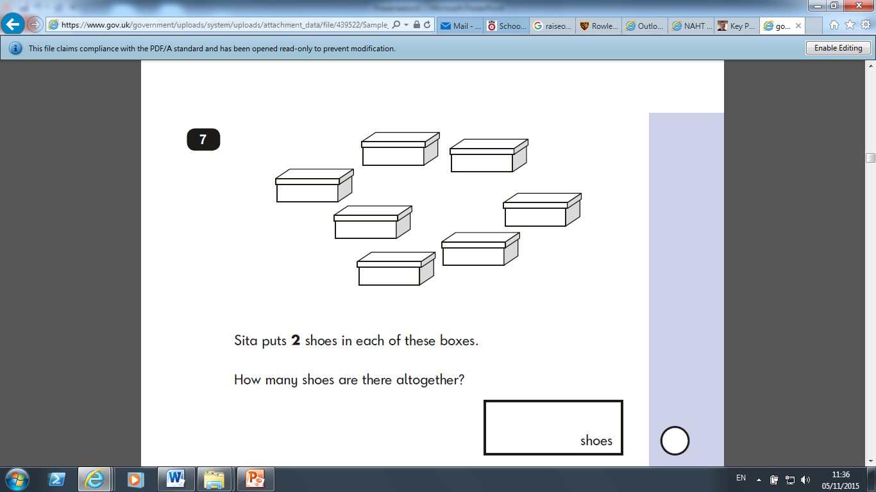
YEAR 2 MATHS

Slide 19
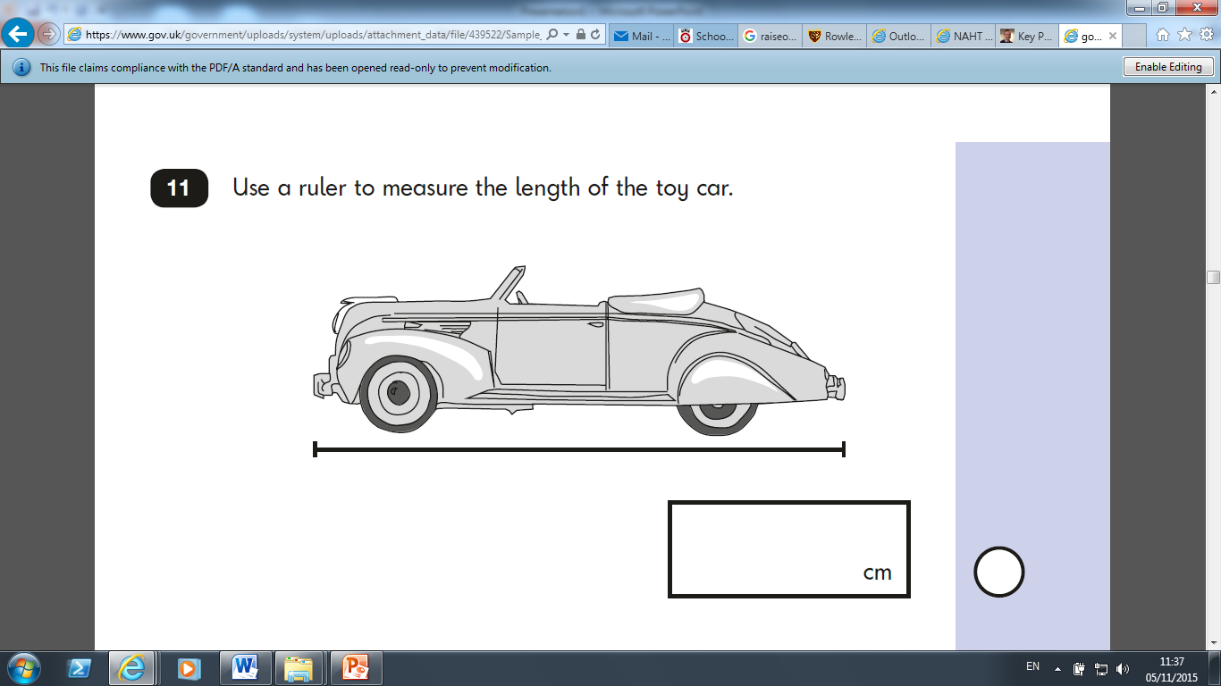
YEAR 2 MATHS

Slide 20
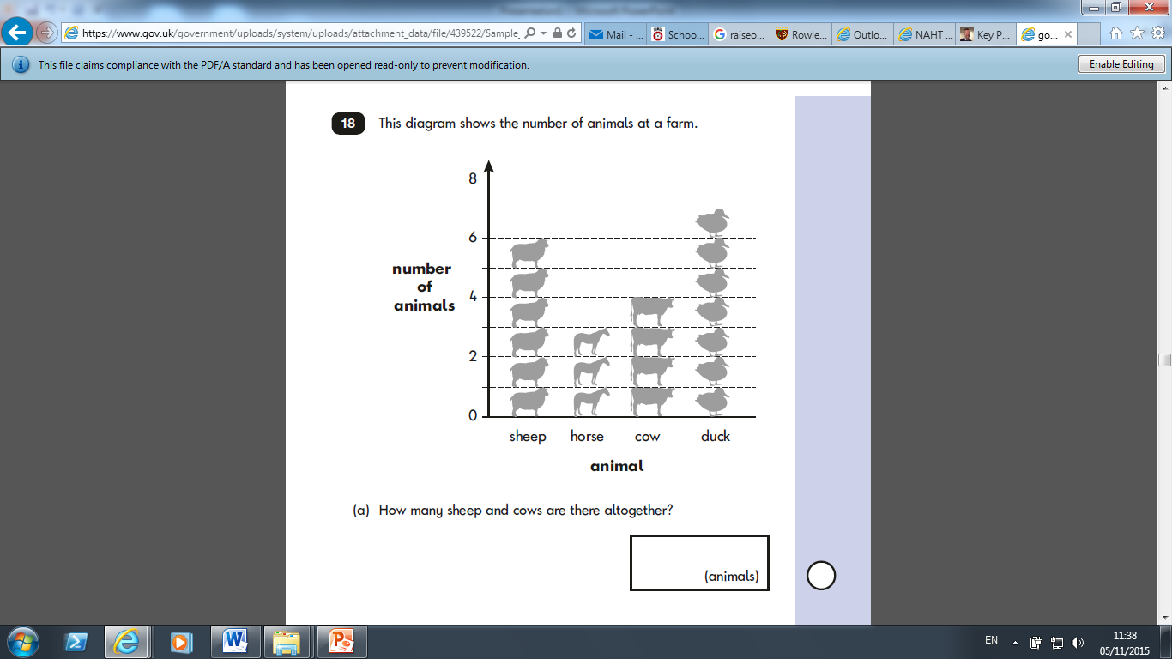
YEAR 2 MATHS

Slide 21
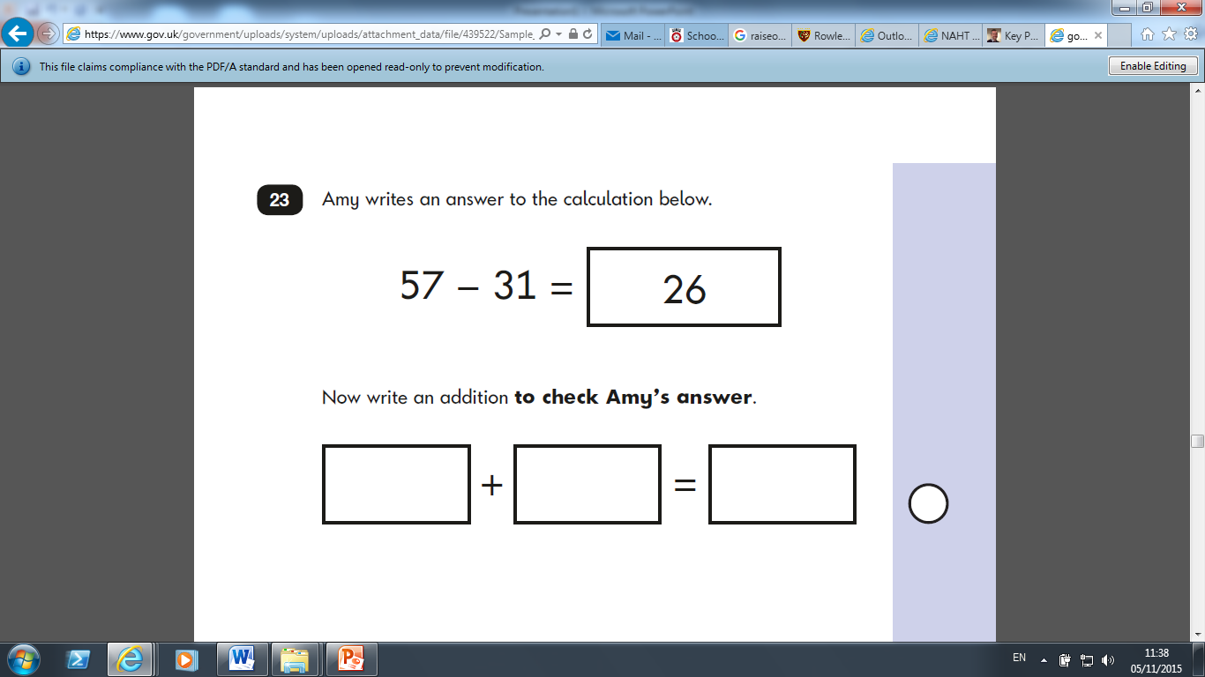
YEAR 2 MATHS

Slide 22
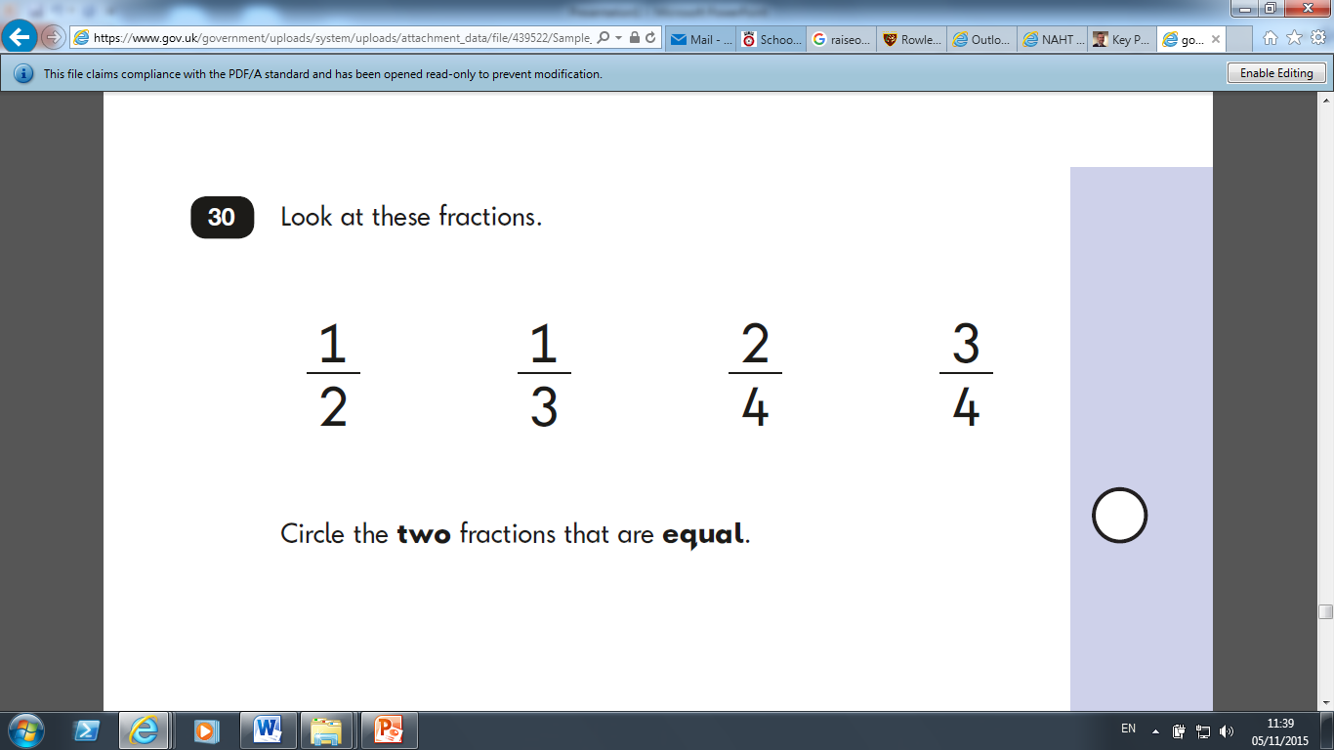
YEAR 2 MATHS

Slide 23
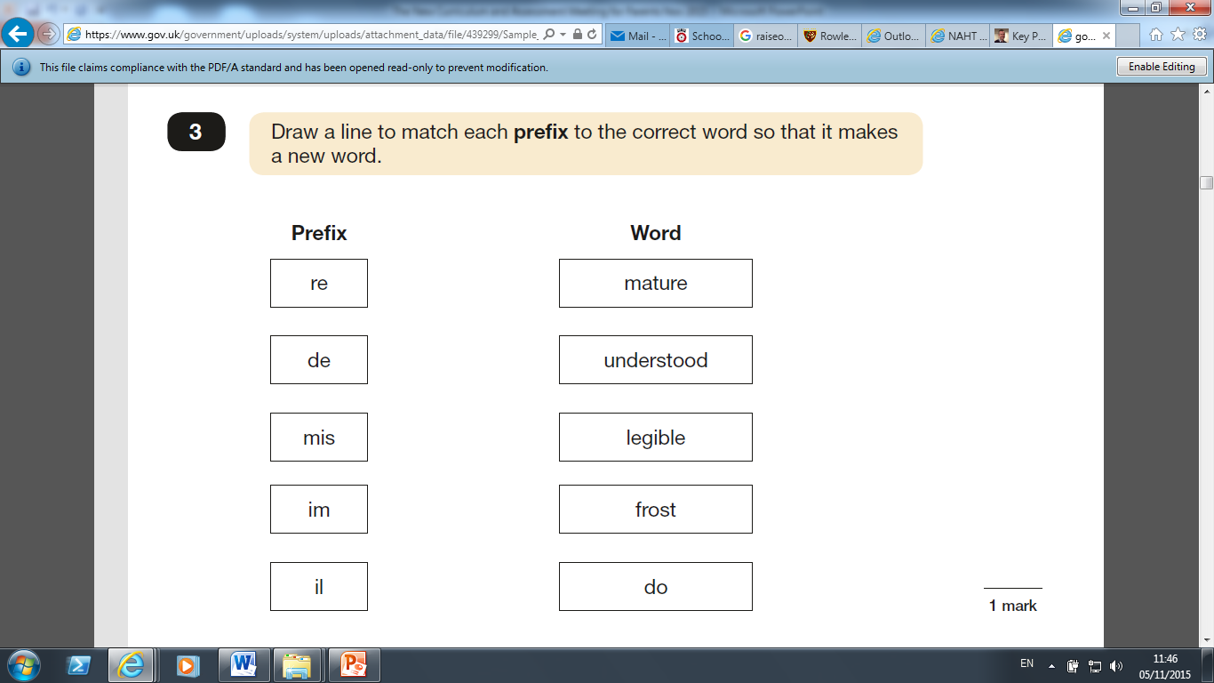
YEAR 6 GRAMMAR

Slide 24
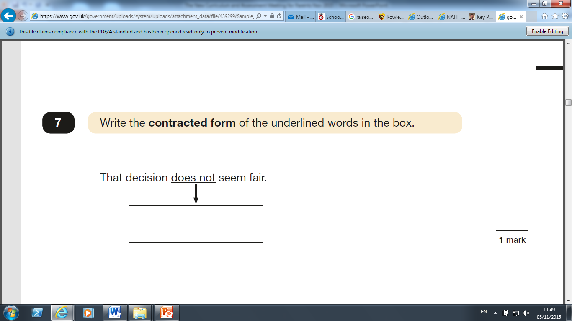
YEAR 6 GRAMMAR

Slide 25
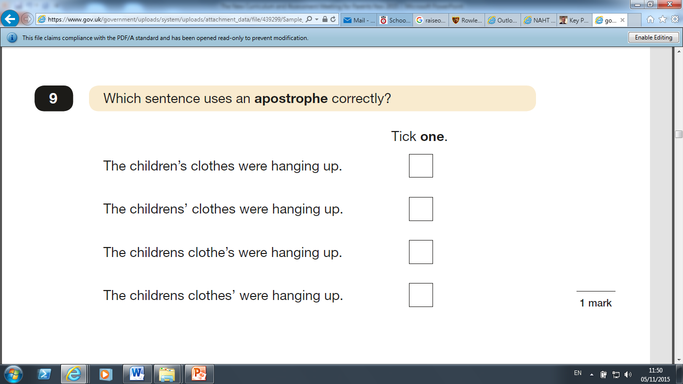
YEAR 6 GRAMMAR

Slide 26
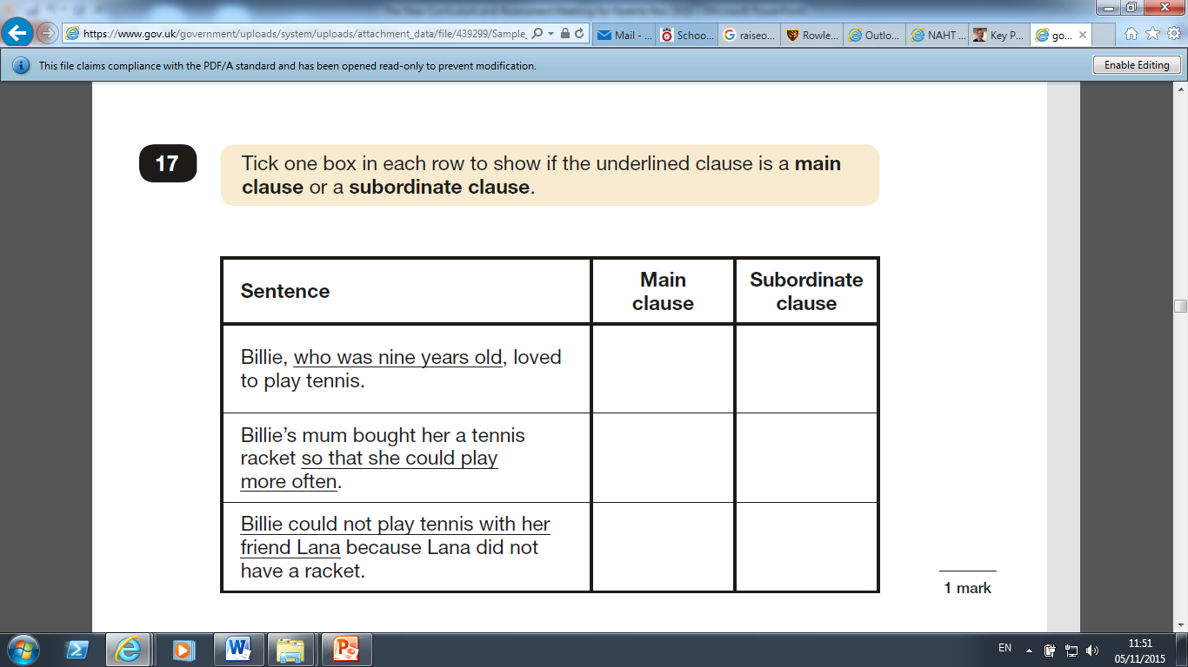
YEAR 6 GRAMMAR

Slide 27
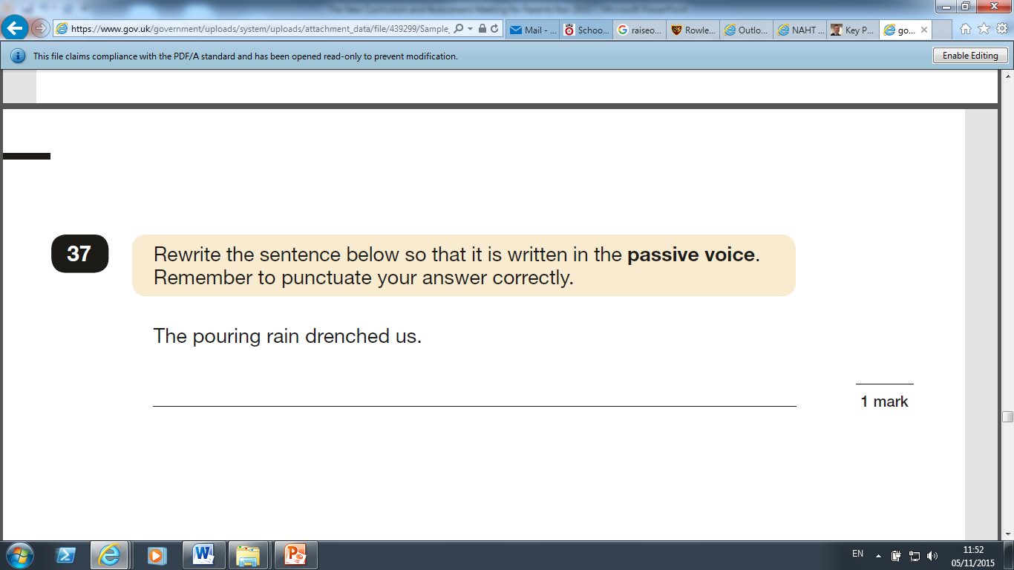
YEAR 6 GRAMMAR

Slide 28
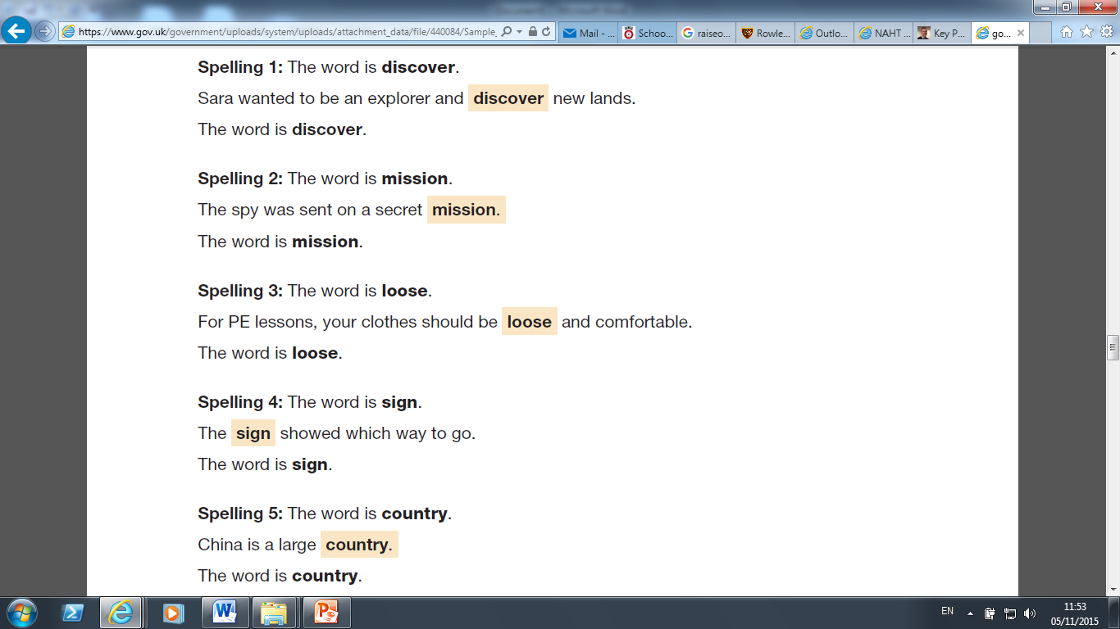
YEAR 6 SPELLING

Slide 29
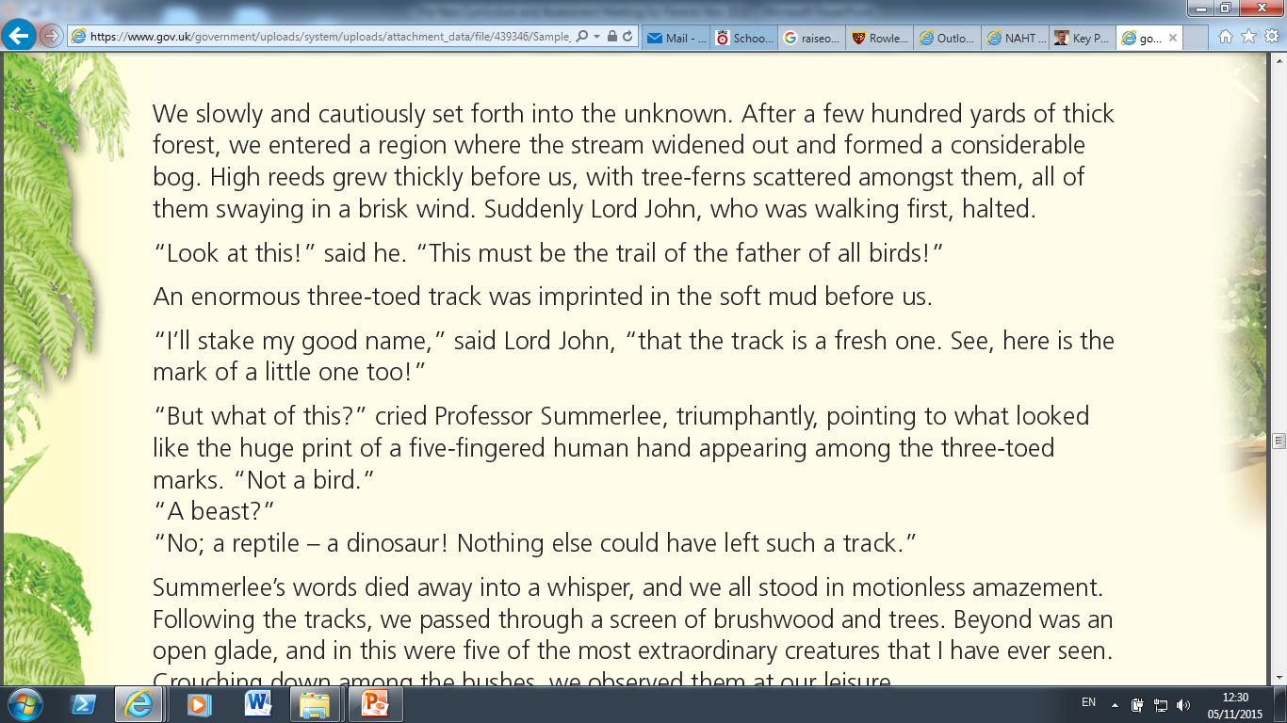
YEAR 6 READING

Slide 30
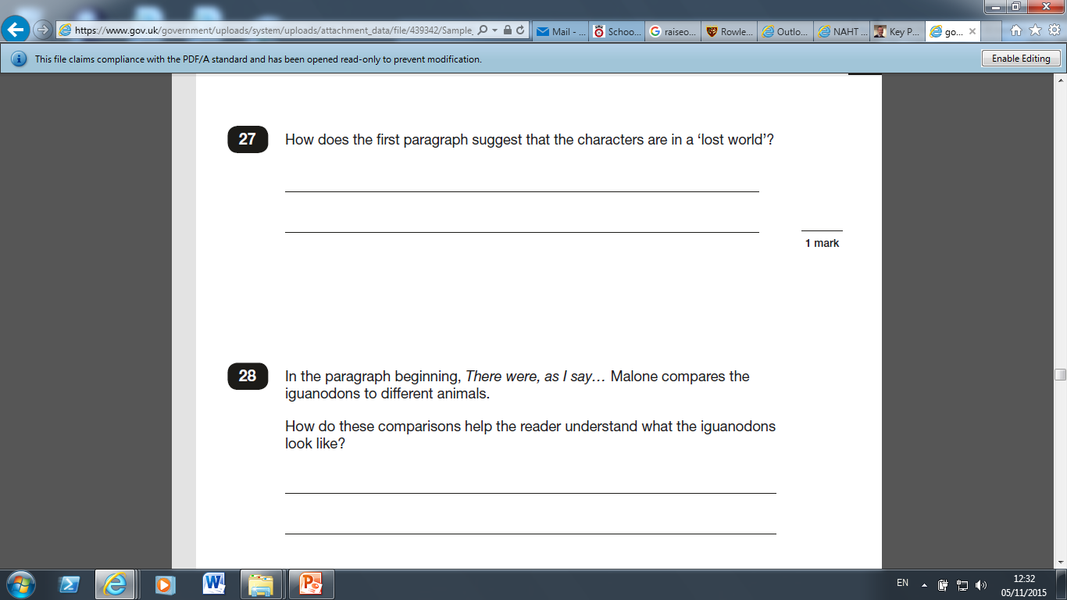
YEAR 6 READING

Slide 31
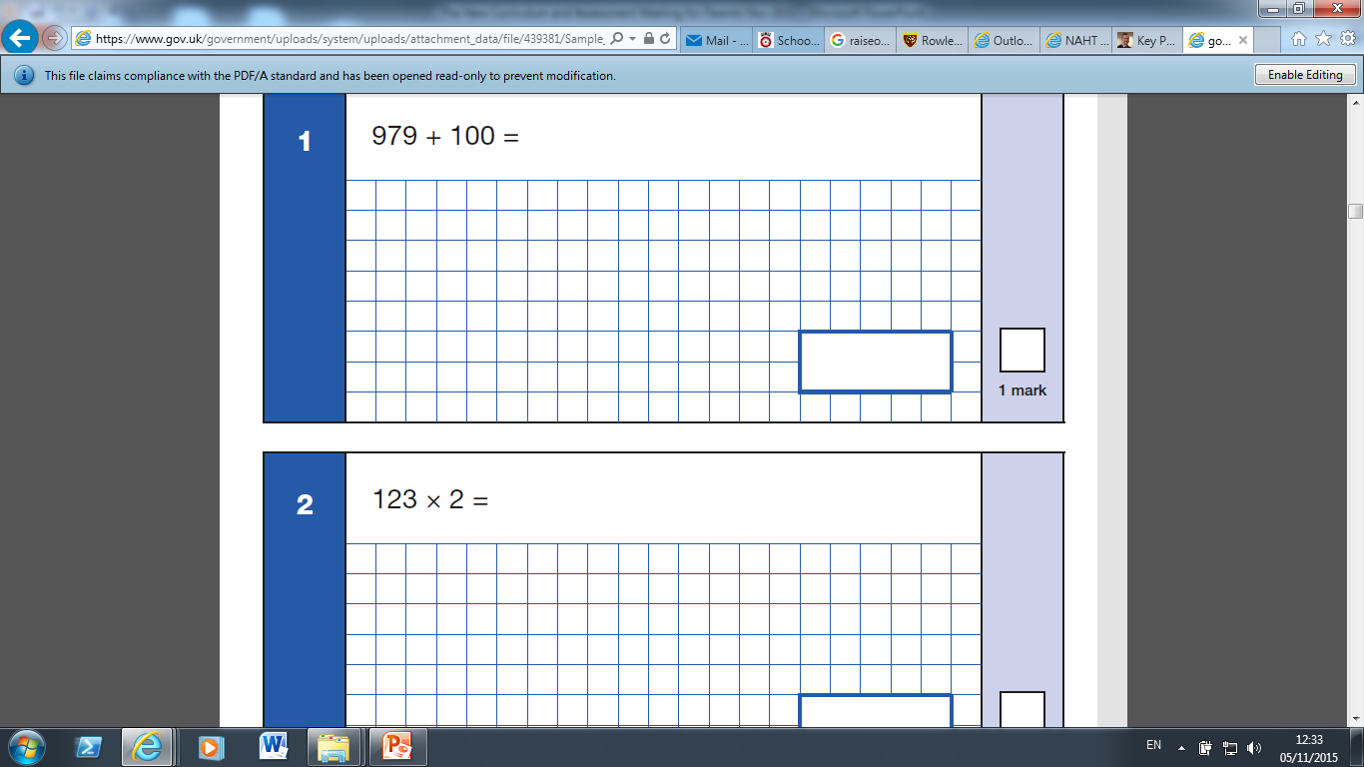
YEAR 6 MATHS

Slide 32
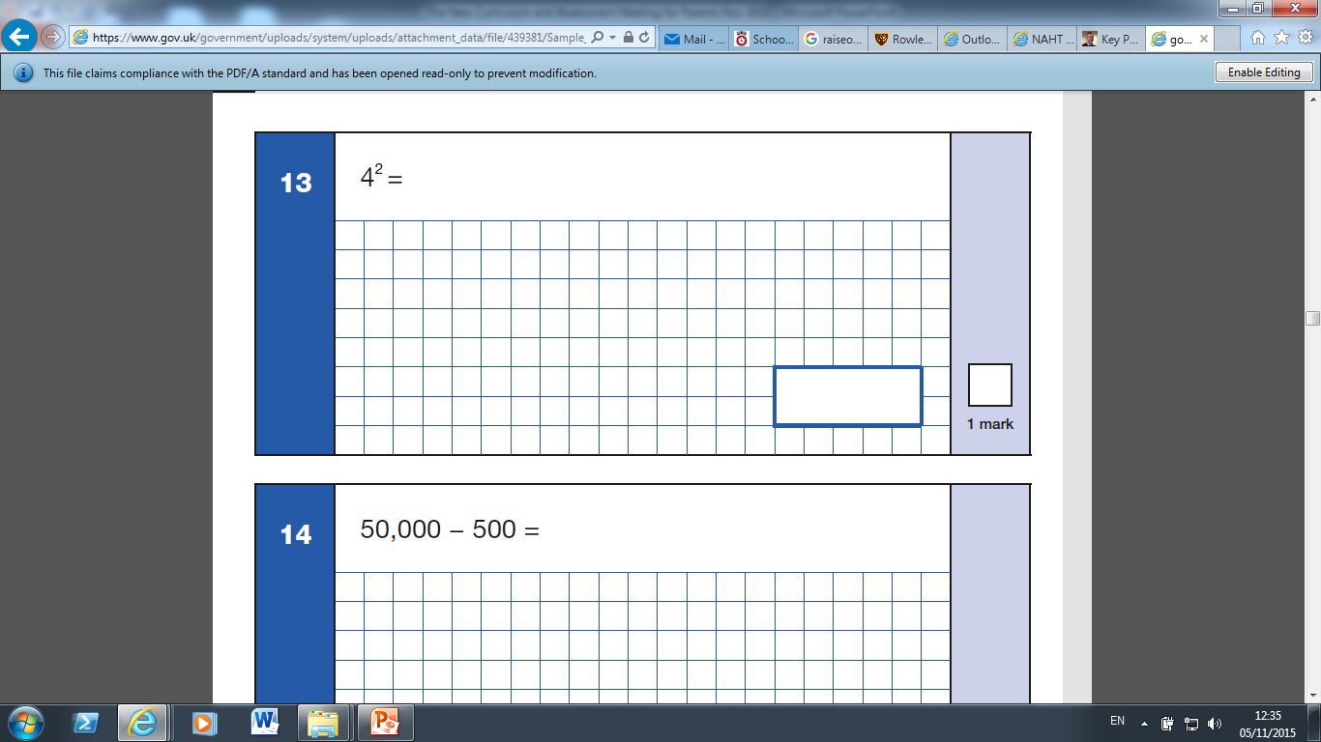
YEAR 6 MATHS

Slide 33

YEAR 6 MATHS

Slide 34
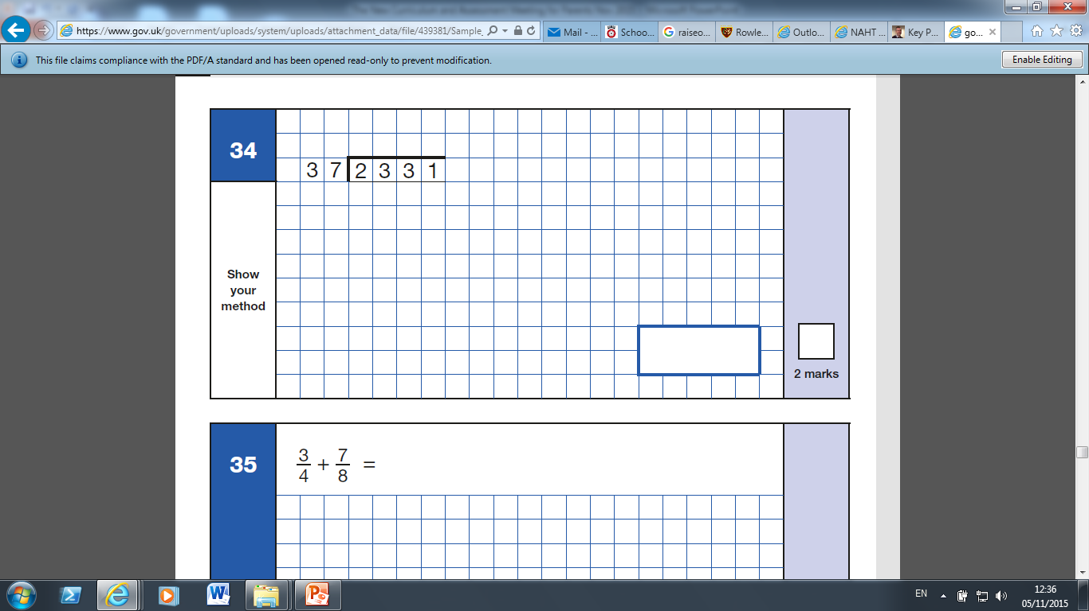
YEAR 6 MATHS

Slide 35
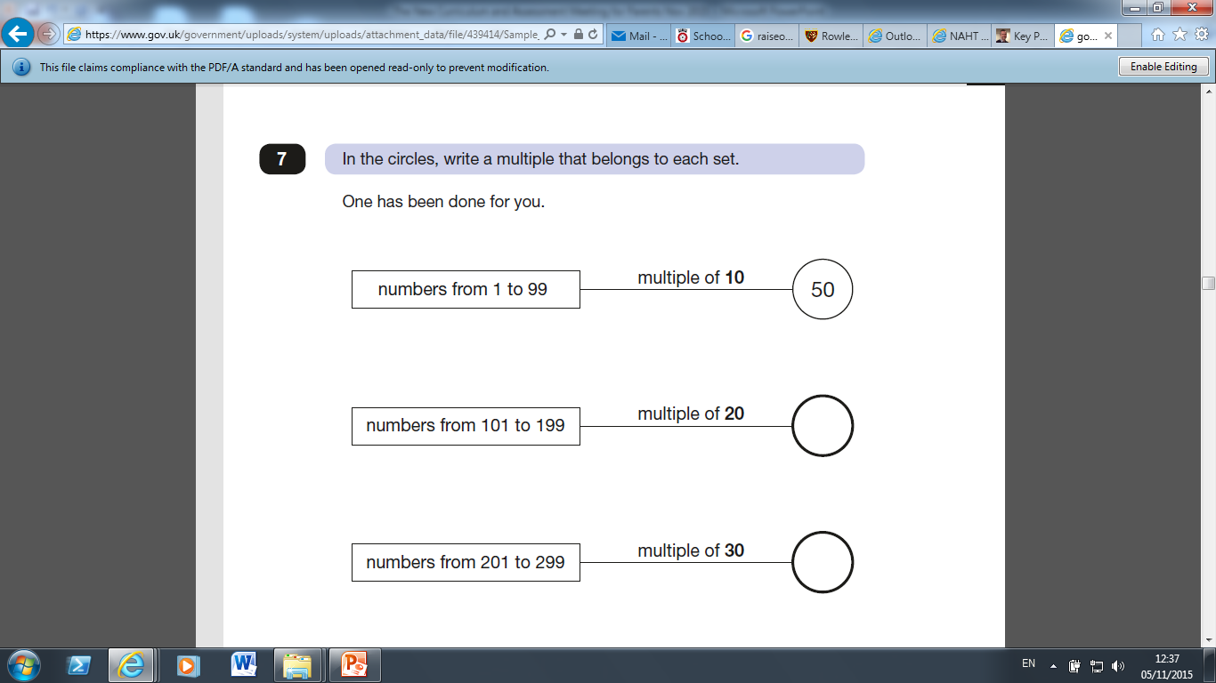
YEAR 6 MATHS

Slide 36
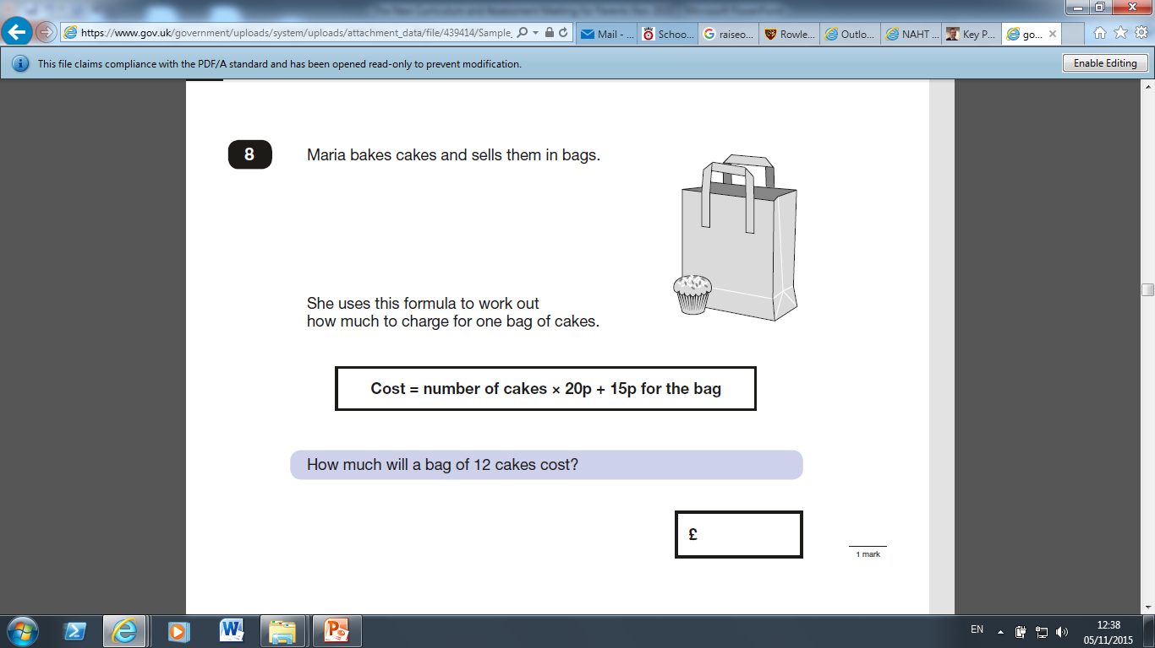
YEAR 6 MATHS

Slide 37
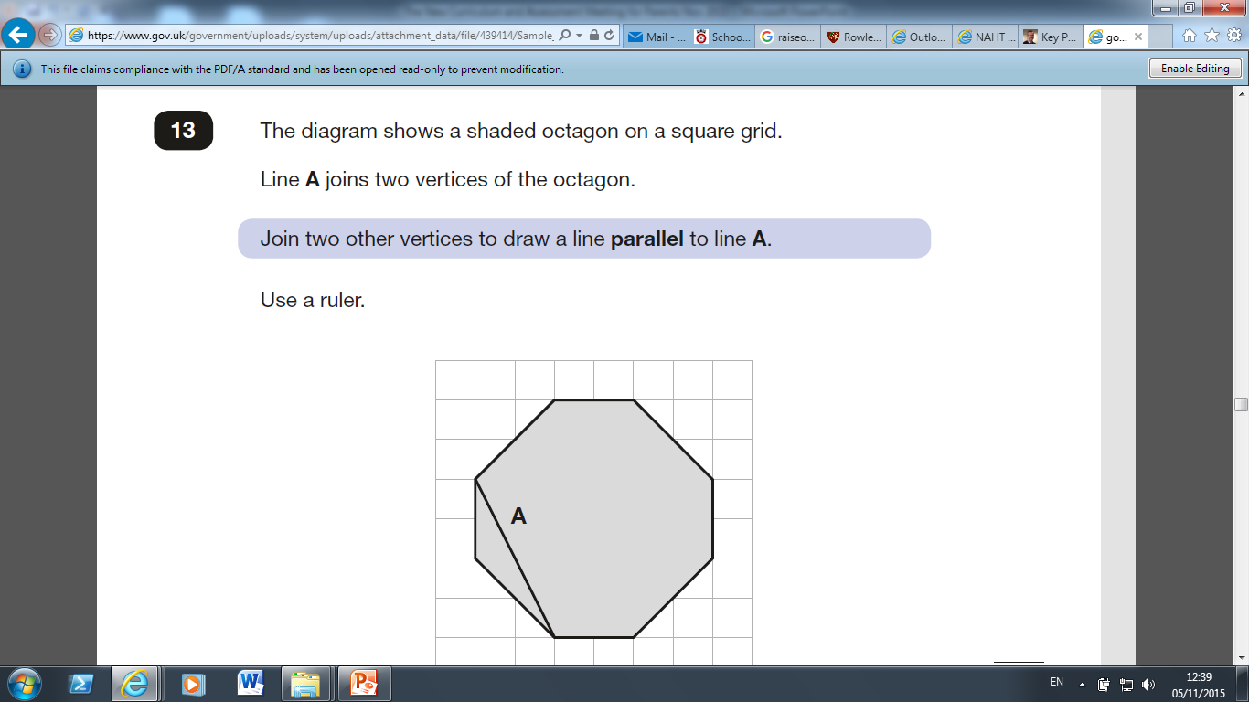
YEAR 6 MATHS

Slide 38
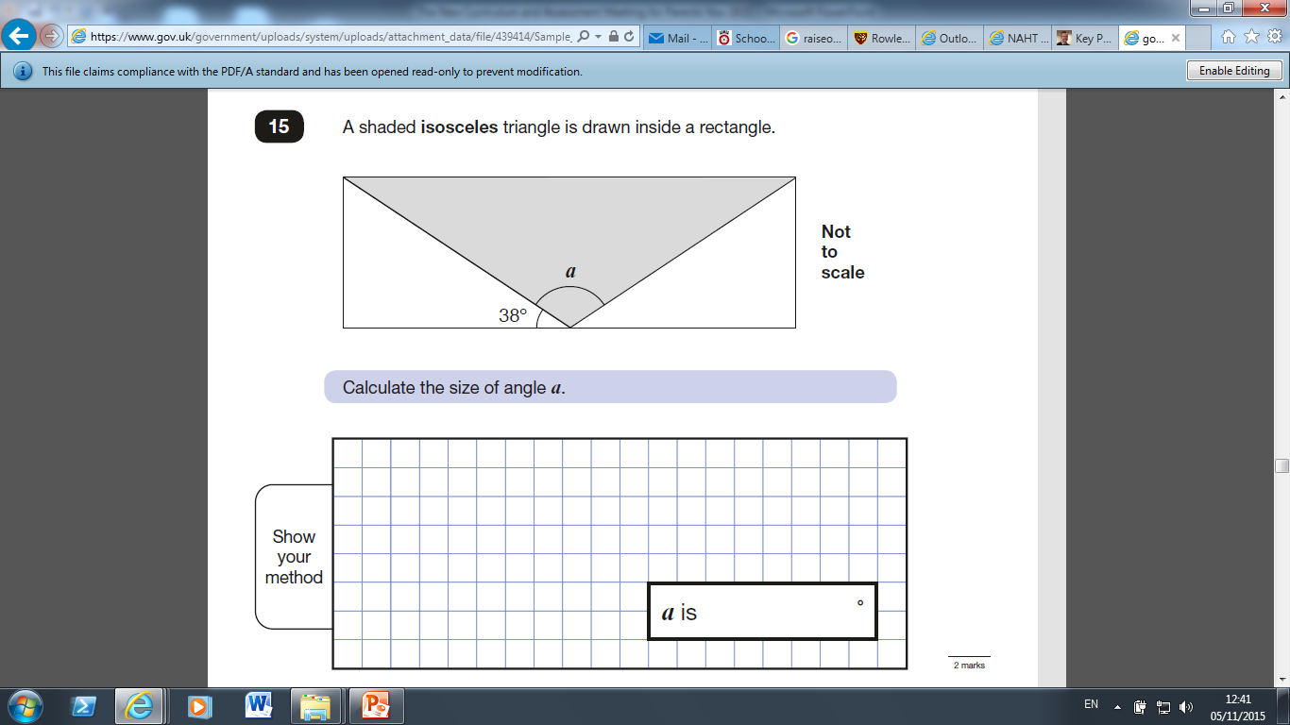
YEAR 6 MATHS

Slide 39
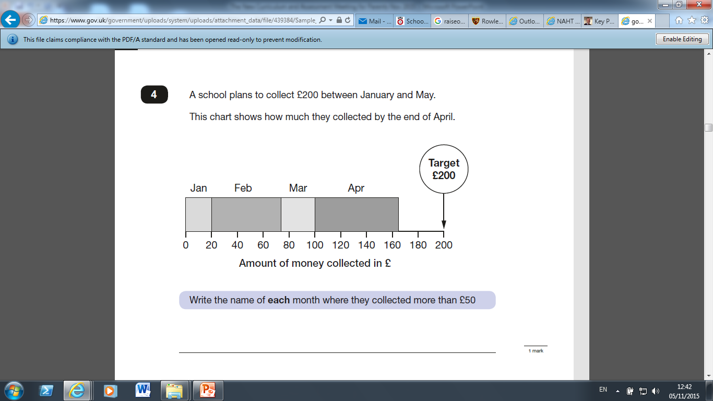
YEAR 6 MATHS

Slide 40
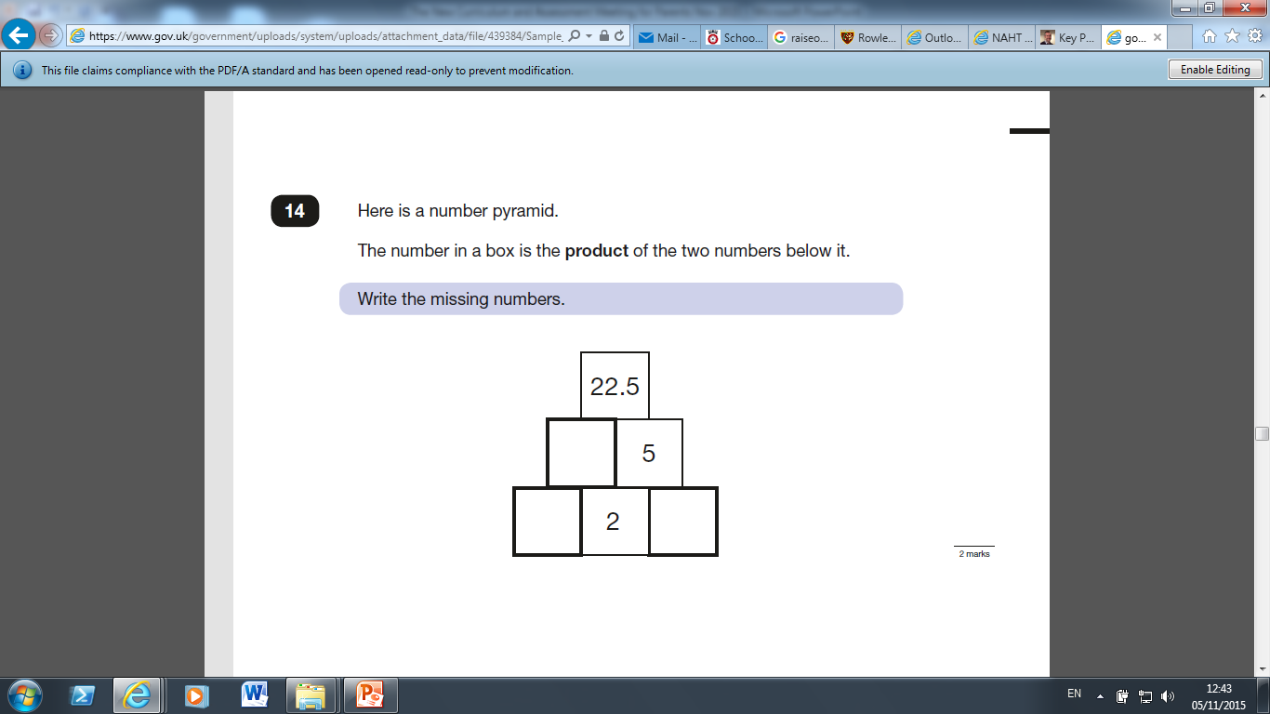
YEAR 6 MATHS

Slide 41
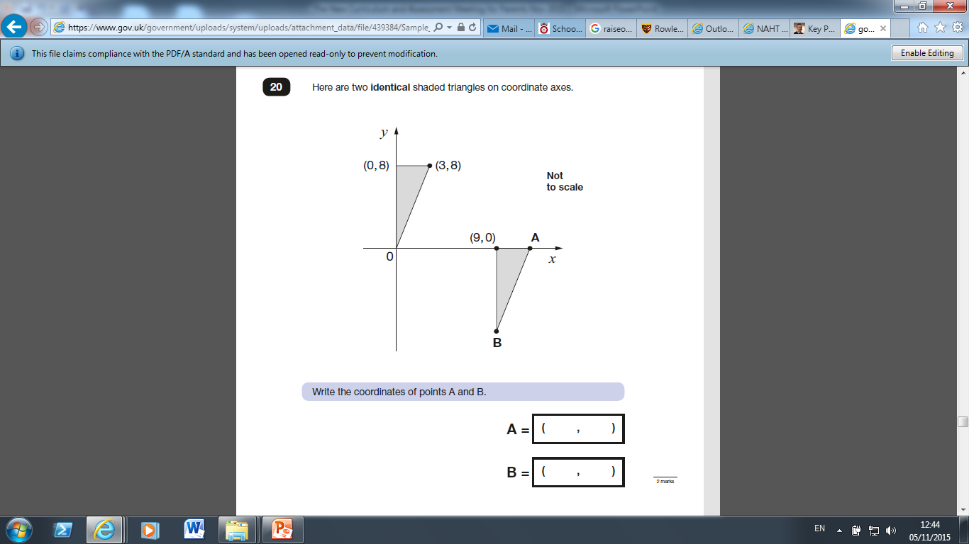
YEAR 6 MATHS

Slide 42
Changes to Assessment:
Higher Expectations!!!!
NO MORE LEVELS
Are children on track to be secure in their year group objectives?

Slide 43
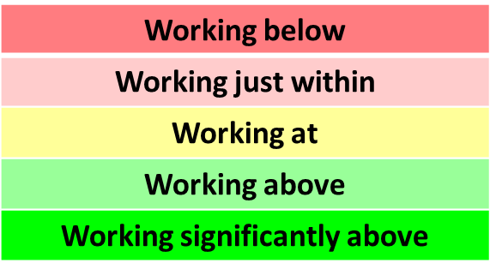
How will you know how your child is doing?
Target Tracker:
(So many colours!!!!)
Statements – from key objectives (individual targets)
working towards, achieved, mastered
Steps – how are they doing within the year group expectation?

Slide 44
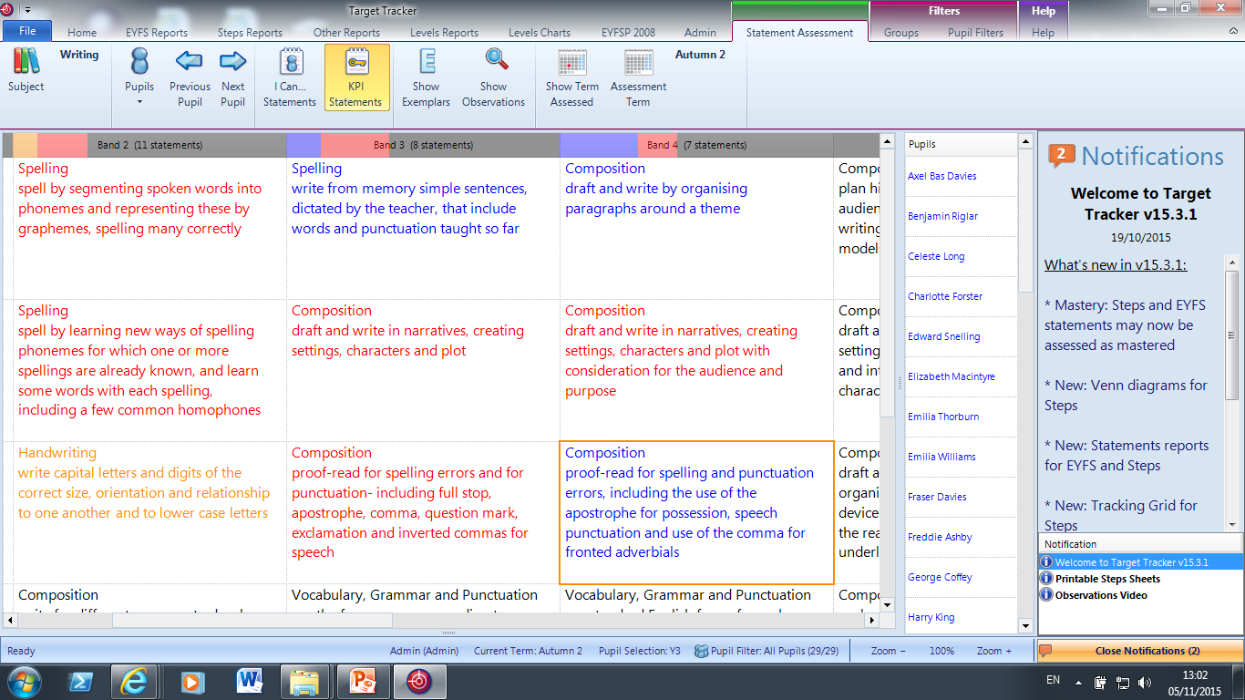
YEAR 3 STATEMENTS (writing)
working towards, achieved, mastered

Slide 45
How will you know how your child is doing?
Statements – from key objectives (individual targets)
working towards, achieved, mastered
Parents evenings in the future (not this one)
End of year Annual School report (Spring term)
Any other time at your request

Slide 46
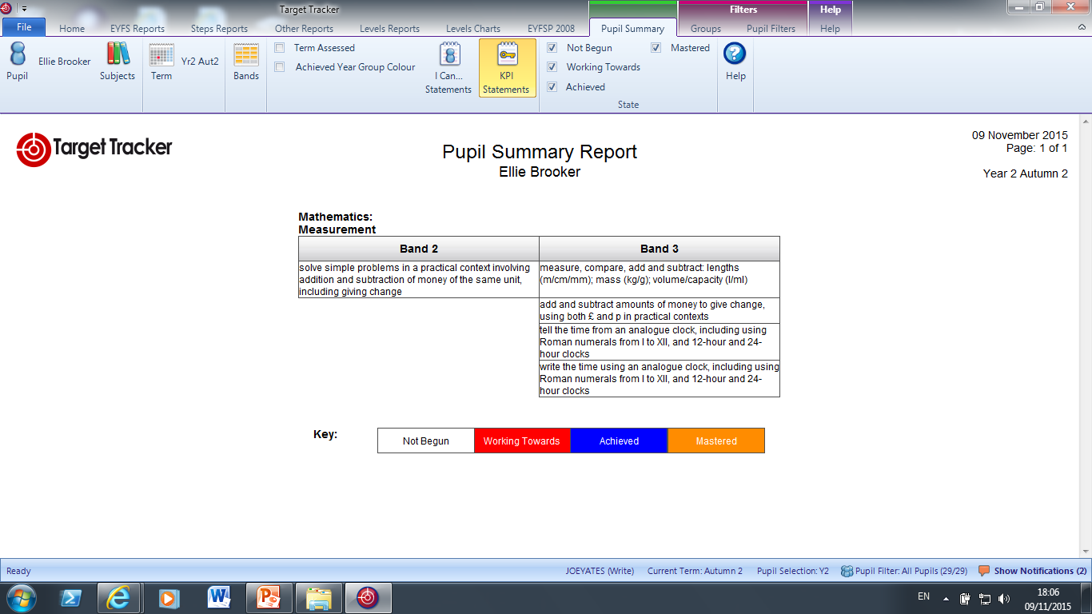
Annual Reporting Changes
Child’s name

Slide 47

How will you know how your child is doing?
Steps – how are they doing within the year group expectation?
Parents drop-ins (Spring term) and Parents Evenings (Summer term)
End of year Annual School report
Any other time at your request
Remember the
expectation is
much higher.

Slide 48
STEPS
We now use year group numbers
Example from Year 5
5b 5b+ 5w 5w+ 5s 5s+
(beginning) (within) (secure)
End of year
expectation

Slide 49
STEPS
Example from Year 5
4s 4s+ 5b 5b+ 5w 5w+ 5s 5s+ 6b 6b+
(secure) (beginning) (within) (secure) (beginning)
If your child was secure at the end of Year 4, you would expect
them to be 4s+ (secure plus) or 5b (beginning) in the first half
of the Autumn term

Slide 50
STEPS
Example from Year 5
4w 4w+ 4s 4s+ 5b 5b+ 5w 5w+
(within) (secure) (beginning) (within)
If your child wasn’t yet secure at the end of Year 4, you would
expect them to be 4w+ (within plus) or 4s (secure) in the first half
of the Autumn term

Slide 51
STEPS
Example from Year 5
4s 4s+ 5b 5b+ 5w 5w+ 5s 5s+ 6b 6b+
(secure) (beginning) (within) (secure) (beginning)
If your child was exceeding expectations at the end of Year 4,
you would expect them to be 5b+ (secure plus) or 5w (within)
in the first half of the Autumn term

Slide 52
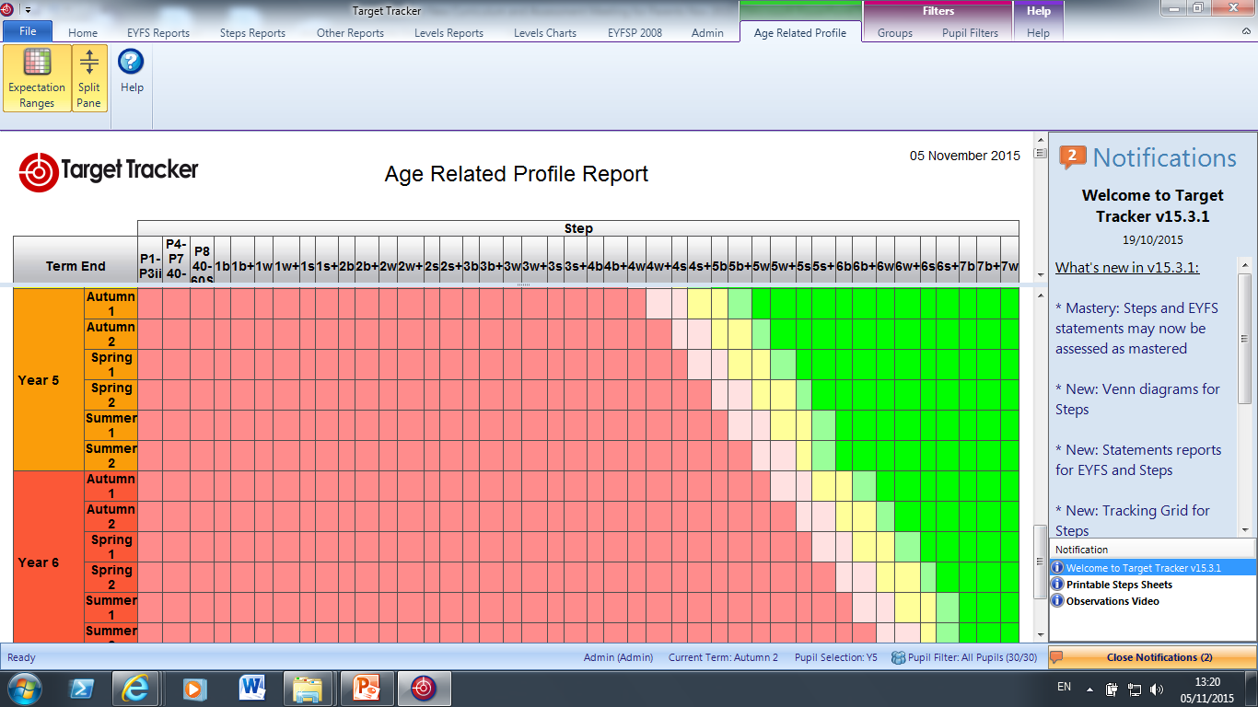
At the end of Autumn 1, to be on track, children need to be in the yellow
4s+ or 5b
At the end of the Summer 2, to be working at expectation, children need to be in the yellow 5s
Working below
Working just within
Working at
Working above
Working significantly above

Slide 53
Annual Reports and Parents Evenings:
Is your child on track to be secure at the end of the year?
We will tell you where your child is now in relation to the key objectives for Reading, Writing and Maths. We will also tell you our predictions for the end of the year and how we will support them in their learning.

Slide 54
You will receive a sheet with three of these for Reading, Writing & Maths
(with the key) :
Year 2 Steps Assessment.
 | 1w | 1w+ | 1s | 1s+ | 2b | 2b+ | 2w | 2w+ | 2s | 2s+ | 3b | 3b+
Autumn 1
Autumn 2
Spring 1
Spring 2
Summer 1
Summer 2

Slide 55
How can you support your child’s learning at home?
Teacher’s will give you guidance, based on the key objectives (found on the website) as to what your child needs to work on.

Slide 56
What is the bottom line?
Our assessment system may have changed, but your children haven’t!
It is our job to make sure that we do everything that we can to meet their individual needs and ensure that they make very good progress while they are with us.
We will do everything that we can to prepare them for secondary school and beyond.

Slide 57

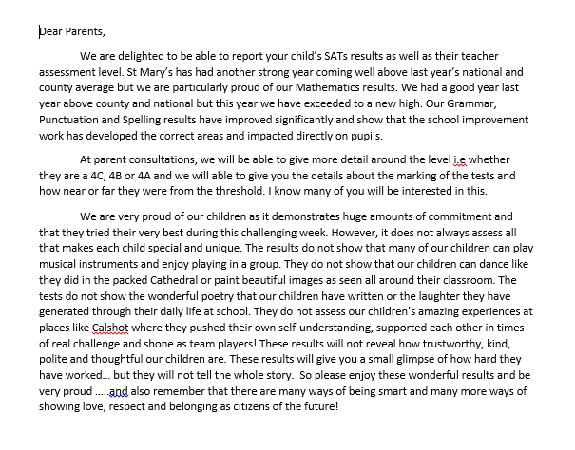
Great results through
irresistible learning and fun!

