Slide 1
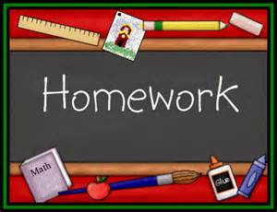
Parents Forum
Does our Homework Policy reflect what our pupils need?
Thank you for coming. Please help yourself to a cup of tea or coffee. We will start at 9.05am.

Slide 2
Homework
To develop a LOVE of learning
To show RESPECT for the power of scholarship
By sharing our learning we foster a sense of BELONGING
Rationale
Homework plays an important role in children’s education and should be an integral part of their development and learning. At St Mary’s we are very committed to building strong home/school links. We know that education is most effective where there is a positive partnership between home and school. We hope that homework/learning at home will increase a child’s enjoyment of learning and his/her understanding. We know that it is crucial that we offer support to parents so that there is a better understanding of how learning can be further extended at home. In this policy homework refers to any work or activity which children are asked to do outside of lesson time, usually with parents or carers.

Slide 3
Aims
Although homework can be set in many different forms, the aims are broadly:
To develop independence in children
To enable them to practise skills learnt in the classroom
To develop self-discipline and time management skills
To allow research in an area of personal interest, particularly as part of a class topic
To develop research skills as part of an open ended assignment
To foster a partnership between school and home
To help raise standards of attainment
To improve the quality of the learning experience and to extend it beyond the classroom
To prepare Y6 pupils for transfer to secondary school.

Slide 4
Guidelines
Homework should be set on a weekly basis excepting periods when children have other priorities in their schedule ie SATs, school plays or productions to prepare for, or exterior activities such as residentials or concerts.
Children will be asked to work on a variety of tasks throughout their school life. These will include reading, learning spellings and times tables, maths investigation, completing written assignments, researching topics, and practical activities
Children will be expected to take responsibility for their own homework tasks. Parents and teachers will use the Home School link Book as a form of communication, noting any difficulties and successes, and signing it on a weekly basis. Pupils will be given two books for their homework (these will alternate to allow a week for homework completion and a week for marking and feedback) and this will be kept as their personal record of achievement.
Should pupils be unable to complete their homework tasks because of illness or the nature of the task, then the Home School Book should be completed by the parent giving the reasons. This will enable the teachers to further support the child in their class learning.
At the beginning of each academic year each class teacher will send home a homework timetable to enable parents and children together to plan when assignments will be completed.
Homework is expected to be handed in on time to facilitate marking.
Should pupils hand in homework late on a regular basis or fail to complete tasks, then parents will be informed. Pupils who regularly miss deadlines for handing in completed homework may be asked to complete this during break times.

Slide 5
Working in Partnership
Children should be responsible for taking home their assignments and Homework Book, completing the tasks to the best of their ability and handing in finished pieces on time.
Teachers should regularly set tasks which are achievable and interesting, mark the work and provide positive, constructive feedback.
Parents should ensure that children have a quiet place to study, be aware of their child’s assignments and provide support when it is required. They should also sign the Home School Book to acknowledge that work has been completed.
If homework is becoming burdensome for a child, parents should come and discuss the matter with the class teacher in order that school and home can work in partnership to support every child.

Slide 6
Progression
Oak Class: 1 hour per week
Reading (Read to or heard read) every night. Then a project will be given for two weeks alternating with Maths or English activity. Year 1’s will have their spellings. Year R’s will have sight words to read.
Ash Class: 1 hour to 1 ½ hour a week
Reading every night, Spellings and a spelling exercise weekly, English or Maths activity weekly.
Lime and Elder Class: 2 hours per week
Reading every night, Spellings with a spelling exercise, English and Maths activity which consolidates learning from the week.
Year 6 may have extra activities which will help them prepare for residentials, SAT’s or transition to Secondary.

Slide 7
Examples
Feedback from the pupils, indicate that projects over a period of 2 or 3 weeks are exciting and interesting. What do you think the parent body feel about this?
Do parents feel confident in helping pupils with homework? Spellings/phonics? Maths? Could we run some short courses/information sessions?
New system: one book, one week then swap. How do parents feel about this? Is this making it easier for pupils to complete?
Year R parents: apart from reading, would you like a project/piece of homework?

Slide 8
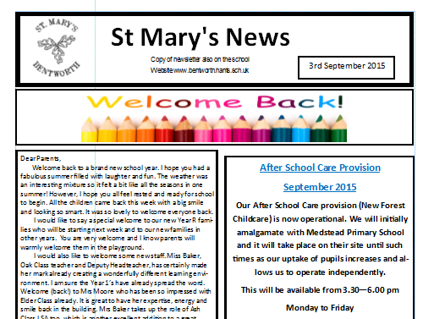

Other areas for input…
Email
Hard copy
Newsletter: best format?

