Slide 1

Parents Forum: Wednesday 6th May 2015
Update on assessment reform
Parent/school agreement- Our Parent Promise
E-safety

Slide 2

Where did we get to? What’s new?
Current Year R model: GLD
Good level of development
Next year model: Baseline
Will that give an end assessment?

Slide 3
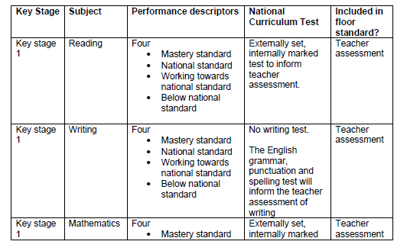
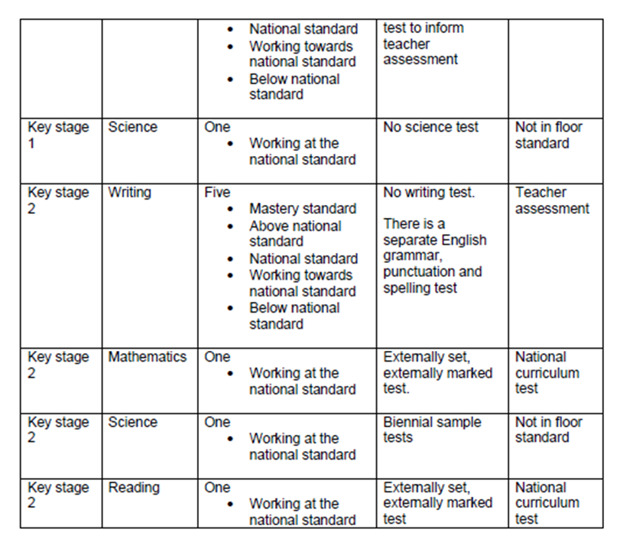
These remain the same but we have not got the definitive version of how these are going to be assessed.
KS1:
English: Reading and GPS
Maths
KS2:
English: Reading and GPS
Maths
Science

Slide 4
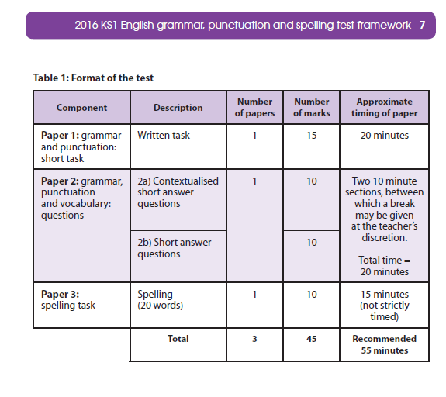
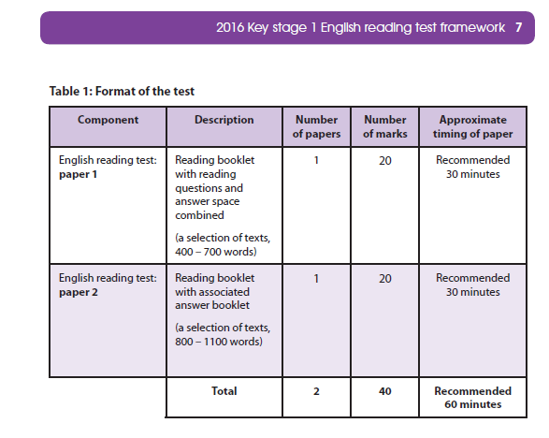
Uplevelling- working at the new National Curriculum level
Key Stage 1 papers

Slide 5
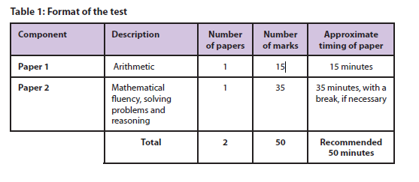

Slide 6
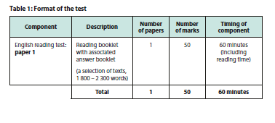
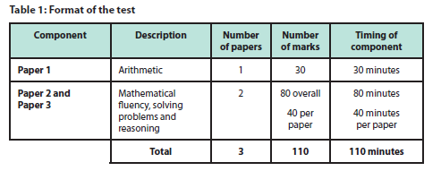
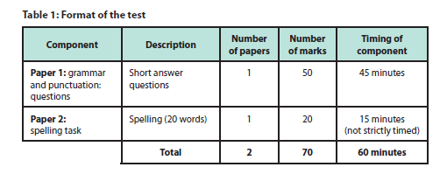
Uplevelling- working at the new National Curriculum level
Key Stage 2 papers

Slide 7
Our Parent Promise
Why?
What’s the goal tonight?
Pupils Promise update

Slide 8
E-safety
http://www.net-aware.org.uk/#
https://www.thinkuknow.co.uk/parents/

Slide 9
Next…..

