Slide 1
Assessment: tests, reporting and life after levels…
Welcome to your parents forum……

Slide 2
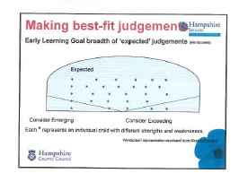
Early years model going forward……although this will change!
Depth
Breadth
Age Related Expectations (ARE) with Key Performance Indicators (KPI’s)

Slide 3
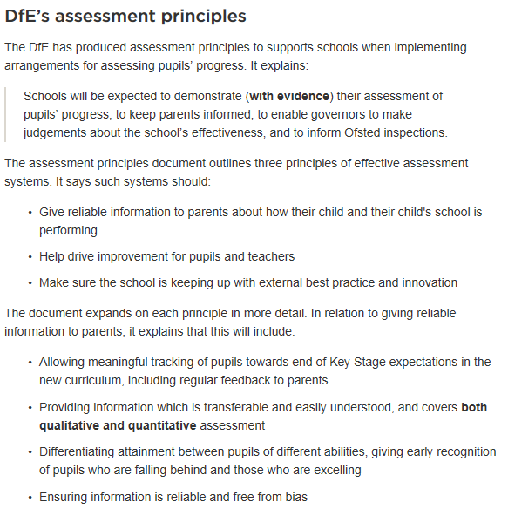

Slide 4
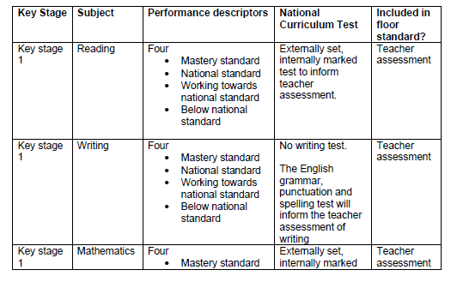
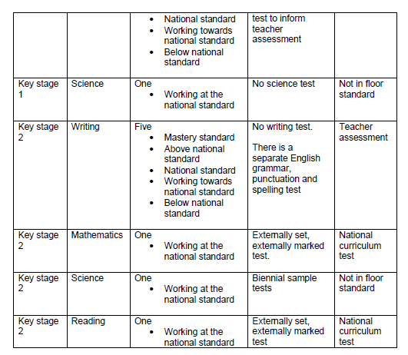

Slide 5
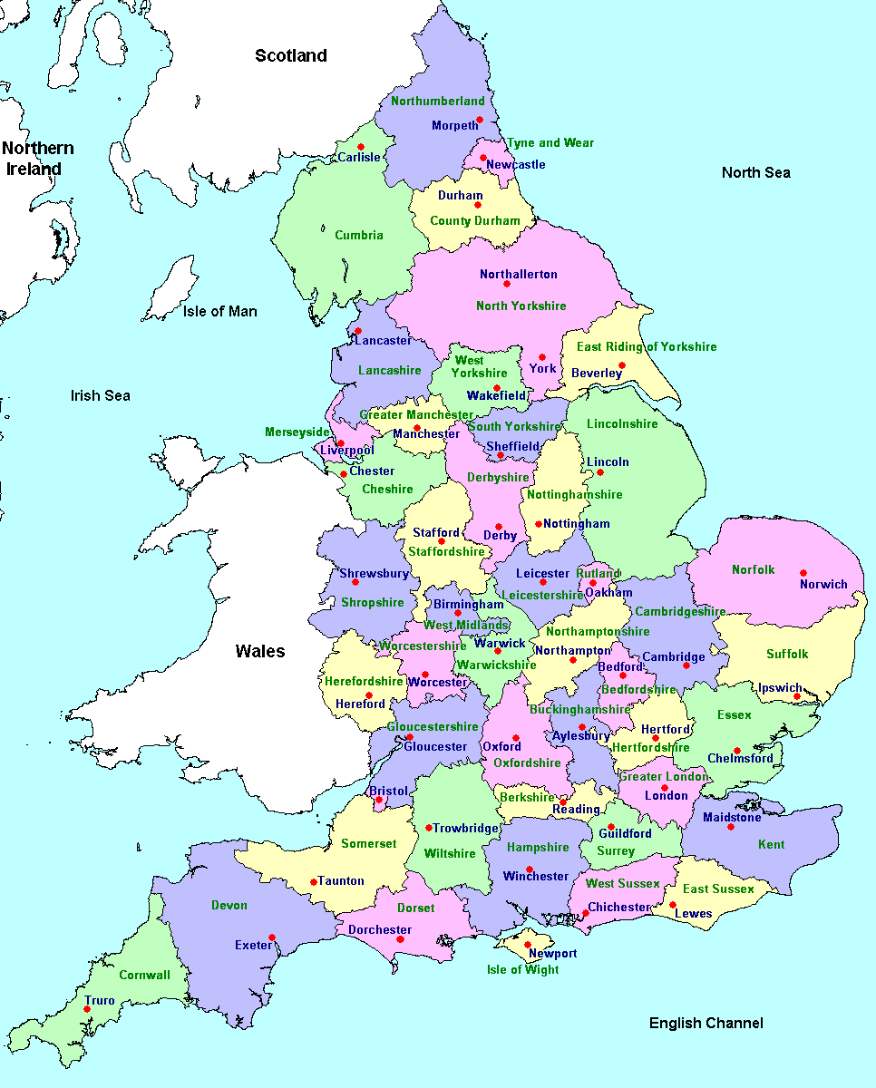
Next steps….
Nationally
Locally
internally

Slide 6
ANTI-BULLYING WORK

