Slide 1

ANXIETY

Slide 2
What is Anxiety
Anxiety, sometimes labelled as worry, apprehension, fear or nervousness, is an evolutionary way of protecting ourselves from danger. Historically, we have needed to protect ourselves, for example from wild animals. Even today there are certain situations where this system can be beneficial to us, for example helping us achieve things.
The Fight, Flight or Freeze Response
https://www.youtube.com/watch?v=FfSbWc3O_5M
Video Credit- www.anxietycanada.com
Notes:
https://www.youtube.com/watch?v=jEHwB1PG_-Q
https://www.youtube.com/watch?v=rpolpKTWrp4
https://www.youtube.com/watch?v=FfSbWc3O_5M

Slide 3
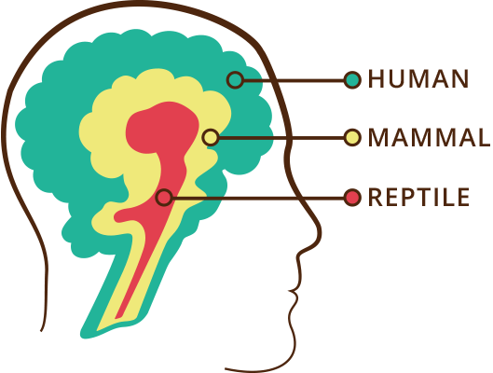
Evolution of the brain
Evolved 55-24 million years ago, thoughts and emotions required for complex social living: emotional regulation, planning, creating, imagining, communication, cooperation, empathy, compassion.
Evolved 206-144 million years ago. Shared with other mammals – attachment system, emotions, memories, safety seeking.
Evolved 248-206 million years ago. Regulates hunger, temperature, fight flight system activation.
Notes:
The old reptile and mammalian brains still operate within us.
As new brain structures emerged throughout evolution nothing that maintained our survival was deleted, but was kept and built on.
This means that our old brains are still guiding much of our behaviour – tribalism, conflict, territory defending, social inclusion and exclusion etc.
BUT we can use our new brain to override and not act out old brain drives and motives.
The problem for teenagers is that the neo-cortex or the NEW brain, is the last part of the brain to fully develop.

Slide 4
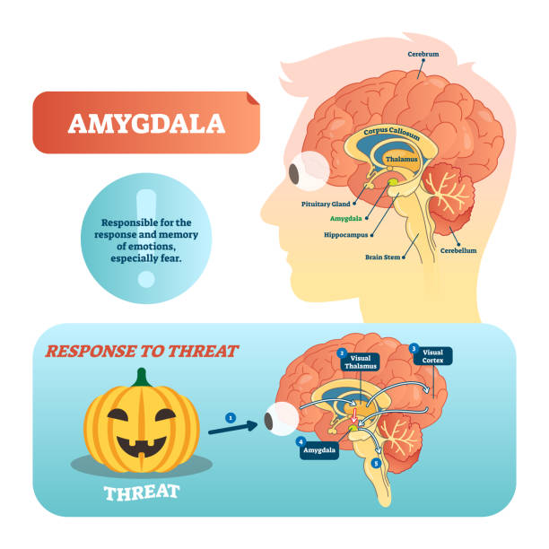

Slide 5
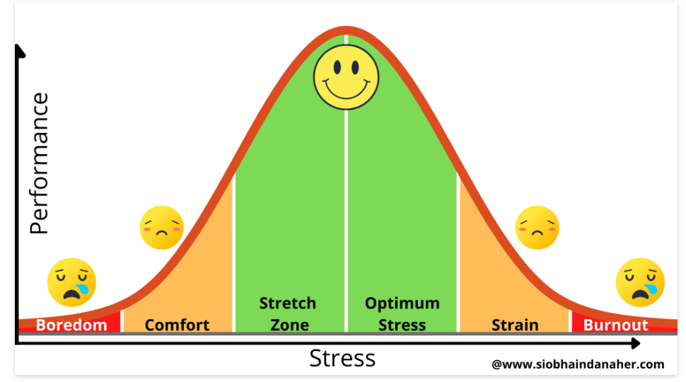
What is Anxiety
Anxiety can be thought of as a car alarm. Sometimes the car alarm goes off when there is a danger (someone might be breaking into it) but sometimes it goes off when there is not an immediate threat, for example the wind might set it off. The same thing happens in our brain, sometimes our “alarm” goes off when there is no immediate danger.
Anxiety is not always a bad thing, it becomes a problem when it is prolonged, frequent and impacts on daily functioning. Anxiety can influence:
Friendships and social life
Academic performance
Mood
Notes:
Image obtained from copyright free website that COMS recommended.
Explain Yerkes-Dodson law- how some anxiety in a situation can be beneficial, however when too much anxiety then perform poorly.
Extreme ends of the bell curve.

Slide 6
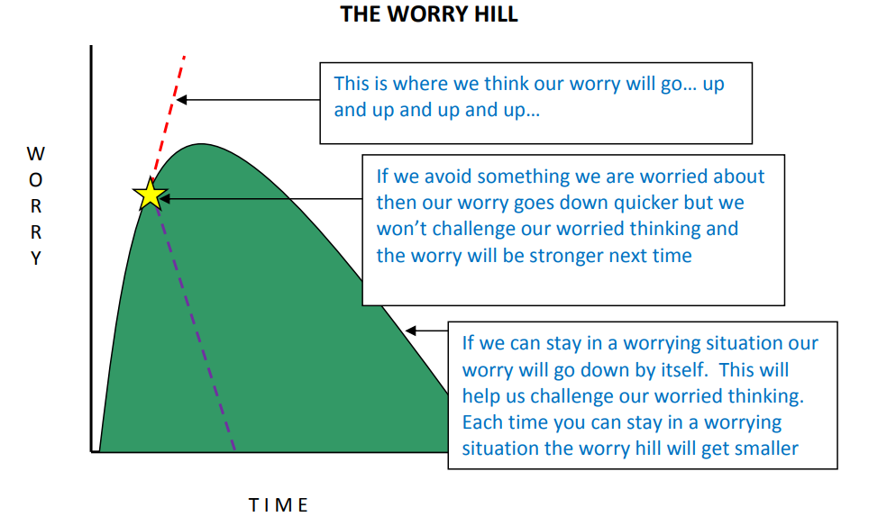

Slide 7
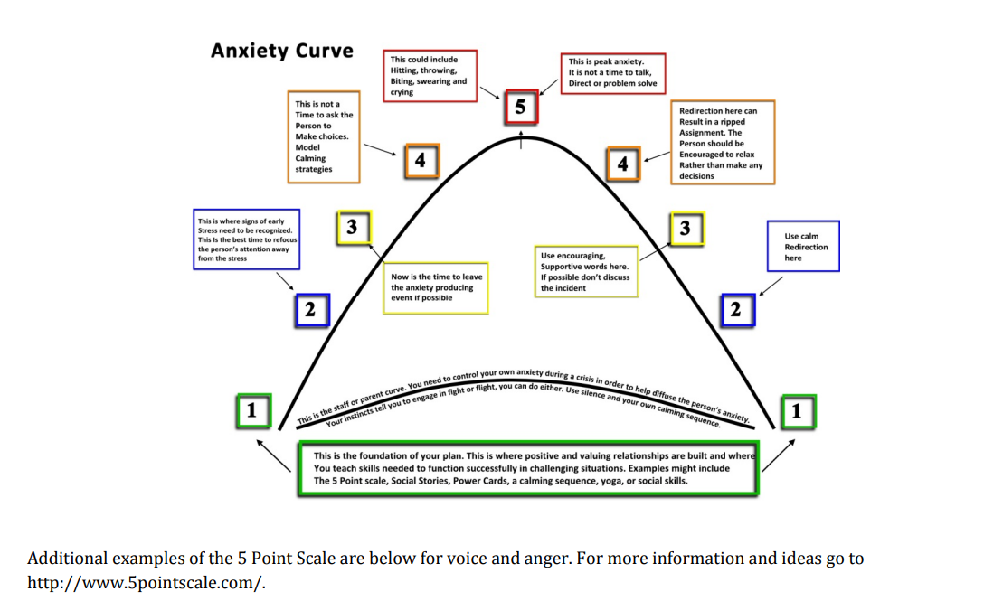

Slide 8


What Anxiety feels like:
Body
Heart rate increases
Breathing speeds up
Sweating
Muscle tension
Dry mouth
Feeling sick
Notes:
Images acquired from copyright free location
Explaining that there are other bodily sensations, behaviours and cognitions associated with anxiety
Children often notice the bodily sensations and are not so aware of the cognitions. Children might complain of an upset stomach or feeling unwell when they feel anxious and want to avoid something.

Slide 9
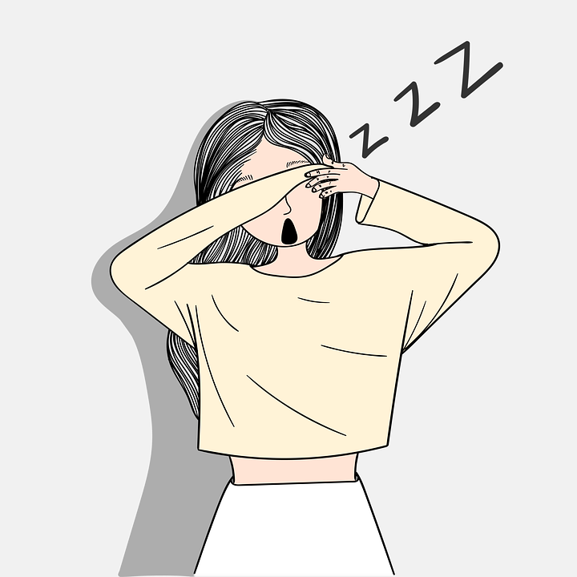
What Anxiety feels like:
Behaviour
Avoidance (e.g. staying off school, not going to a party)
Agitated/irritable
Restless
Tired
Sleep difficulties
Notes:
Image copy right free
Explaining that there are other bodily sensations, behaviours and cognitions associated with anxiety
Children often notice the bodily sensations and are not so aware of the cognitions. Children might complain of an upset stomach or feeling unwell when they feel anxious and want to avoid something.

Slide 10

What Anxiety feels like:
Cognition (thoughts)
Thinking things might go wrong
Thinking something is wrong with them
Notes:
Explaining that there are other bodily sensations, behaviours and cognitions associated with anxiety
Children often notice the bodily sensations and are not so aware of the cognitions. Children might complain of an upset stomach or feeling unwell when they feel anxious and want to avoid something.

Slide 11
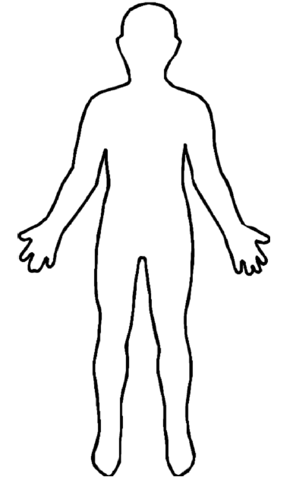
What anxiety feels like continued:
Think about your young person, what signs of anxiety do they display?
Top Tip: To help them identity anxiety, draw around the outline of your young person on a piece of paper. Work with your young person to identity what happens in their body when they feel anxious. For example, what they notice when they feel nervous to go into school. This encourages a conversation about anxiety. This can also work with labelling and understanding other emotions.
Notes:
Have a think about your YP
Image taken from Hampshire CAMHS website.

Slide 12
Where does Anxiety come from?
Anxiety is a result of a combination of factors.
There is a biological factor to anxiety, with anxiety running in families. Research has suggested that individuals can inherit characteristics that make them sensitive/vulnerable to anxiety.
Anxiety can come from adverse life events.
Anxiety can also be learnt, either through directly experiencing something or from observing others. For example, a child might learn that a spider is something to be scared of if they see their parent being fearful of a spider.
Anxiety can also be learnt from other’s reactions, for example how someone responds to a child’s anxious behaviour.
Notes:
Emphasise that no single factor is likely to have caused their child’s anxiety disorder, but that typically a number of factors play a role. Anxiety runs in families
• 1/3 of what makes a child anxious is explained by genes (so mostly influenced by environment).

Slide 13
Cycle:
Situation
Going into school
Thought
Mum may get hurt when driving home
Behaviour
Cling to mum, seek reassurance, refuse to go into school
Emotion/Feeling
Worried, scared, anxious
Physical Sensation
Sweating, stomach ache
Notes:
Example of an anxiety cycle-
Anxiety is maintained by:
1- anxious thinking and expectations= the child thinks that something bad is going to happen and thinks they will be unable to cope. They look for evidence to support this.
2- emotional reaction
3- physical bodily sensation/response = interprets bodily signs as something bad is happening, being aware of the physical symptoms reduces the confidence in coping with challenges, can be unpleasant so avoidance is increased.
4- anxious behaviour- avoidance keepings fears going as we never know if something bad happens or not and we do not get the opportunity to develop coping skills.
Anxious thinking: for example a child thinks something bad is going to happen and thinks they will be unable to cope
And the child looks for evidence to support this, eg, a past experience, fear of dogs and must be avoided as they bark and look scary

Slide 14
Maintenance Cycle
Perceived Danger
(Anxiety)
Anxiety Grows
Avoidance
Short Term Relief
Notes:
“If you feel anxious, or anticipate feeling anxious, it makes sense that you will do things to reduce your anxiety. People sometimes try and reduce the anxiety by avoiding the feared situation altogether. This avoidance instantly decreases the anxiety because you have not put yourself in a distressing situation. However, while avoidance makes anxiety better in the short term you have also made the anxiety worse in the long term.”

Slide 15
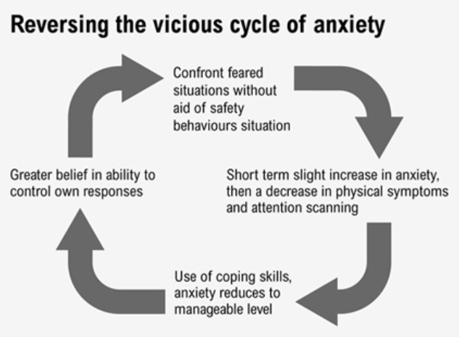

Slide 16
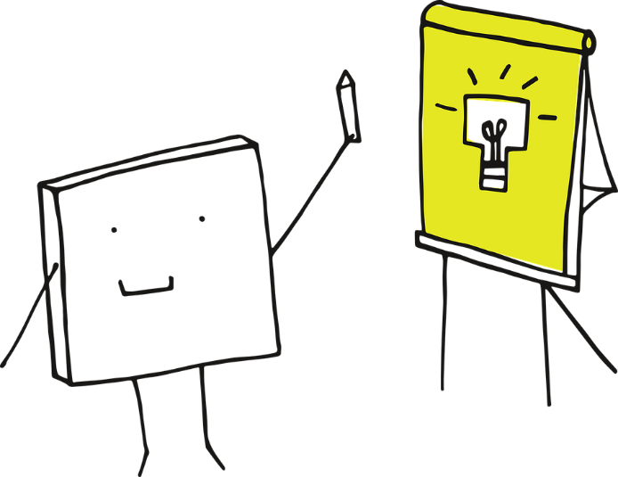
Top tip: Modelling Courage
Modelling: Your child will learn from you. It is important to model brave behaviour. Explain to your child when you feel anxious, what you are going to do to overcome it or how you will challenge that feeling and, if appropriate, what you felt like afterwards.

Slide 17
Encouraging Courage
People with anxiety can use “safety behaviours” or subtle avoidance to help cope with anxiety. These safety behaviours also play a part in the vicious cycle of anxiety. A child might learn that they can only manage the anxiety provoking situation because of the safety behaviour that they use.
Safety behaviours might include:
Bringing a water bottle in case get a dry mouth
Avoiding eye contact in class so they are not asked a question
Rehearsing or planning what you are going to say
Notes:
We will go on to talk more in second part of presentation about safety behaviours

Slide 18
Encouraging Courage
Reassurance seeking is a type of safety behaviour. Your child might seek out reassurance from you when they feel anxious and this prevents them from learning to cope independently with their anxiety.
Examples of reassurance include:
Where are we going?
What is happening next?
When are you coming home?
It is important to be aware of how you are responding and whether this is reinforcing anxious thoughts and behaviour. Avoid saying “Don’t worry”. If you are reassuring your child, ask yourself whether this is helping them to try out new things (testing a fear) or whether it is encouraging avoidance.
Responses that promote new learning include:
I really think you can do this. I was so proud when you asked a question in class last week.
Go on, have a go, you’ve done it before and it went really well.
Notes:
Give examples, alternatives
Give example of how when someone says “don’t worry” it rarely helps. Makes you then think about it more. Makes the person think that there must be something to worry about in the first place.

Slide 19


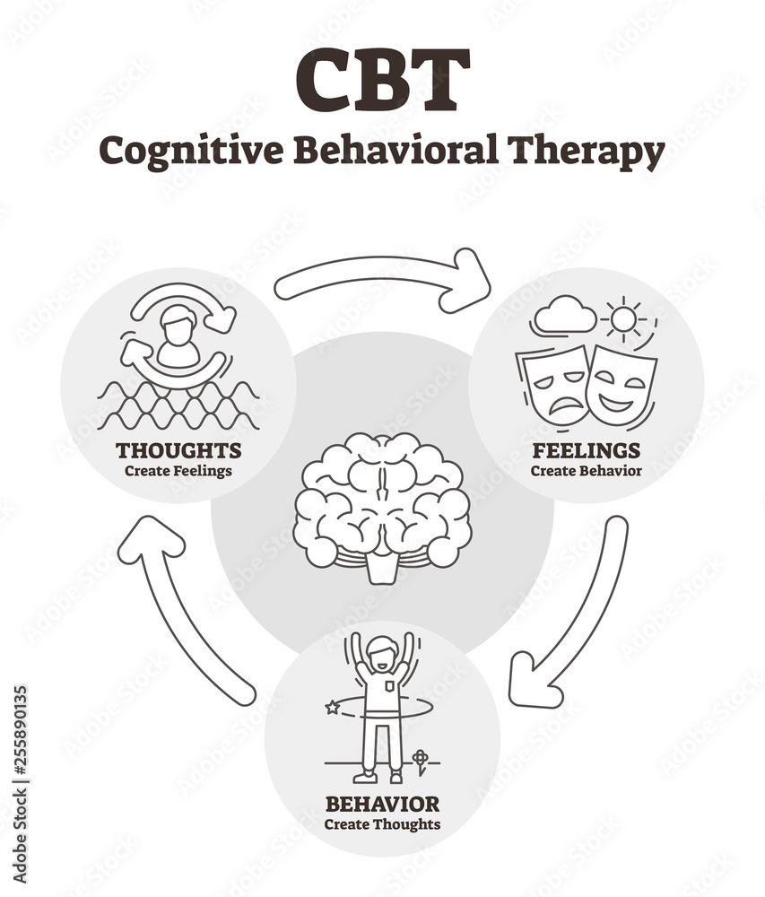
Helping Your Child with Fears and Worries
The guidance and advice in this section is based on Cognitive Behaviour Therapy (CBT)
‘Helping Your Child with Fears and Worries 2nd Edition: a self-help guide for parents’
This approach teaches you cognitive behavioural strategies and empowers you to use them with your child
Notes:
The programme is aimed at parents of children aged 5–12 years whose primary presenting problem is anxiety.

